Slide 1
Creating
Accessible
Media
Joseph Polizzotto
Faculty Reports
Winter 2016

Slide 2
Delivering Content- Rich Media: benefits all students
"We're living in an age where our students are so distracted by technology that they sometimes forget where they should focus their attention when engaged with technology or media," he said. "Turning on captions seems to enable students to focus on specific information.“¹
Robert Keith Collins-- Assistant Professor of American Indian Studies, San Francisco State University
1. Source: SF State University Study on Use of Captioned Media

Slide 3
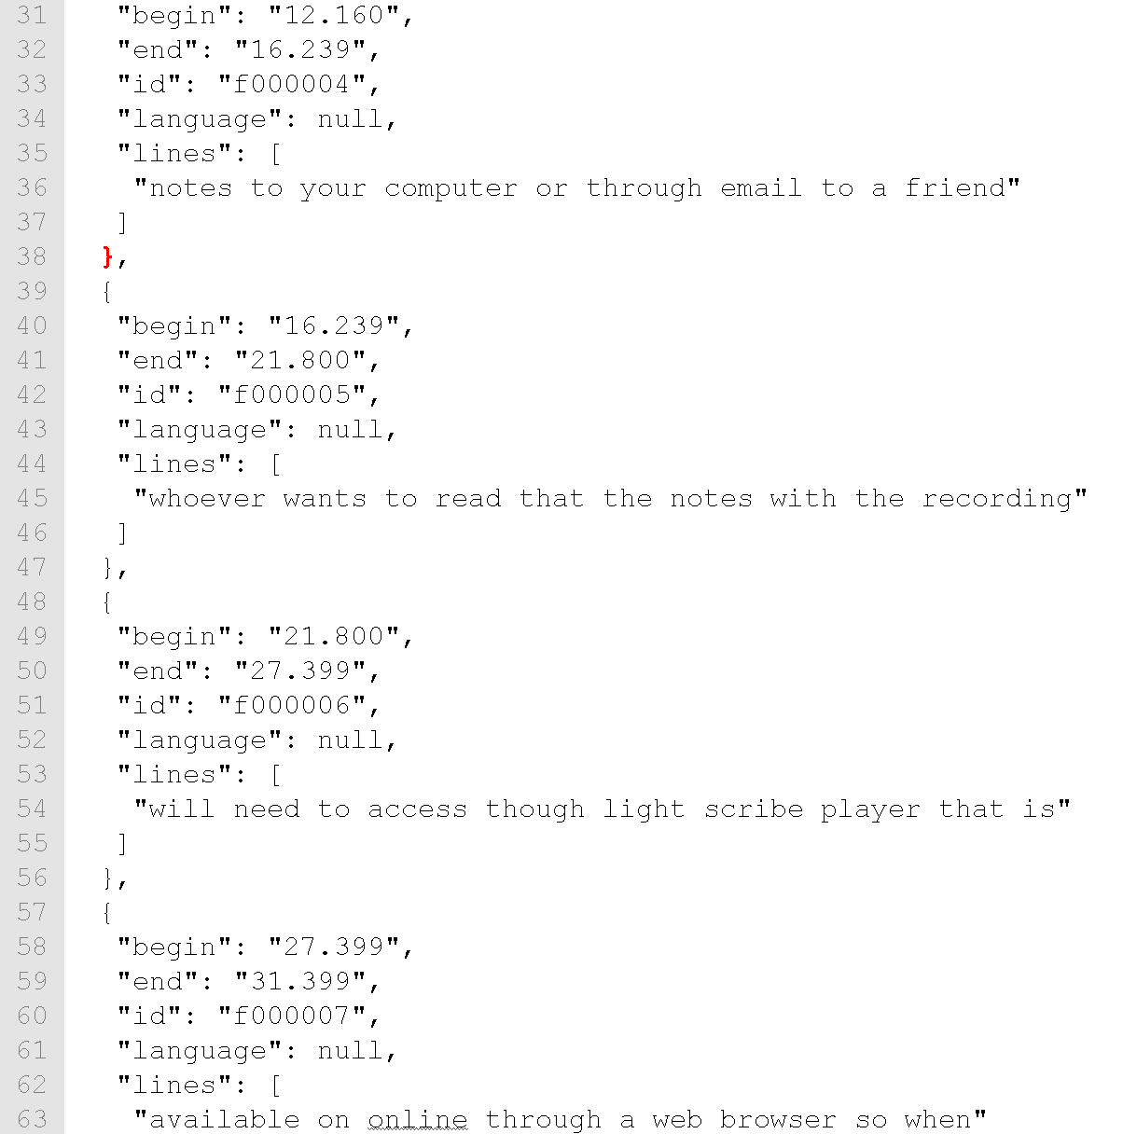
Syncmaps: declare time relationships between text files and media files

Slide 4




Syncmap formats: used for captioned videos and digital talking books
Syncmaps used for Captioned Videos:
.SRT= SubRip Text
.VTT=Web Video Text Tracks (WebVTT)
.JSON= JavaScript Object Notation (pronounced Jason)
Syncmaps used in Digital Talking Books:
.SMIL= Synchronized Multimedia Integration Language

Slide 5
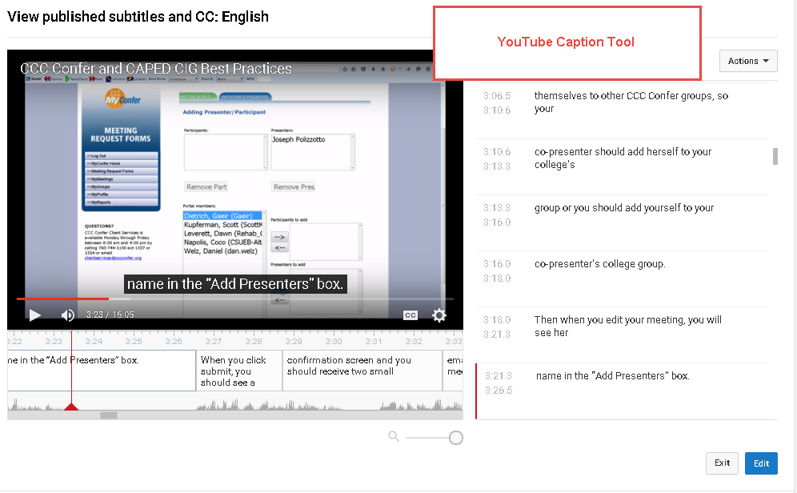
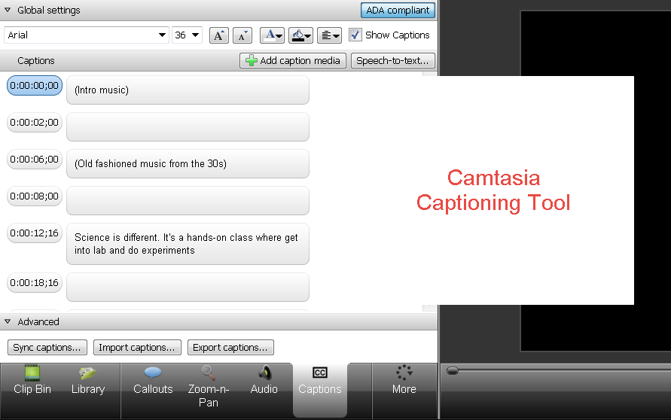
Syncmap
Creation Tools:
YouTube &
Camtasia

Slide 6
Syncmap
Creation Tools:
YouTube &
Camtasia (2)
YouTube automatically creates syncmaps using automated speech recognition (ASR)
  Caption blocks may be too short or too long
  Timings may not be very accurate
  Notoriously inaccurate but you can leverage it for a down and dirty transcript
  Alternatively, upload your transcript and get a better syncmap– (still requires careful editing)
Camtasia creates syncmaps using ASR as well
  Strongly recommended that you train Camtasia to recognize your voice
  Will work well when there is only one speaker in the video
  Requires careful editing!

Slide 7
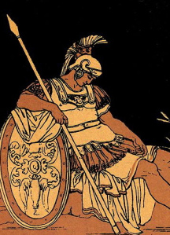
Aeneas:
A faster way to produce syncmaps
Aeneas² is a python library that syncs text files and audio/video tracks through forced-alignment
Can output to common formats: SRT, VTT, JSON, SMIL
Makes adjustments to spurious text and extraneous background noise
Aeneas Web App facilitates process for users who are unfamiliar with command line interface
Also performs batch processing on multiple text + audio pairs
2. For more information, see Practical Introduction to Aeneas

Slide 8
Aeneas:
Why is it useful?
Captioning videos often is a laborious process!
Captioning videos is expensive.
Not all videos that we would like to caption qualify for the DECT grant; hence, the necessity for an efficient in-house captioning workflow.
      Videos for department or faculty webpages
      Videos we have received permission to caption but we are not the copyright owners
      YouTube videos we post to AMARA
        Aeneas is fast, accurate, and free

Slide 9
Aeneas:
How does it work?
Aeneas requires that you have a 1) a text file (TXT or XHTML in UTF-8 format) of your transcript and 2) an video/audio file (MP4, MP3, WAV, OGG, AAC)
Aeneas requires that you specify these parameters:
  The formats of the input files (e.g., plain, subtitles, parsed)
  The language of the text
  The format that you wish to output (SRT, VTT, JSON, SMIL)
  The name of your output file
For captioning purposes, your input text file could be in either a PLAIN, SUBTITLES, or PARSED format
  PLAIN format is where each text fragment is on a separate line
  PARSED format is where each text fragment has an ID
  SUBTITLES format is where each subtitle block is on consecutive lines separated by blank lines

Slide 10
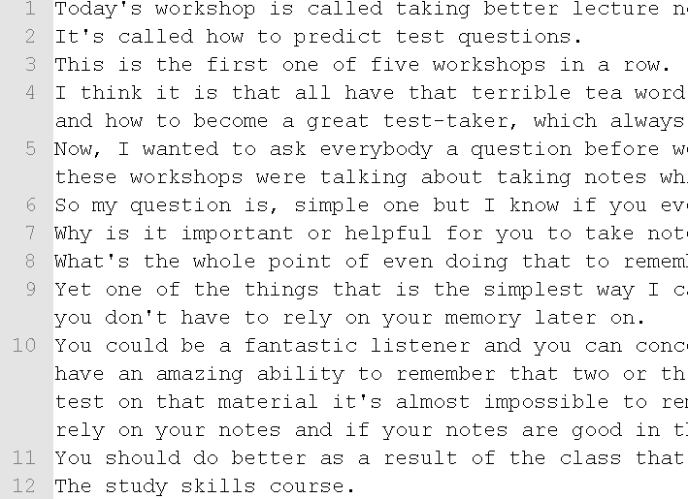
Aeneas:
Input type #1: Plain
Text fragments are on separate lines
Plain Format

Slide 11
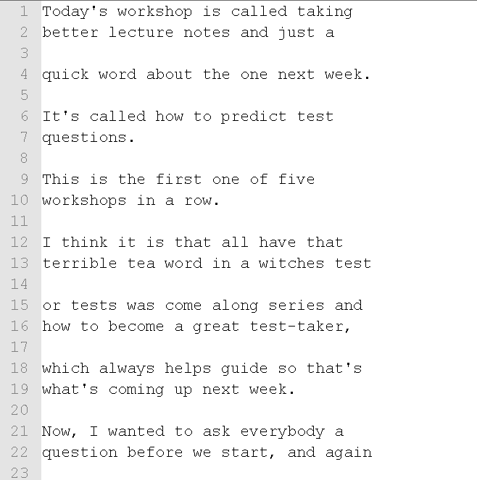
Aeneas:
Input type #2: Subtitles
Text fragments are separated by blanks
Subtitles Format

Slide 12
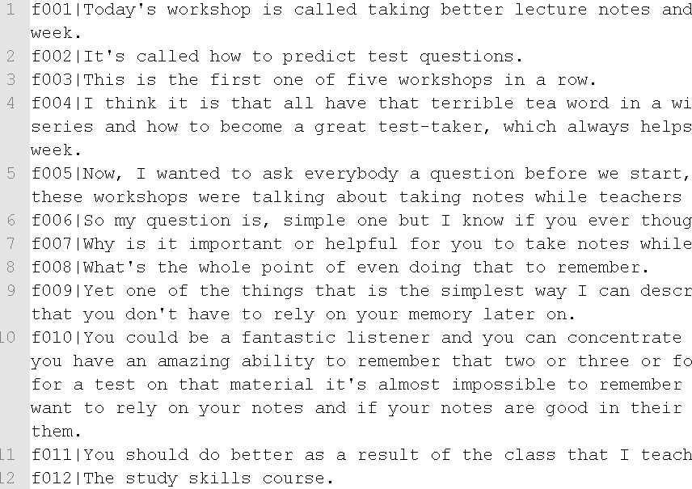
Aeneas:
Input type
#3: Parsed
Each text fragment has an ID
Parsed Format

Slide 13
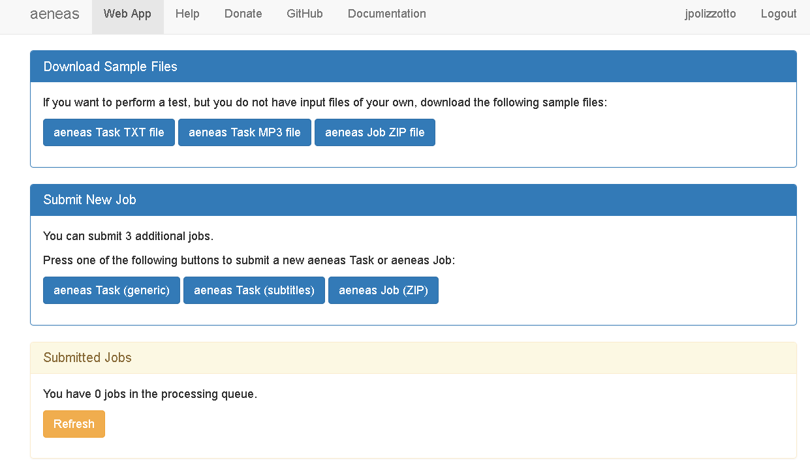
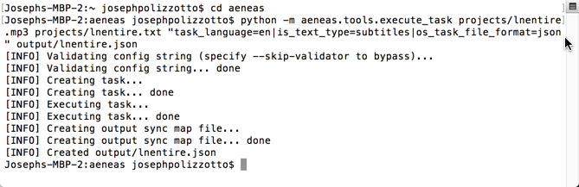
Aeneas:
Web app or command-line
Aeneas Web Interface
Command Line

Slide 14
Aeneas: useful features and parameters
Convert syncmaps into other supported formats (e.g., SRT→ VTT etc.)
  Useful for quick conversion
Download audio from YouTube video
  Good when you no longer have raw files
  Can be used for videos you do not own too ☺
Ignore audio at beginning (head) and end (tail) of audio input file
  Helpful when video has bumper music

Slide 15
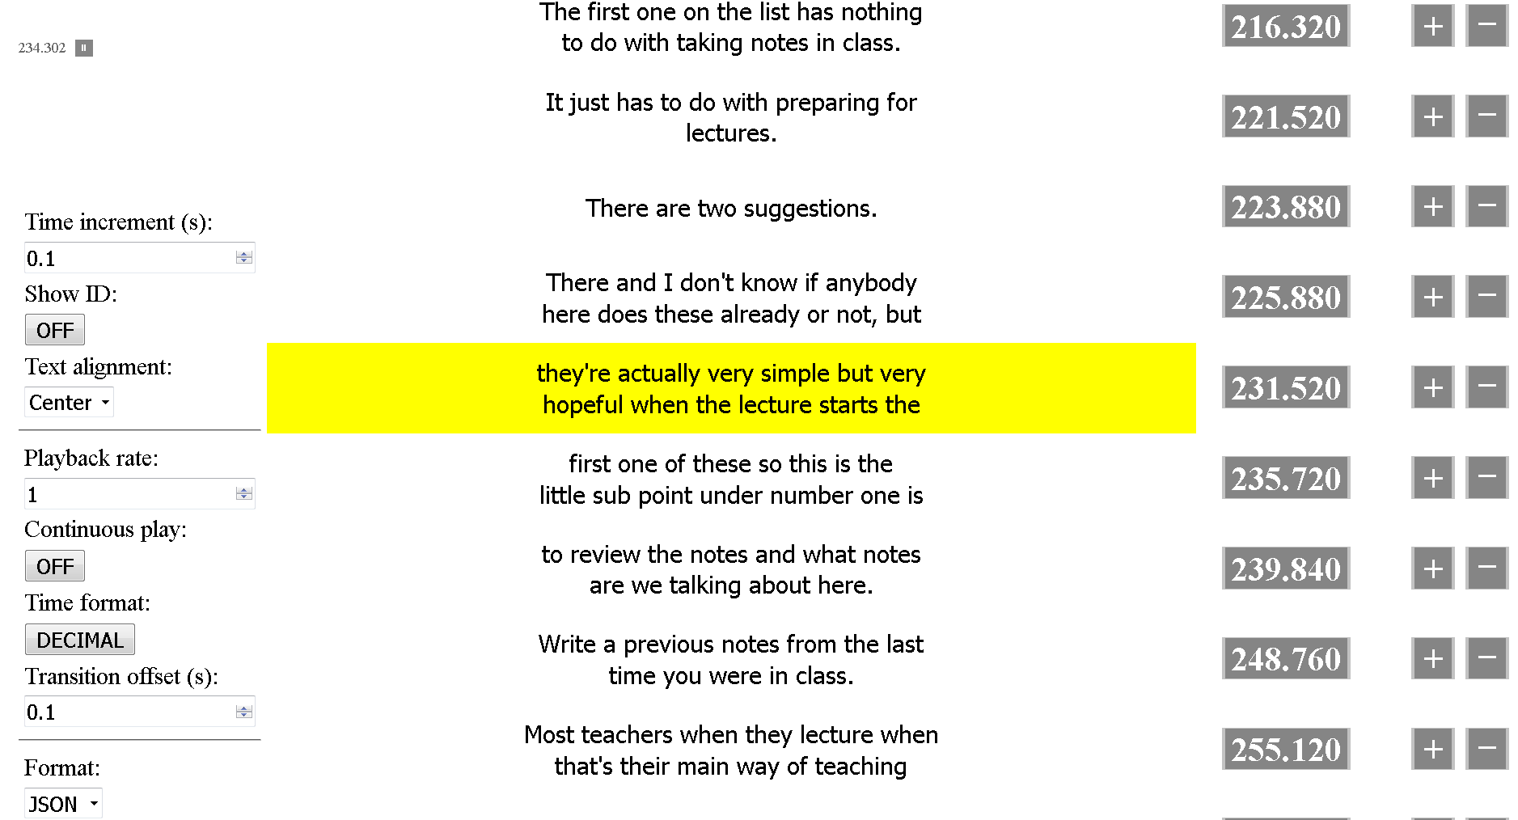
Aeneas: finetuneas check-up tool

Slide 16

Video Players:
Selecting the best player
Not all video players are accessible to individuals with disabilities. The reasons may be the following:
    No keyboard navigability
    No support for captions
    Unclear where keyboard focus resides
    No support for caption tracks
    No shortcut keys for easy stop/pause/play controls
    No possibility to speed up or slow down the video
N.B. Making sure videos are captioned is not the only consideration we must make when adopting course materials or when posting our videos online.

Slide 17
Able
Player:
A fully accessible video player
Able Player³ has a number of features that make watching videos easier and more learner-focused:
  Keyboard through all major control elements
  Access Play/ Stop/ Pause/ Forward/Backward controls through use of shortcuts
  Support for interactive transcripts that can ease navigation to specific part of video
  Support for videos with audio description and text-based audio descriptions (screen reader will play description)
  Can play YouTube videos
  High-contrast player controls
  Can play audio tracks (MP3, OGG etc.) alongside the audio track
  3. For more information and examples, see the Able Player website

Slide 18
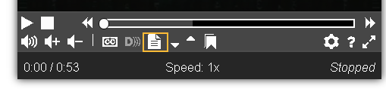
Able
Player:
A fully accessible video player(2)

Slide 19
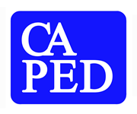
Webinar
Opportunity:
Pearson’s
My Math Lab
&
Accessibility
Attention STEM Faculty:
Come and learn about the latest effort by Pearson to improve the accessibility of MyMathLab
When: Friday, January 22
Time: 12:00 -1:00 PM
Who: Jonathan Thurston, Senior Project Manager of Accessibility (Pearson), and Hei-Jung Kim, Senior Product Manager (Pearson)-- sponsored by the CAPED Access Technology Interest Group
Where: CCC Confer
How: www.cccconfer.org (free to all attendees)
*The video will be archived for later viewing

Slide 20
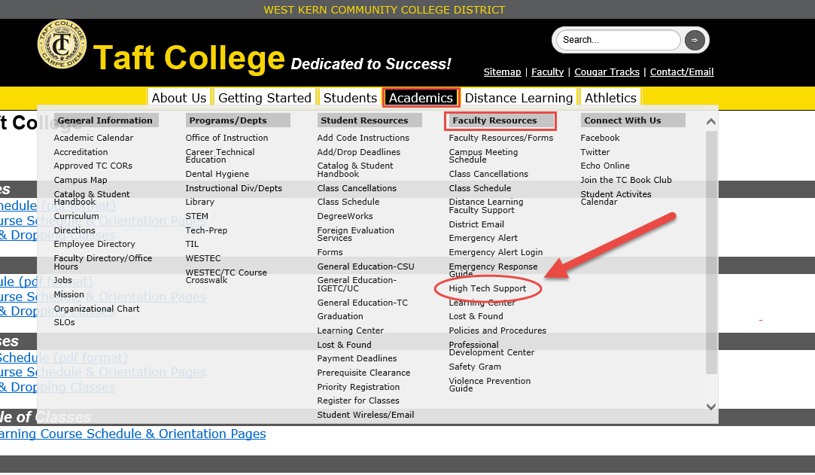

Thank you!

