Slide 1
Engineering Program
Paul Blake
August 18, 2015

Slide 2
Topics
Quick Program Status
3D Printing Collaboration

Slide 3
Engineering Program Highlights
1st Full Year is Complete
7 of 7 courses are articulated with CSUB
Advisory Committee Functioning – 8 Members
  Energy (CRC, AERA, Chevron, STANTEC, Linn Energy)
  Agricultural (Bolthouse & Paramount Farms)
  CSUB (Dept Chair – Physics & Engineering)
Grant Extended to 6th Year – Sept 30, 2017

Slide 4
Engineering Program Metrics –
Leading Indicator & Current Performance
Start Program

Slide 5
Intro to Engineering – Math Course Enrollment*
* 62 students surveyed from 3 sections of ENGR 1500

Slide 6
Student Profile*
  82% of students who start Introduction to Engineering, complete the course
  100% of completing students leave with an educational plan
  91% are working full or part time
  51% are first generation students
  62% declare or confirm engineering as major
  TBD are no longer attending TC
    WHY?????????
* Based upon 62 students (3 sections of ENGR 1500)

Slide 7
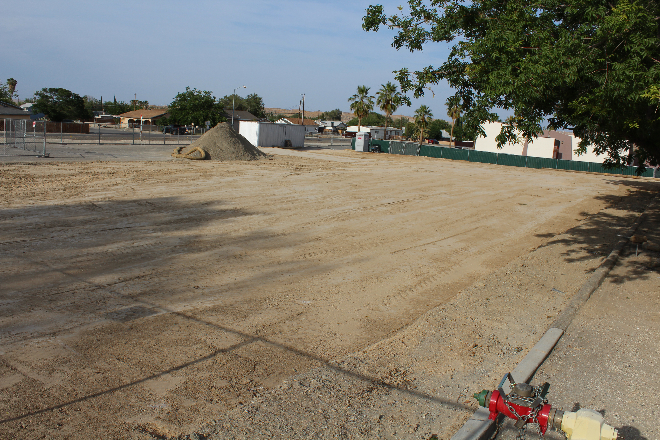
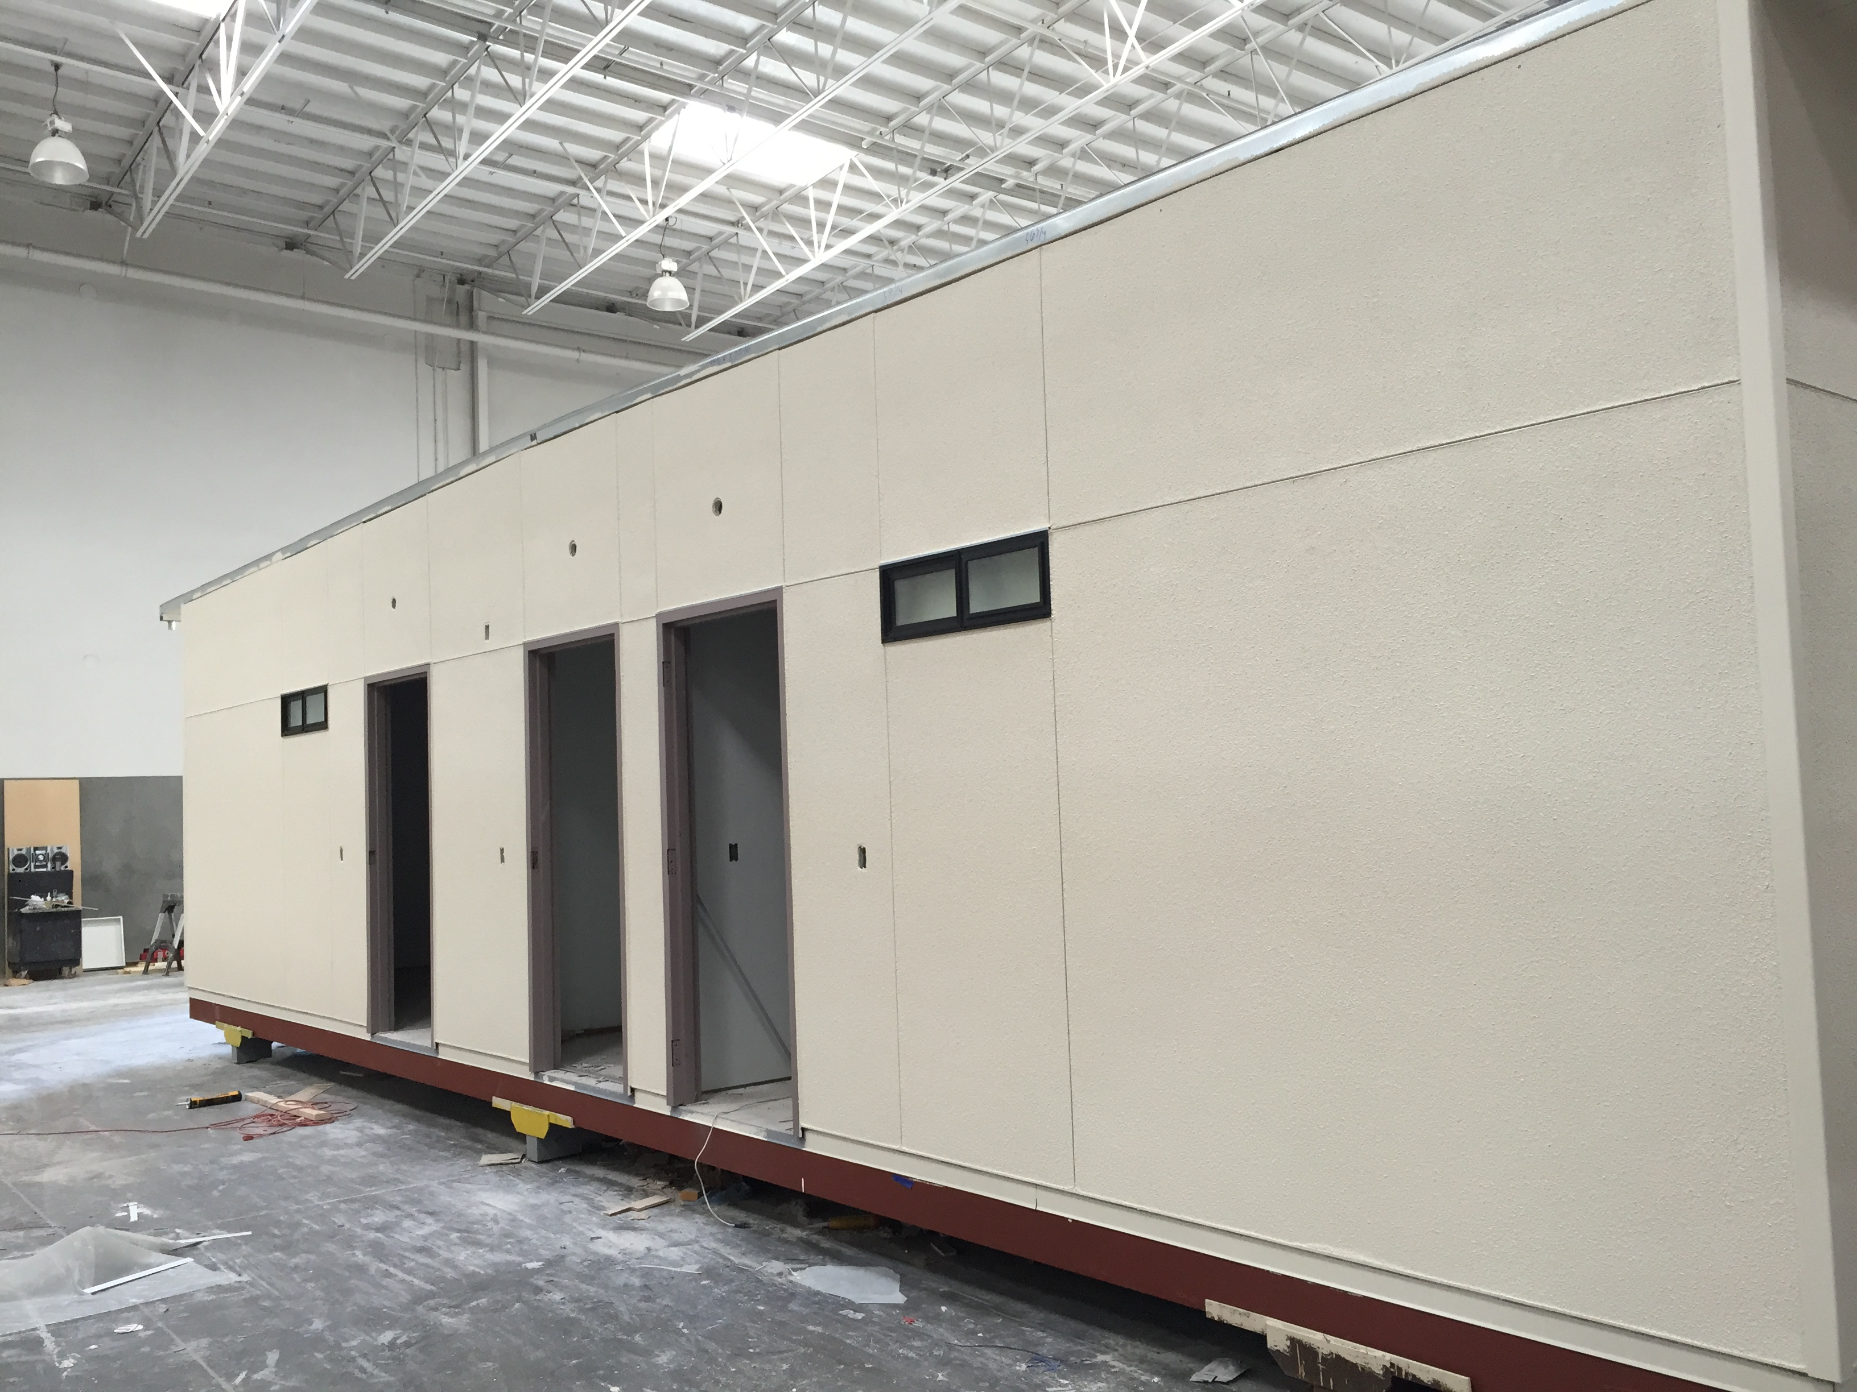
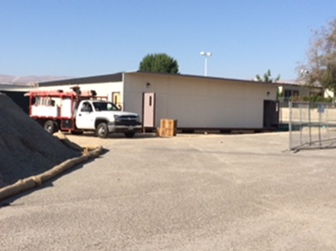
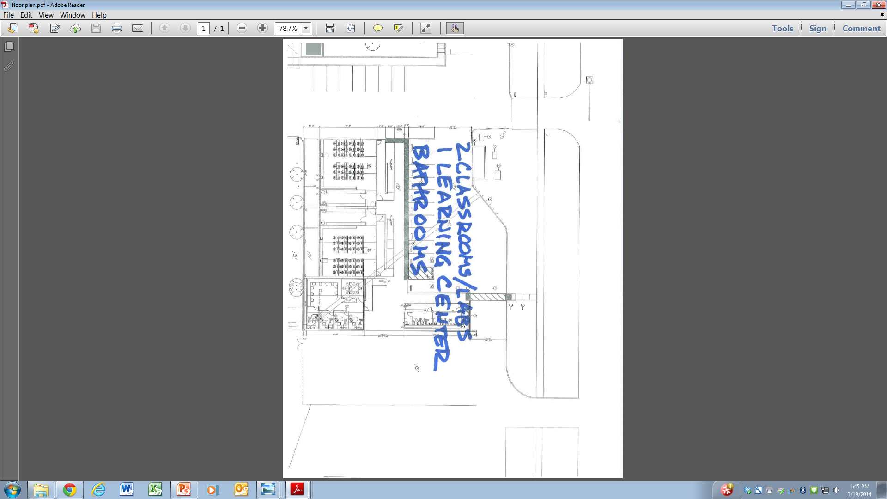
Going Forward
2 Multi Purpose Classrooms / Labs with Storage
Innovation Center
Meeting Room
Offices (4)
Bathrooms
Plan: occupy in Fall 2015 and begin teaching in Spring 2016

Slide 8
Going Forward
Integrate:
  Courses as scheduled – 2nd Faculty
  Dedicated Tutoring
  Building / Innovation Lab
  Summer internships & research opportunities
  Industry problems into course and lab work
Build student performance profile
    Part Time / Full Time
    Living Situation
    Financial Aid
    Academic Performance
Review - Remedial Math Pathway – decrease time

Slide 9
3D Printing - Collaboration
Enhance student learning experience – hands on
Introduced to faculty in Fall 2014
ENGR 1510: Engineering Graphics and Introduction to Design
Collaboration
  Science: James May
  Dental Hygiene: Eric H.
  STEM Outreach: Rachel Belden
  Art: Erin Kaczkowski (Student: Tanner Holder)

Slide 10
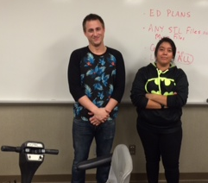
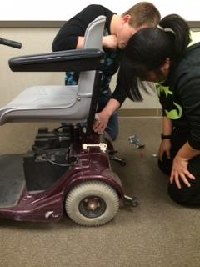
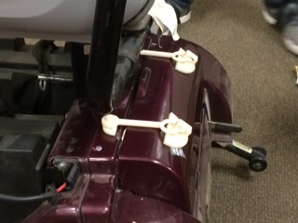
ENGR 1500 – Eng Graphics & Intro to Design
Thank you!!!
Liz McKnight

Slide 11
Collaboration
Science – James May
Dental Hygiene – Eric Hershkowitz
STEM Outreach – Rachel Belden
Art -Erin Kaczkowski

Slide 12
New Semester
New Opportunities

Slide 13
Questions & Answers
Thank You!!!!

