Slide 1

1.) In-Service Report
2.) Tech Talks
3.) Distance Education Snapshot
Faculty Reports
Fall 2015
Dan Hall

Slide 2
@One “From Communication to Community”
An online workshop that focused on enhancing communication skills for current and potential distance education faculty to increase the efficiency, effectiveness and overall quality of an online course.
28 full-time and adjunct Taft College faculty participated

Slide 3
Responses from workshop participants:
Pros -
Most faculty liked the flexibility that the online workshop provided for their schedule.
Helpful to gain the experience of an online course.
Learned some activities that helped instill community within the online course.
Liked the Accountabilabuddy concept/activity

Slide 4
Responses from workshop participants:
Pros
The workshop helped me with understand the importance of properly writing questions to the student population that will stimulate an online conversation.
I appreciated the experience of an online class that was tied heavily to discussion boards--and less of an independent study course.
I liked the on-line format. I would like to see more on-line workshops. I included my communication policy that I developed in the workshop in my summer syllabi.

Slide 5
Responses from workshop participants:
Cons-
Did not care for replying to 2 other discussion posts.
Did not learn any new pedagogies to help with retention and success of students.
Not impressed with the instructor’s lack of response to emails.
Some instructional resources were not accessible.

Slide 6
Responses from workshop participants:
Cons
Some students wanted to get the class done and over with, but had to wait for other responders to comment, so they could comment as well.
There were also all the usual issues with technology, schedules, families, and life in general--the same as our students face.

Slide 7
Upcoming Tech Talks
Twice monthly on alternate weeks of the FIGs
  2nd Tuesday
  4th Thursday
September 8th
  Canvas LMS Discussion

Slide 8
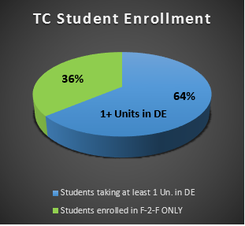
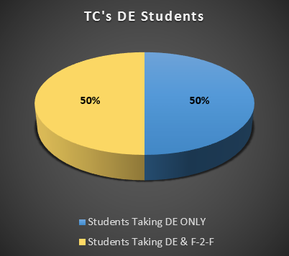
As of 8/11/15
Total Student Headcount: 2724
# Students taking DE courses: 1740
# of students taking only DE courses: 878
# of students taking a full-load from DE courses only: 194

Slide 9
Where Are Our DE Students Located?
Area | # of Students | % of DE Students
Bakersfield | 1149 | 66%
Taft | 298 | 17%
Shafter | 71 | 4%
Wasco | 37 | 2%
Arvin | 33 | 1.9%
Lamont | 22 | 1.3%
Maricopa | 14 | 0.8%

Slide 10
TC DE Students from Bakersfield by Zip Code
Zip Code | # of Students | Part of Bakersfield
93301 | 18 | Central/Downtown
93304 | 66 | S Central
93305 | 21 | NE
93306 | 43 | NE
93307 | 109 | SE, E and NE
93308 | 68 | NE and NW
93309 | 133 | SW
93311 | 180 | SW
93312 | 184 | NW
93313 | 186 | SW
93314 | 136 | NW

Slide 11
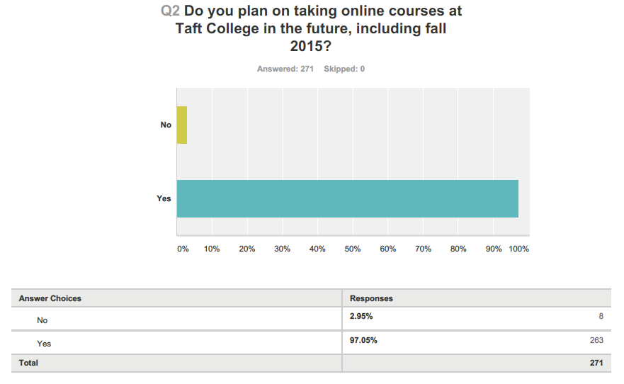

Slide 12
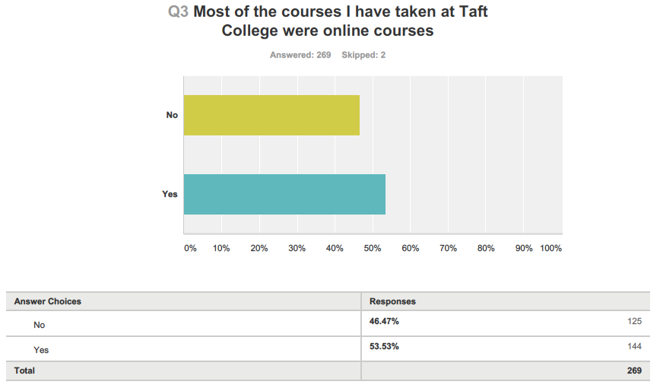

Slide 13
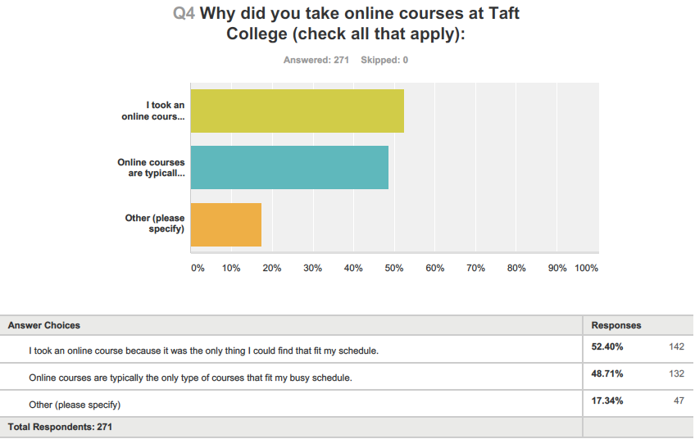

Slide 14
Q4-Why did you take online courses at TC?

Slide 15
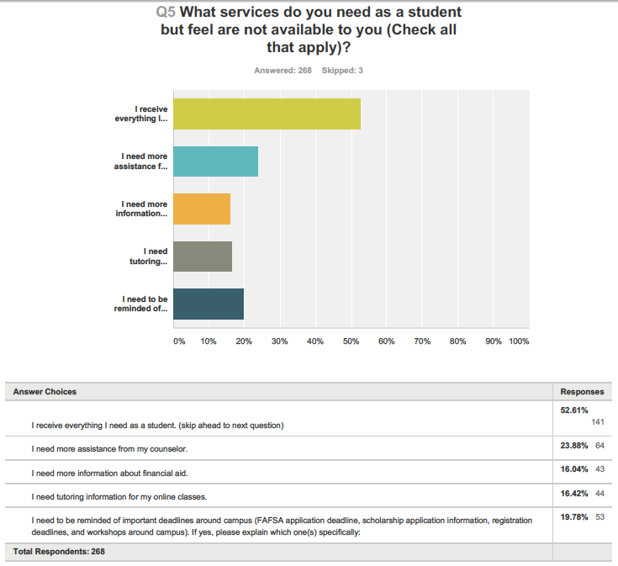

Slide 16
Q5-Do DE students have the same information about campus resources as typical students?
The top three services DE students feel they need more information/access to are:
Financial Aid
Deadline/Important Date Reminders
Information on Scholarships

Slide 17
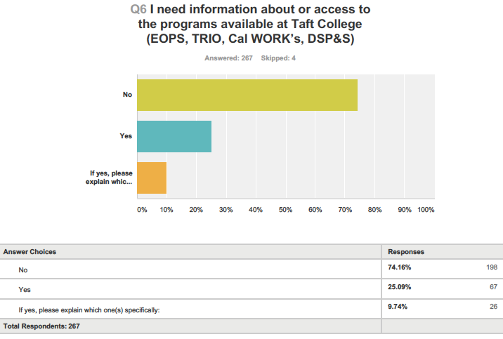

Slide 18
Q6-TC Programs for TC students
Students that are primarily at a distance do not always hear reminders about TC programs. They oftentimes do not know how to determine if they are eligible or know how to apply.
With reminders and informational flyers we would like to help close this gap.

Slide 19
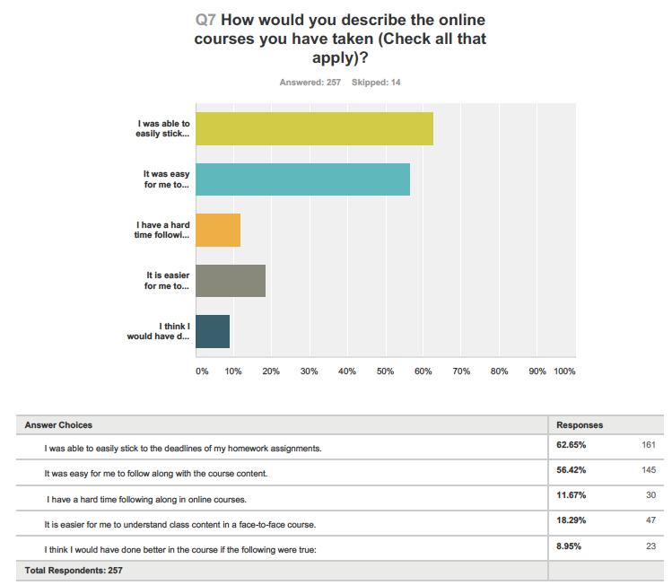

Slide 20
Q7-How do students view their online experience?
The most common responses of the 9% of students that responded, I think I would have done better if:
I had a more responsive instructor
I received reminders about the due dates of my assignments.
Other responses:
“I would have liked the instructors to respond to emails quicker or have another instructor available for help”
“If everything was listed on the class calendar including discussions and modules that needed to be read.”
“One of the courses I took did not have lecture notes and it was difficult to know what to study for quizzes and exams”
“I wish teachers checked in and responded to private messages quicker.”
“I would have liked more coursework to be available from day one. I like to get ahead.”

Slide 21
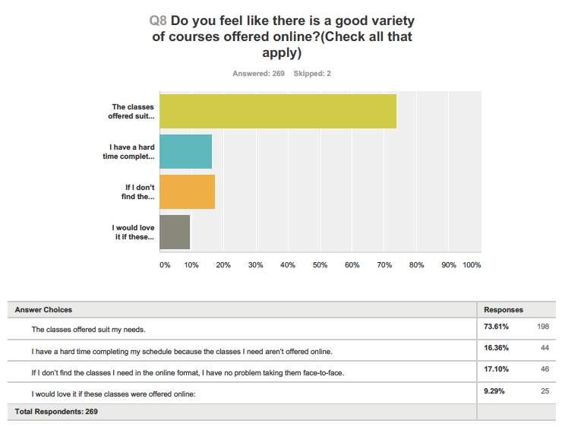

Slide 22
Q8-Do you feel like there is a good variety of courses offered online?
44% of students that took the survey have a hard time completing there schedule because they cannot find the classes they need offered online.
25% responded, I would love if these classes were available online:
Any Lab
Students communicated the desire to have the classes they need to graduate and transfer offered online.
More of the classes that fill quickly
Chemistry
Business Admin Courses
English 0900
Statistics
Philosophy
Sign Language
English 1700
Biology
Geology
Political Science
English 2400
Speech
Creative Writing
English 2600
IES

Slide 23
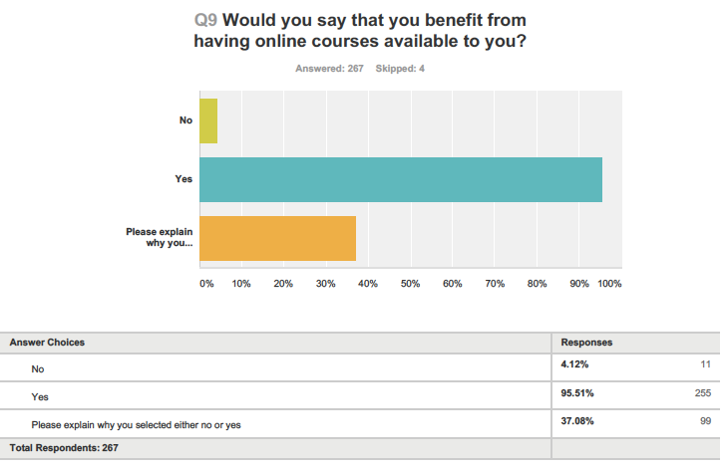

Slide 24
Q9:Would you say that you benefit from having online courses available to you?
About 96% of students replied that they benefit from having online courses available to them.
37% of students gave us an explanation as to why they specifically benefit from these course offerings. The most common reasons why students choose online were because they are parents, working, or have very busy lives and this is the only way they would be able to further their education.
“If it were not for the wide variety of online classes Taft offers, I would not be in school right now. I have a full time job and am a full time mom. I went to BC 10 years ago but had to stop. Taft has given me a fresh start and the online programs have made it possible. I have recommended Taft to several of my coworkers for this reason and 5 have registered for this fall, 3 will be registering in the Spring. It has been amazing for them to realize, as it was for me, that school can be an option for us.”

Slide 25
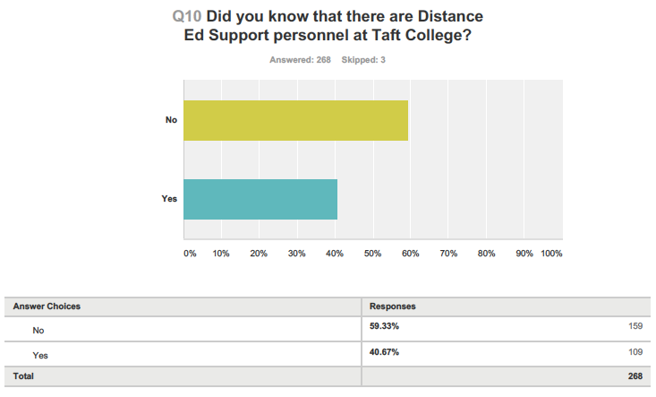

Slide 26
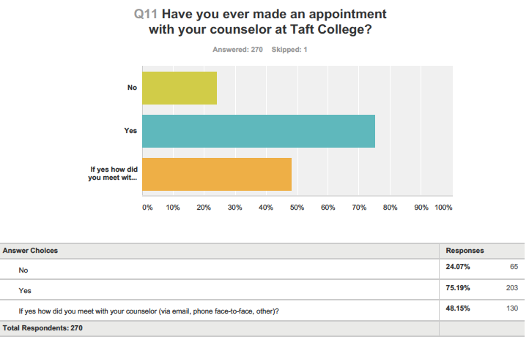

Slide 27
Q11- How do you usually communicate with a counselor (F-2-F, Email, Phone)?
75% of DE students have met with a counselor. 25% have not once meet with a counselor. Of the students that have, most use Face to Face appointments.
We wonder if our 25% is unable to physically make an appointment due to their schedules. Do they know that they can make a phone or email correspondence appointment?

Slide 28
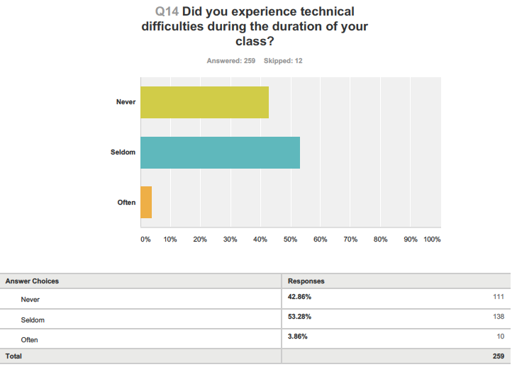

Slide 29
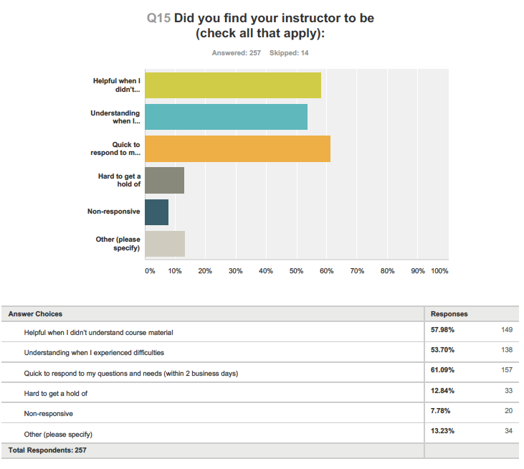

Slide 30
Q15- I found that my instructor was other:
13% of students left a comment about their experience.
Most of these comments reflected the 20 percent of students who felt they had unresponsive instructors.
“One of the two instructors was wonderful, but the other one was not as good at communicating.”
“Not informative enough.”
“Only one class was harder to understand than the others. I think had I called the instructor instead of emailing, I would have been better off. This happened my first semester when I was less confidant. Now I understand that the professors are there to answer questions.”
“One teacher would only answer questions every two or three weeks, then your assignment was late or it didn’t matter anymore.”
“I wish teachers checked in and responded to private messages quicker.”
“They don’t grade homework fast and we don’t know our grade for half the course.”

Slide 31
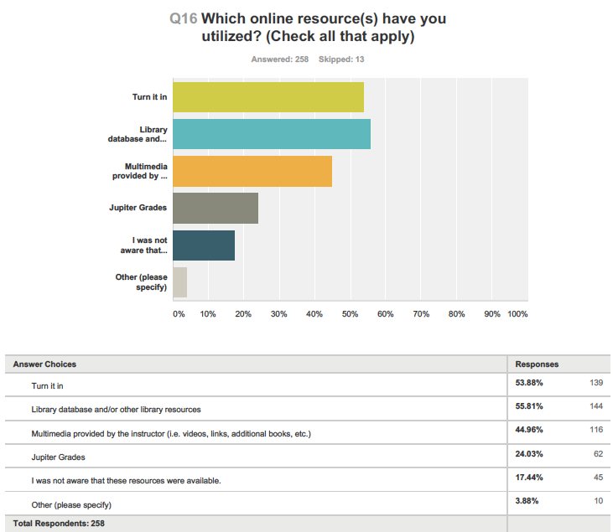

Slide 32




Q16- Which online resource(s) have you utilized?
“I loved the videos that Prof. Duncan provided. The wiki space Prof. Ashmore uses is helpful. Turnitin is only helpful to the student if the instructor uses the grade mark system to provide clear feedback. Prof. Dyer has definitely used it to its full potential.”
“Some of these sites are hard to navigate if you have never used them before.”

