Slide 1
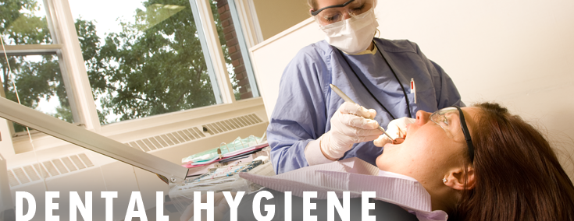
REMEDIATION IN DENTAL HYGIENE PROGRAMS
Kelly Donovan

Slide 2
Cycle One Story

Slide 3
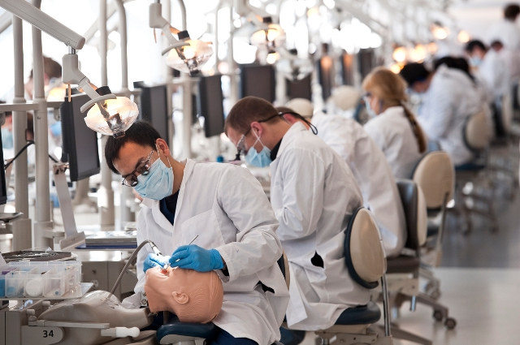
Participatory Action Research Study Background
As the dental hygiene curriculum is a rigorous and intensive program, research shows that the approximate retention rates for dental hygiene students are at an average of 91% (Sanderson, 2014).
Notes:
Since its inception, dental hygiene education has expanded to over 332 programs nationwide, with 29 accredited programs in California (CDHEA, 2015). The dental hygiene program is a rigorous, intensive science-based program. The traditional dental hygiene program in California is a two-year program with a curriculum consisting of approximately 50 units. The dental hygiene student is required to complete additional general education requirements to earn an AS degree in dental hygiene.
As the dental hygiene curriculum is a rigorous and intensive program, research shows that the approximate retention rates for dental hygiene students are at an average of 91% (Sanderson, 2014). Students that are not successful in the program are subject to remediation procedures. Remediation polices have been studied in various educational settings such as nursing programs and among students with disabilities (Reis, 2000) (Schiff & Calif 2004); however, the remediation policies in dental hygiene programs and remediation methods have not been studied. Therefore, further research is indicated in the area of remediation policies and methods in dental hygiene programs to gain understanding of existing remediation programs.

Slide 4
Title Page
Notes:
Dental hygiene students at Dental Smiles College who do not successfully pass pre-clinical requirements and the expectations of the course Introduction to Clinic are remediated. Evidence shows that there is a lack of consistency with remediation policies and procedures. However, in the past eight years, the researcher has observed the inconsistencies in remedial procedures. For example, some students who have not successfully passed pre-clinical requirements have been held back several weeks and retested. In contrast, some students have been dismissed from the program and have re-entered the program the following year, while other students have been dismissed from the program altogether. Therefore, a need exists to examine remediation policies and procedures in dental hygiene programs in order to more effectively understand student and faculty needs concerning the remediation process, and to improve remediation. The following is the inquiry question for this Participatory Action Research Study: What might dental hygiene program staff and faculty implement as a remediation process that benefits and develops students’ strengths and abilities using new resources and tools?

Slide 5
Cycle One Questions
What has been done to improve dental hygiene remediation programs?
2. What might dental hygiene program staff and faculty implement as a remediation process that benefits and develops students’ strengths and abilities using new resources and tools?

Slide 6
LITERATURE REVIEW THEMES Related to Dental Hygiene
Students who are having
difficulty with the clinical
component are not
identified until midterm
or late in the
Curriculum ( Wood, 2014).
Financial compensation for faculty responsible
for overseeing remedial courses is a factor (Freudenthal, 2009; Holt, 2005).
Review of the literature
suggests the need for dental
hygiene programs to develop
clearly written remedial
policies and procedures to
aid in student success(Holt,2005, McCann,1995:Wood 2014).
Notes:
Theme 1: Mandatory assessment/placement prior to program entrance. Early identification of those students who are in need of remediation was a consistent theme among the literature. Students who are having difficulty with the clinical component are not identified until midterm or late in the curriculum, (Freudenthal, 2009; Wood, 2014). Recognition and intervention early in the program may maximize retention and success (Fredenthal, 2009). The literature reviewed suggests that current clinical remedial policies do not allow for early identification and retention.
Theme 2: Comprehensive based assessment model. The second theme included the need for a more comprehensive-based assessment model (Branson, 1999; Wood, 2014; McCann, 1995). Dental hygiene retention issues are not widely addressed in dental literature (Fredenthal, 2009; Holt, 2005). Dissatisfaction and lack of familiarity with assessment practices was also noted (McCann, 1995; Wood, 2014). Review of the literature suggests the need for dental hygiene programs to develop clearly written remedial policies and procedures to aid in student success (Holt, 2005, McCann, 1995; Wood, 2014).
Theme 3: Cost vs. benefit of remedial program. Another reason cited for the lack of clear remedial policies and programs was the potential cost for such programs. Most programs do not charge the student additional fees for the remedial process (Branson, 1999; Freudenthal, 2009, Holt, 2005; Wood, 2014). Financial compensation for faculty responsible for overseeing remedial courses is a factor. Few programs provide an “adjustment to clinical workloads” (Freudenthal, 2009; Holt, 2005). Faculty compensation, clinical workload, clinical overload and clinical adjustment are factors in the remedial process.

Slide 7
LITERATURE REVIEW THEMES Related to Dental Hygiene
The most widely
used remedial method
is one-on-one faculty
instruction
(Branson, 1999;
Freudenthal, 2009;
Holt, 2005; Wood, 2014).
Studies have shown that incoming student GPA remains a useful predictor of student success (Mills, 2008; Ward, 2010).
.
Common consequences for
unsuccessful students included
issuing an incomplete grade,
requiring the student to attend additional
clinical sessions, probation, or dismissal from the program
with an option to reenter the program the following year
(Branson, 1999; Freudenthal, 2009; Holt, 2005).
Notes:
Theme 4: Grade point average. Grade point average (GPA) and student study habits were a consideration in the literature in regards to student success. Studies have shown that incoming student GPA remains a useful predictor of student success (Mills, 2008; Ward, 2010). Prior research was completed to study the possible need to change dental hygiene program admissions criteria. However, Ward (2010), recommended keeping current admissions criteria standards the same, and implementing a formal remediation program for weaker students after completion of the first year of the program.
Theme 5: Common consequences of clinical failure. The common consequence of clinical failure was also a constant theme among the literature sources reviewed. Common consequences for unsuccessful students included issuing an incomplete grade, requiring the student to attend additional clinical sessions, probation, or dismissal from the program with an option to reenter the program the following year (Branson, 1999; Freudenthal, 2009; Holt, 2005).
Theme 6: Frequent remedial strategies used. The literature also showed consistency in the most frequent remedial strategy used among faculty. A variety of instructional methods were indicated throughout the literature including typodont practice, and review of instrumentation through video presentations (Wood, 2014). The most widely used remedial method is one-on-one faculty instruction (Branson, 1999; Freudenthal, 2009; Holt, 2005; Wood, 2014). Faculty involved in clinical remediation met regularly to discuss the progress of students’ clinical skill (Holt, 2005).

Slide 8
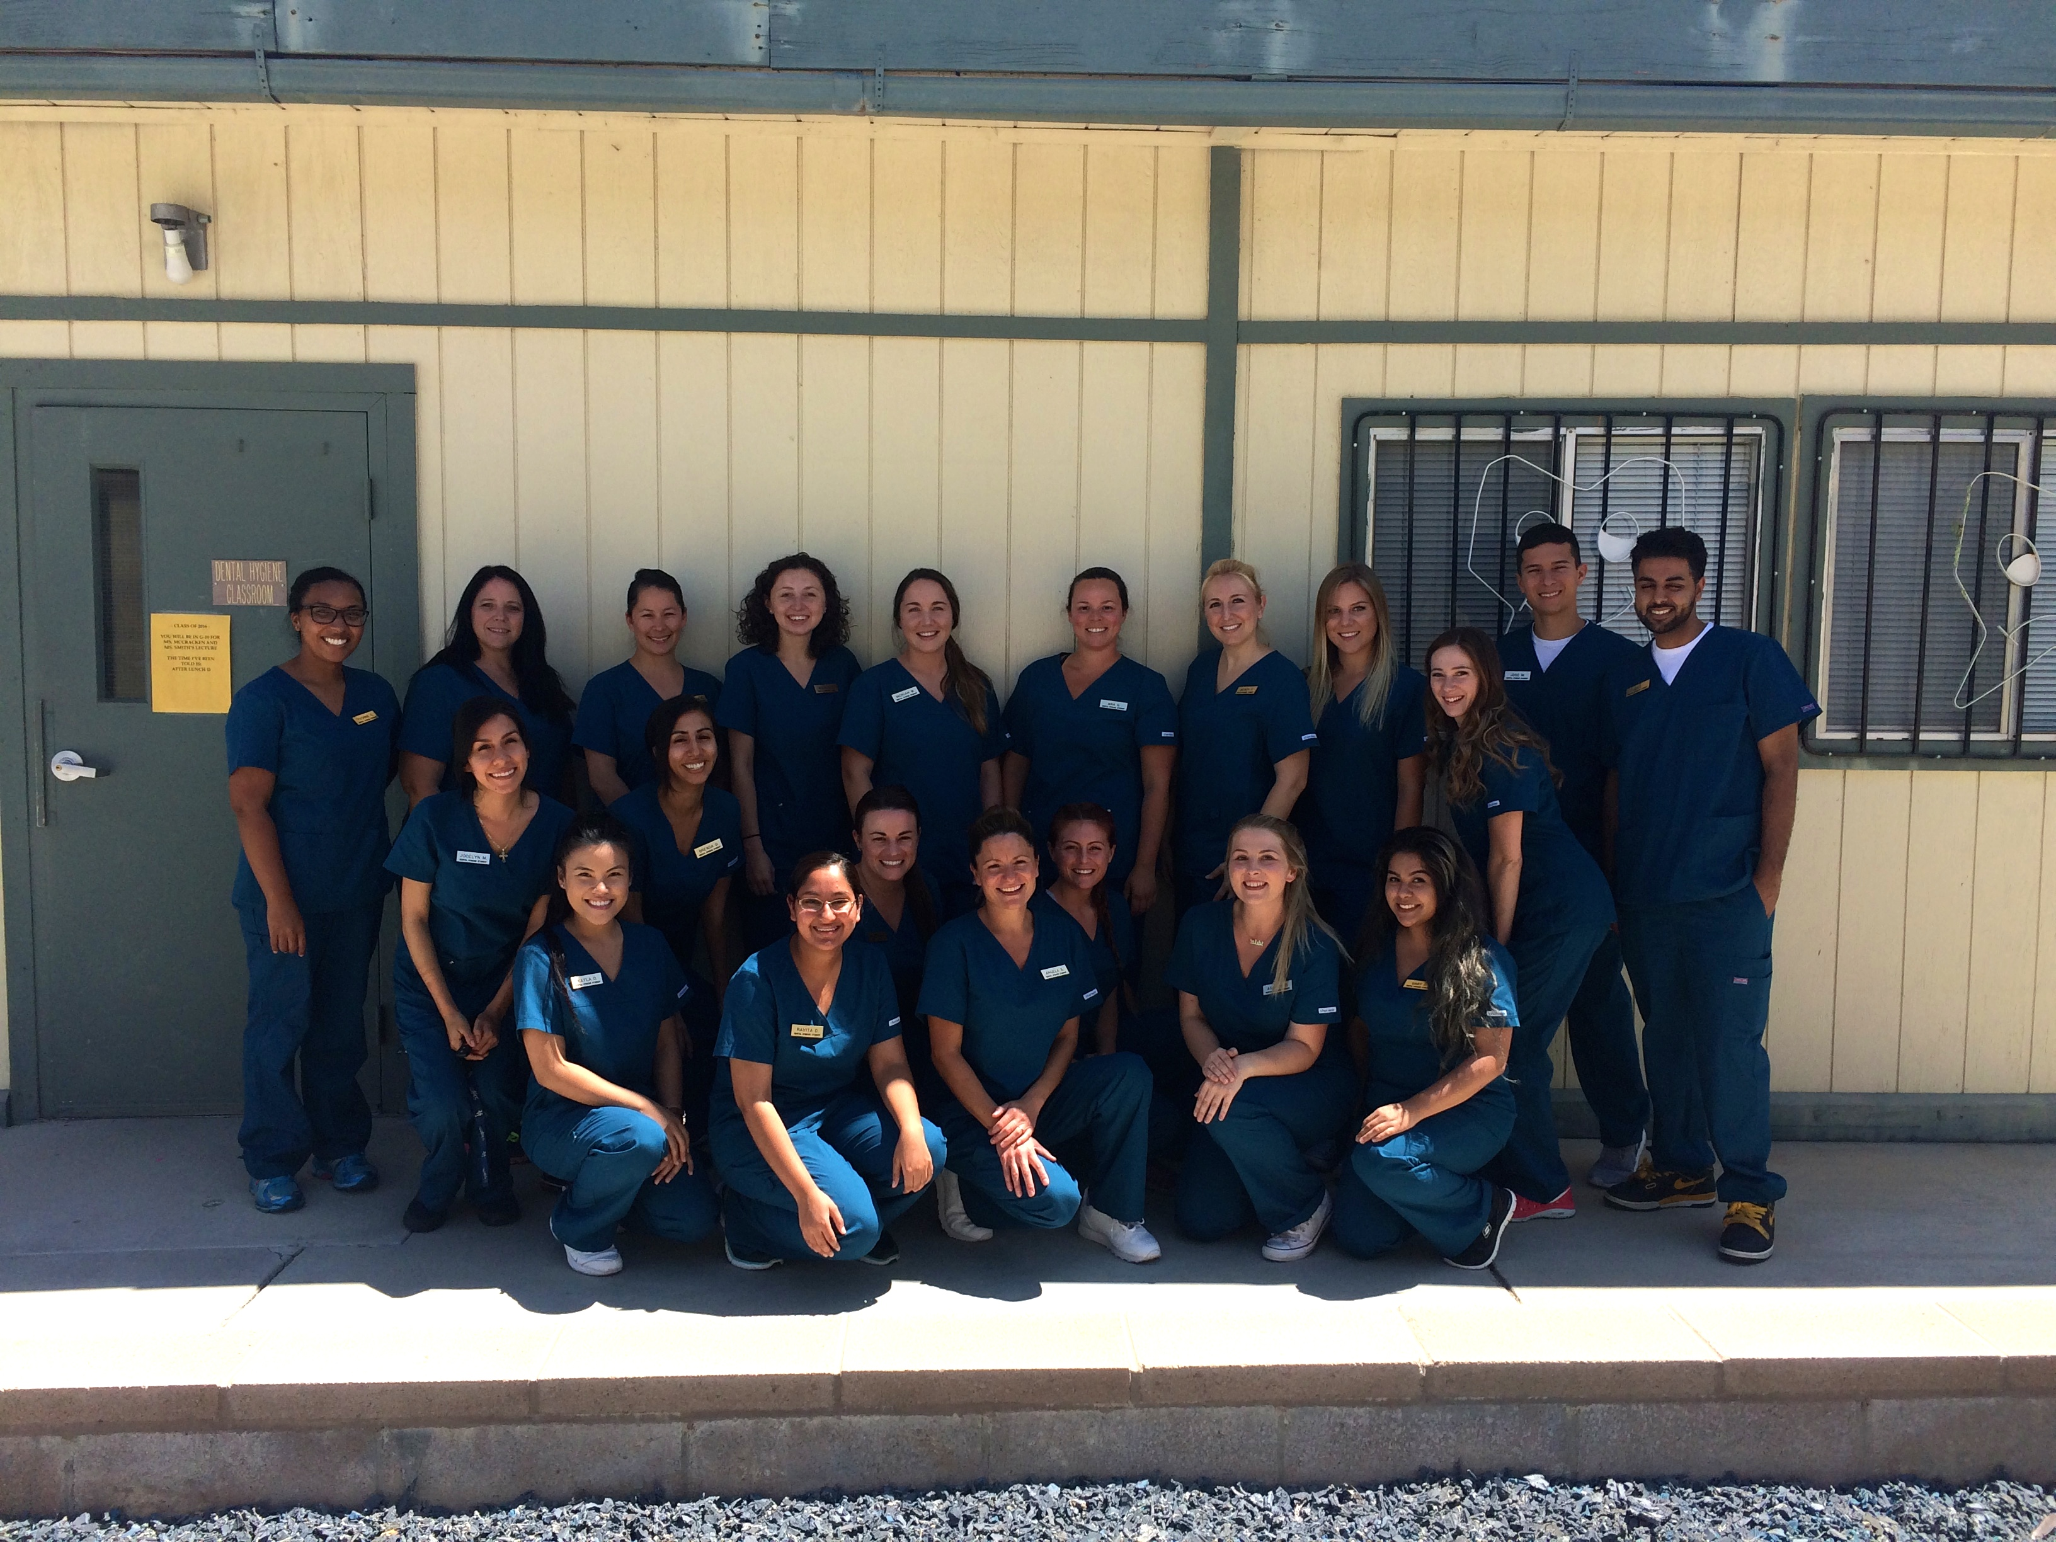
CYCLE ONE-PARTICPATORY ACTION RESERCH TEAM

Slide 9
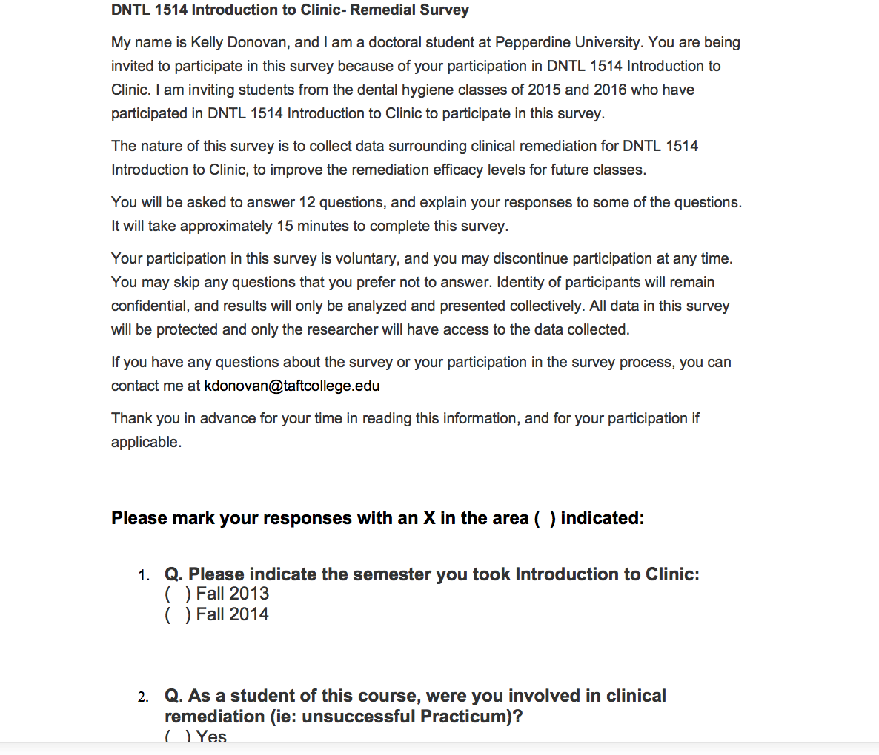
Student Survey- Fall 2013 & Fall 2014
Notes:
During Cycle One, the Participatory Action Research Team consisted of both first and second-year students at Dental Smiles College. A student survey was conducted and administered to both first and second-year dental hygiene students. The purpose of the survey was to collect data surrounding student’s experience with clinical remediation in the pre-clinical course Introduction to Clinic. The survey consisted of 12 multiple choice and open-ended questions, with the opportunity for participants to explain their responses (see Appendix for student survey). Of the second-year students, 18 of 18 students enrolled complete the survey. Of these 18 students, 14 had been involved in remediation, with four not involved in remediation. Of the first-year students, 16 out of 20 students enrolled completed the survey, seven of whom received remediation.

Slide 10
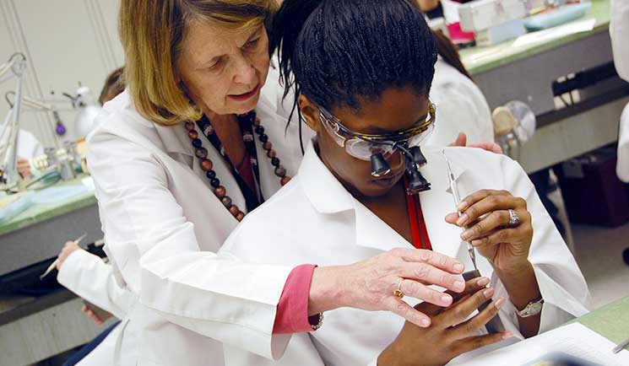
Student Survey Results
One-on-One Instruction
Equal Attention During Clinic
“Followers follow a leader who will provide a solid foundation”- Strengths Based Leadership (Rath & Conchie, p. 87).
Notes:
Learning and applications derived from Cycle One included a more precise understanding of student need in order to improve remediation efficacy in the Introduction to Clinic course. In the area of the most helpful teaching method, one-on-one instructor support was the most consistent theme that emerged throughout the survey. . Of the 34 students who participated in clinical remediation survey, 65% reported One-on-one instructor assistance was the most helpful teaching method In the matter of adequate one-on-one instructor support provided, one-half of the student surveyed responded that adequate instructor support was given, while an equal one-half of the students surveyed responded that they did not receive adequate support.
Student comments surrounding the reasons for lack of support revealed that not all students receive the same amount of attention in clinic. Some instructors spent 30 to 40 minutes with one student, while others spent an equal amount of time per student. The students also cited that although one-on-one instruction is desired; there is a lack of calibration between the instructors that makes the instruction confusing. A consistent method of student support and stability is essential for effective leadership. “Followers follow a leader who will provide a solid foundation” (Rath & Conchie, p. 87).

Slide 11
Student Survey Results
Instrumentation Schedule
High Test Anxiety
Seeking and promoting student feedback is important to quality improvements-The Speed of Trust (Covey, 2006).
Notes:
Introducing instruments sooner in the semester was also suggested. The students responded that introducing the instruments sooner in the semester would increase practice time before the Practicum. In addition to introducing the instruments sooner in the semester, the students also suggested being able to use their personal instruments for testing purposes rather than those provided by the clinic. Seeking and promoting student feedback is important to quality improvements (Covey, 2006).
Reformation of instructor evaluation methods. Students also recommended reducing the number of instructors evaluating students. Suggestions were made to revise the current number of instructors evaluating the student from four evaluators to two. Student responses cited that four instructors made the students nervous and anxious. Additionally, nervousness and test anxiety were frequently mentioned in the responses. Suggestions to alleviate test anxiety included a mock-practicum in advance of the actual Practicum exam. Also, a more serene testing environment was suggested. It was noted that a more welcoming, friendly attitude from instructors during testing would also alleviate test anxiety. Encouragement and support during the remedial process is an important consideration student success.

Slide 12
Cycle Two Story

Slide 13
Cycle Two Questions
In what ways if any have the changes recommended by the students and implemented into the Fall 2015 remediation program at Dental Smiles College improved the existing remediation program?
In what ways if any have the changes implemented into the Fall 2015 student remediation program at Dental Smiles College impacted the student and faculty perceptions of remediation?

Slide 14
LITERATURE REVIEW THEMES Related to Allied Health Programs
Educators must be mindful of incorporating strategies that support theoretical frameworks of how students learn (Evans, 2103).
Early intervention such as web- based activities and student intervention programs may provide increased retention and attrition rates (Corrigan-Magaldi, 2014).
Failure to offer remediation to students is more of an
expenditure than the cost of the program itself
(Bettinger, 2009).
.
Notes:
Theme 1: remedial programs based upon a framework which addresses students’ individual needs. The literature revealed the importance of a remedial program based on the students’ individual needs. The literature reviewed by researching the outcomes of remediation programs in associate degree programs of nursing. The literature describes the Wilsonian technique, which describes a framework to facilitate a systematic approach to remediation procedures (Culleiton, 2009). The system is designed to address intervention specific to student needs. The remediation program should not be a one size fits all, but rather support services that assist the student in focusing on their individual learning style (English, 2004). Educators must be mindful of incorporating strategies that support theoretical frameworks of how students learn (Evans, 2103). An example of such a theoretical framework includes the Transformative Learning Theories (TLT) developed by Mezirow
Theme 2: cost vs. benefit of a dental hygiene remedial program. The literature discussed the cost implications of hiring a full-time faculty member to the remediation role. The research showed that costs and resources associated with clinical remediation were justified, as remediation is a useful strategy in decreasing attrition rates (Hutton, 2007). Failure to offer remediation to students is more of an expenditure than the cost of the program itself (Bettinger, 2009). The incorporation of a remediation program was beneficial in reducing retention rates as well as supporting student success.
Theme 3: alternative strategies for socio-economic and underserved groups. The literature also discussed alternative strategies for socio-economic and underserved groups. The community college serves as a pathway for culturally diverse socio-economic and underserved groups to enter the college system (James, 1991). Many of these students are first-generation college students, and may not have an adequate support system in place within the family or the institution itself. Time and financial restrictions, poor self-esteem, and lack of information about support systems that exist may hinder the success of the underserved allied-health student. (Corrigan-Magaldi, 2014). Early intervention such as web-based activities and faculty intervention programs are helpful in retention of the underserved student, and may provide increased retention and attrition rates (Corrigan-Magaldi, 2014).

Slide 15
LITERATURE REVIEW THEMES Related to Allied Health Programs
The implementation of a remedial program in summer term may assist the instructor in a more progressive and comprehensive program (Corrigan-Magaldi, 2014).
A shared responsibility in the learning incorporating
a teaching-learning
partnership creates
an equitable and fair
learning environment (Evans, 2013).
Students’ who visualized themselves as calm during test taking and imagined being able to address questions with ease had an increased level of academic success (English, 2004).
Notes:
Theme 4: remediation programs implemented over summer term or semester break. The implementation of a remedial program over summer term or semester break was cited among the literature. The allied-health student may benefit from a remedial program implemented during a time when regularly scheduled courses are not in session. A remedial session over summer term or break may provide individualized instructor attention and alleviate the time constraints of the regularly scheduled term.
Theme 5: remediation programs that decrease anxiety levels of the educator and student. An additional theme among the literature included the need for a remediation programs that decrease anxiety levels of both the educator and the student. Educators may encounter the responsibility to address and ‘fix’ weak students. Educators may have anxiety surrounding remediation interventions and strategies, time restrictions, and additional faculty to implement the remediation (Culleiton, 2009).
Theme 6: personalized student-faculty mentoring program. The literature also showed consistency in the importance of a remedial program containing a student-faculty mentoring component. Faculty-student motivation is a vital component of the remedial program (Corrigan-Magaldi, 2014). Faculty-facilitated remedial programs assist students in critical thinking skills and improve test-taking capabilities (English, 2004). A shared responsibility in the learning incorporating a teaching-learning partnership creates an equitable and fair learning environment (Evans, 2013). Student-faculty mentoring programs are successful in nurturing and developing student confidence (James, 1991). Faculty that support student engagement and are available to students promote an effective retention program (Ramsburg, 2007).

Slide 17
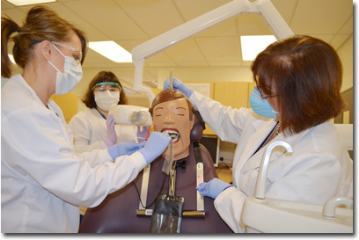
Increased Practice Time
Pre-Clinical Staff Meetings
Rotation Schedule

Slide 18
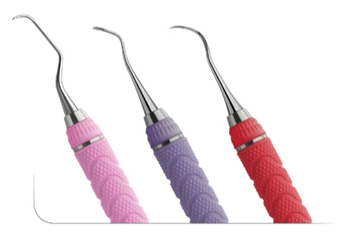
Order of Instrumentation
Mock Exam
Clinical Evaluation Form

Slide 19
Remind
Communication
Tool

Slide 20
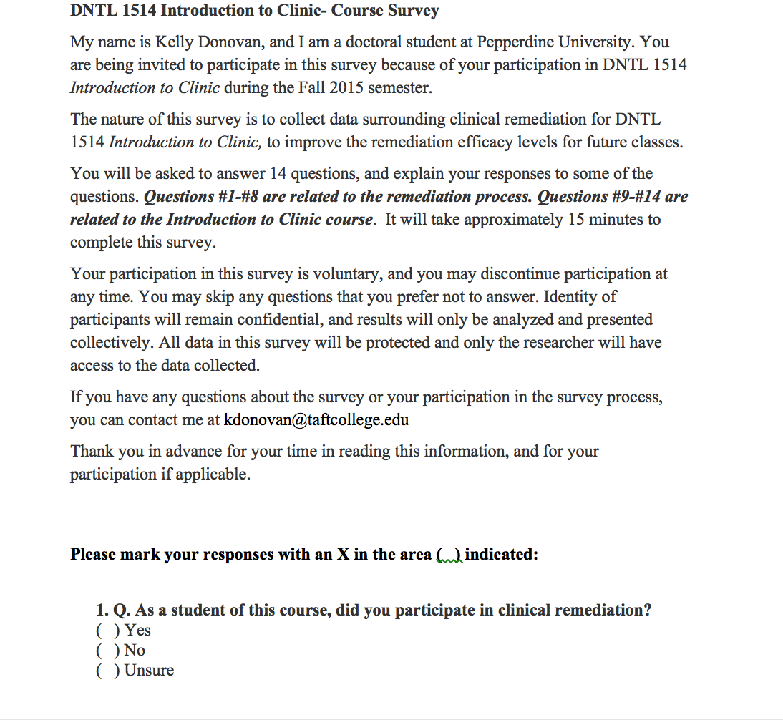
Student Survey-Fall 2015

Slide 21
Student Survey Results
Enough One-on-One Instruction?
Assistance and Support
Yes! 48% increase Yes! 31% increase
Notes:
Learning and applications derived from Cycle One included a more precise understanding of student need in order to improve remediation efficacy in the Introduction to Clinic course. In the area of the most helpful teaching method, one-on-one instructor support was the most consistent theme that emerged throughout the survey. . Of the 34 students who participated in clinical remediation survey, 65% reported One-on-one instructor assistance was the most helpful teaching method In the matter of adequate one-on-one instructor support provided, one-half of the student surveyed responded that adequate instructor support was given, while an equal one-half of the students surveyed responded that they did not receive adequate support.
Student comments surrounding the reasons for lack of support revealed that not all students receive the same amount of attention in clinic. Some instructors spent 30 to 40 minutes with one student, while others spent an equal amount of time per student. The students also cited that although one-on-one instruction is desired; there is a lack of calibration between the instructors that makes the instruction confusing. A consistent method of student support and stability is essential for effective leadership. “Followers follow a leader who will provide a solid foundation” (Rath & Conchie, p. 87).

Slide 22
Student Survey Results
Notes:
19/20 students participated in the survey.
15 students participated on their own=79%
3 were referred by and instructor but also participated on their own= 16%
1 referred to remediation by instructor- 5%

Slide 23
Do you feel that the Remind communication tool was helpful in the course? Yes! 100%
It made things easier…
Even more use would be great!
Reminders are
always helpful!
So helpful, great tool!

Slide 24
LEADERSHIP AND LEARNING
Notes:
----- Meeting Notes (1/9/16 16:22) -----
Survey your students..find out what is and is not working.

Slide 25
Cycle Three Story

Slide 27
Seven Norms of Collaboration

Slide 28
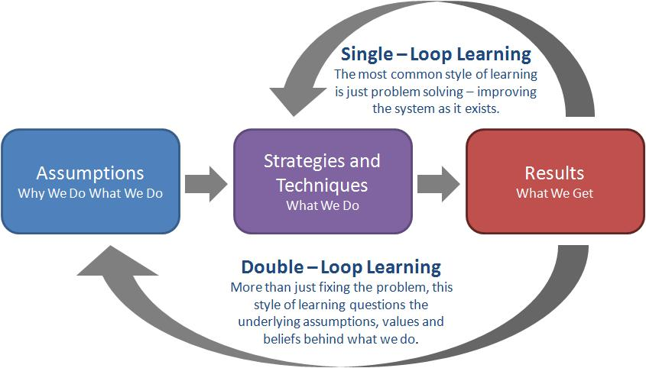
Single & Double-Loop Learning

Slide 29
CYCLE TWO-PARTICPATORY ACTION RESERCH TEAM

Slide 31
Title Page

