Slide 1
Student Services
Updates: Fall 2018

Slide 2
Student Services
Admissions & Records
Assessment/Placement
Athletics
Campus Safety
Counseling & Advising
Dorms
DSP & S
EOP & S, CARE, Cal WORKS
Financial Aid & Scholarships
Outreach
Student Life
Student Resource Center
TRIO
Veteran’s Center
Wellness

Slide 3
Admissions
&
Records
Jennifer Strobel

Slide 4
Staff Changes
Director of Admissions & Records
Jennifer Strobel
Admissions & Counseling Technician
Isaura (Izzy) Santiesteban
Admissions Technician/VA Certifying Officical/DSO
Nichole Cook
Admissions & Records Technicians
Gabriela Molina
Brittany Lange
Evaluator
Tiffany Payne
Student Worker
Jessica Hartness

Slide 5
CCC MyPATH IMPLEMENTATION

Slide 6
Reverse Transfer

Slide 7
Equity
Updates
Breanna Payne

Slide 8
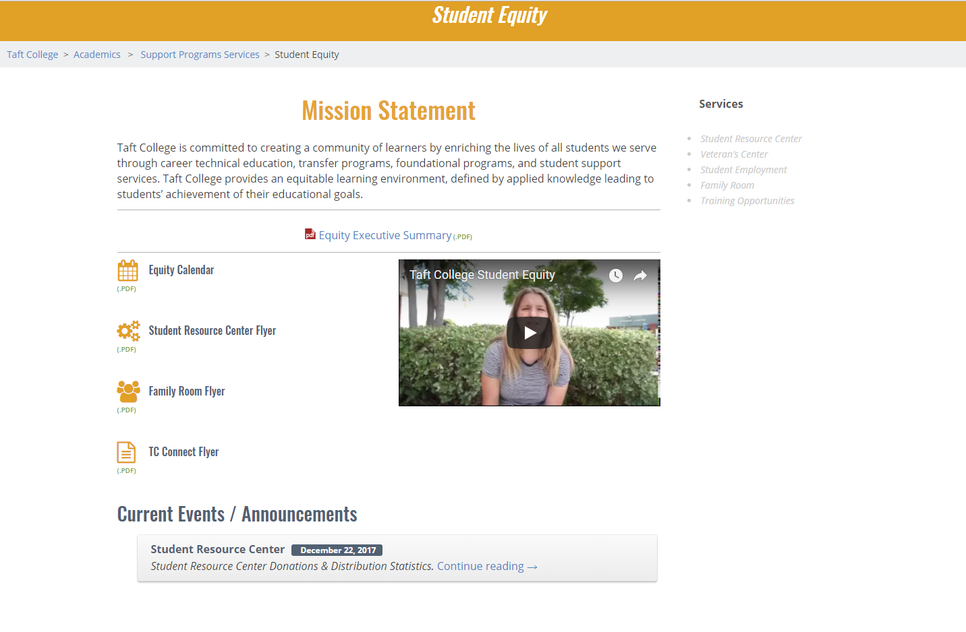
EQUITY UPDATES
Reminder: Equity is now located in the Veteran’s Center
Webpage: http://www.taftcollege.edu/support-programs-services/student-equity/
Almost entirely new group of student workers
Newsletter
TC Connect will not be renewed
Open Office Hours/Peer Mentoring
Online Training to come
New Flyers/Resources to follow

Slide 9
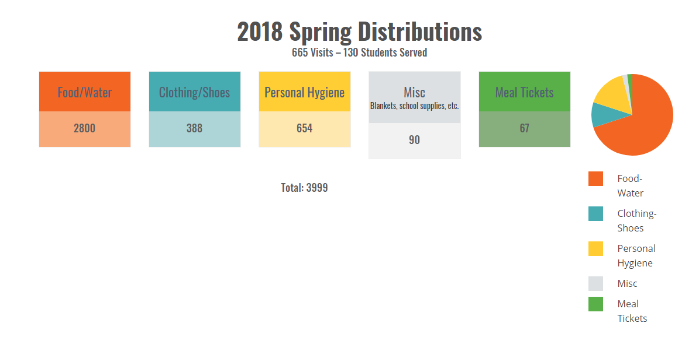
EQUITY UPDATES - SRC
For the 2018 spring semester 130 students utilized the SRC, visiting 665 times between the dates of January 2, 2018 and May 23, 2018.

Slide 10
EQUITY UPDATES - SRC
2018 Fall Policy (Per Visit)
20 Food Items
8 Personal Hygiene Items
Unlimited Clothing/Shoe Items
1 Towel & 1 Blanket
Fall Hours/Flyers: Will be Emailed/Posted

Slide 11
EQUITY UPDATES - SRC
The SRC is currently low/out of stock of these items:
Water bottles
Easy Mac & Cheese
Spaghetti O’s
Chef Boyardee Ravioli
Chips
Cheez Itz
Crackers
Cereal
Granola Bars
Fruit cups
Fruit snacks
Jell-O
Pudding
Baby wipes
Washcloths
Towels
Hairbrushes
Hair ties
Notebooks
Paper
Pencils

Slide 12
VETERAN RESOURCE CENTER
Next to the Cafeteria
Veteran Counselor: Juana Rangel-Escobedo
Certifying Official
Veteran Club Advisor: Tina Mendoza
Veteran Club: Justin Uribe
Veteran Student Workers/Peer Mentors
New Printer: Free Printing for all Veterans

Slide 13
Financial Aid
&
Scholarships
Barbara Amerio

Slide 14
Looking Back The Numbers

Slide 15
Federal Aid
 | 2016-2017 | 2017-2018 | Difference
Pell Grant
Student Count | 1358 | 1509
Total Amount Paid | $4,535,446.69 | $5,583,146.70 | $1,047,710.01 | 24% increase
FSEOG
Student Count | 312 | 342
Total Amount Paid | $52,050.00 | $55,905.00 | $3,855.00 | 8% increase

Slide 16
Federal Aid

Slide 17
State Aid
 | 2016-2017 | 2017-2018 | Difference
Cal Grants
Student Count | 344 | 437
Total Amount Paid | $442,556 | $567,202 | $124,646 | 29% increase
FTSSG
Student Count | 283 | 332
Total Amount Paid | $138,300 | $276,500 | $138,200 | 100% increase
Completion Grant
Student Count | 0 | 73 |  | New program
Total Amount Paid | - | $84,000
Dream Grant
Student Count | 0 | 31 |  | One Time fund
Total Amount Paid | - | $14,099

Slide 19
State Aid
 | 2016-2017 | 2017-2018 | Difference
CCPG (BOGW)
Student Count | 3027 | -
Total Amount Paid | $4,535,446.69 | $5,583,156.70 | $1,047,710.01 | 24% increase

Slide 20
Institutional Aid
 | 2016-2017 | 2017-2018 | Difference
Merit Award
Student Count | 33 | 47
Total Amount Paid | $14,400 | $20,100 | $5,700 | 40% increase
TC Scholarship
Student Count | 278 | 319
Total Amount Paid | $47,250 | $53,625 | $6,375 | 14% increase
Non-Res Scholarships
Student Count | 16 | 31
Total Amount Paid | $75,854.50 | $157,950 | $82,095.50 | 109% increase
Osher
Student Count | 17 | 15
Total Amount Paid | $14,300 | $14,300 |  | Level Funding

Slide 22
Miscellaneous
 | 2016-2017 | 2017-2018 | Difference
EOPS/CARE Grants
Student Count | 272 | 287
Total Amount Paid | 45,300 | $46,525 | $1,225 | .03% increase
Taft College Community Scholarship
Student Count | 32 | 33
Total Amount Paid | $44,250 | $55,000 | $10,750 | 24% increase
Work Study
Student Count | 310 | 255
Total Amount Paid | $890,032.98 | $910,390.68 | $20,357.70 | 3 % increase

Slide 23
17-18 Work Study Program
Program | Student Workers | Earned
Institutional Work Program | 290 | $790,390.26
Federal Work Program | 10 | $59,711.40
Cal WORKS Program | 15 | $60,289.02
Total | 315 | $910,390.68

Slide 24
24.7% increase

Slide 25
# of Student Workers 315
# of Supervisors 54
Fall 17 Expectations 100%
Fall 17 Evaluations 97%
23 evaluations missing from 13 supervisors
Spring 18 Expectations 97%
Spring 18 Evaluations 81%
6 Expectations missing from 6 supervisors
40 evaluations missing from 18 supervisors

Slide 26
Overall Financial Aid Totals
 | 2016-2017 | 2017-2018 | Difference
 | $8,555,565.17 | $10,313,684.38 | $1,758,119.21 | 21% increase

Slide 27
Aid per Academic Year
2008-2009 | $3,302,248.33
2009-2010 | $4,633,152.05
2010-2011 | $5,625,222.86
2011-2012 | $5,781,262.92
2012-2013 | $6,982,748.21
2013-2014 | $7,296,136.00
2014-2015 | $7,838,550.76
2015-2016 | $7,900,094.32
2016-2017 | $8,555,565.17
2017-2018 | $10,313,684.38

Slide 28
208% increase
Over 10 years 20.6% average per year

Slide 29
1st Year of Year Round Pell
 | 2016-2017 | 2017-2018 | Difference
Student Count | 326 | 505 | 179 | 55% increase
Total Amount Paid | $386,078.13 | $741,865.00 | $355,786.87 | 93% increase

Slide 30
Outreach

Slide 31
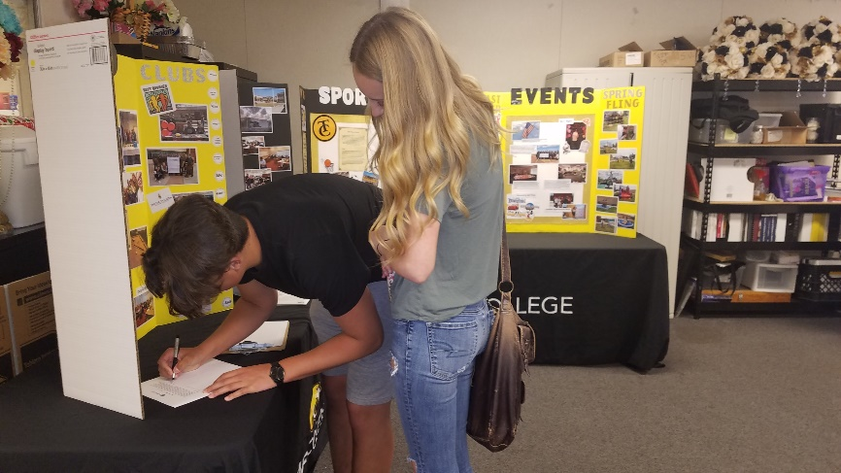
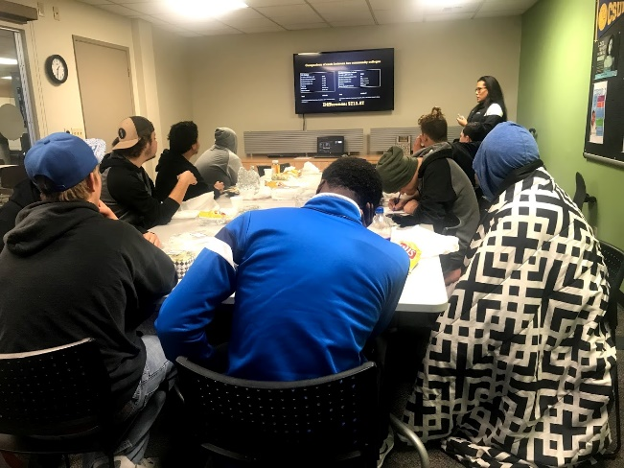
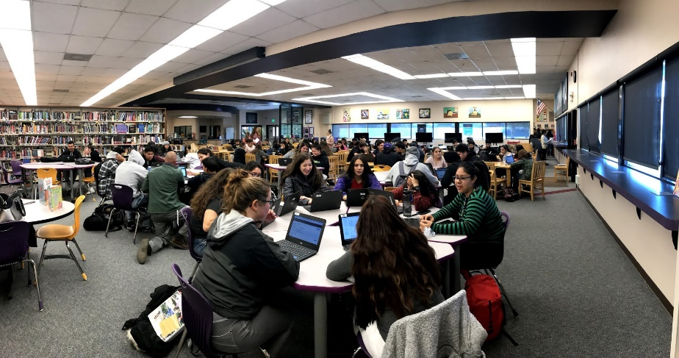
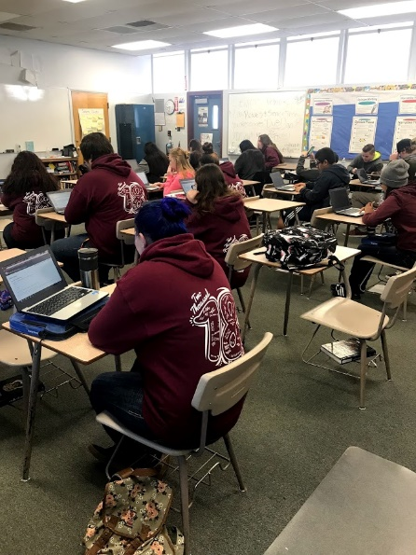
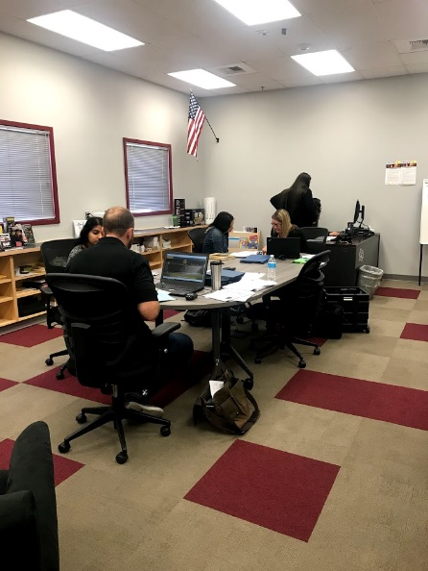
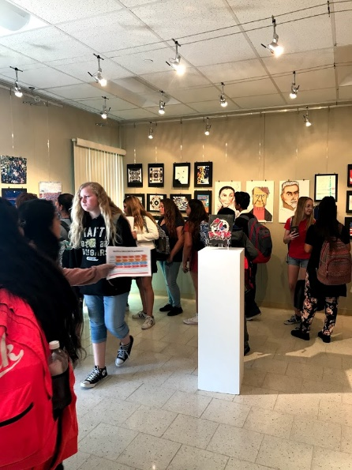
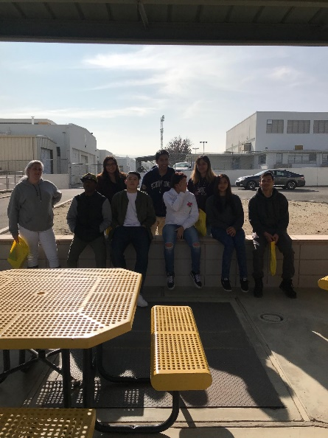
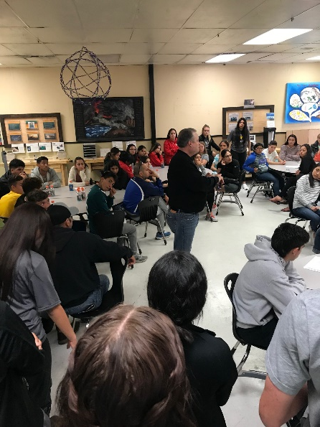
 | 2016-2017 | 2017-2018 | Difference
Events Total | 119 | 163 | 44 | 37% increase

Slide 32
Cougar Day
April 24th & April 25th
Taft Union High School
78 students
0 – 5.5 units: 5
6 – 8.5 units: 6
9 – 11.5 units: 6
12 - + units: 61
Shafter High School
27 students
0 – 5.5 units : 3
6 – 8.5 units : 1
9 – 11.5 units: 1
12 - + units: 22
Wasco Union High School
12 students
0 – 5.5 units: 0
6 – 8.5 units: 1
9 – 11.5 units: 4
12 - + units: 7

Slide 33
Financial Aid
Looking Forward

Slide 34
18-19 Financial Aid
Fund | Totals
Pell Year Round Pell | $6095 $9143
FSEOG | $260
Cal B | $1672
Cal C | $1094
Student Success Completion Grant | $4000
Merit | $600
TCS | $250
NRTC | $7740
Osher | $1000
CCPG | Unlimited

Slide 35
18-19 Work Study
Hours | Total/Year
5 hours | $1840
10 hours | $3680
15 hours | $5520
20 hours | $7360

Slide 36
Awarded to Date – 8.14.2018
Pell 1134 students $9,171,906
Merit 50 students $30,000

Slide 37
Money Network BankMobile
BankMobile Disbursements offers the following choices:
Electronic deposit:
a personal checking/savings account
BankMobile Vibe digital checking account
Paper Check
The BankMobile Vibe Account offers:
Fee-free access to over 55,000 AllPoint ATMs
Built-in money management tools
A recognition program which recognizes students for smart moves in and out of the classroom
No monthly fee for students
No return deposit item fee
No PIN fee
No overdraft fee
No stop payment fee
The BankMobile Vibe app feature lets students quickly and securely log in with just a fingerprint. Within the app, students are able to:
Check balances
View recent transactions
Transfer money
Get answers to FAQs

Slide 38
BankMobile ATM Location
Library Lobby

Slide 39
California State Aid Consolidation
2017-2018
2018-2019
Full-time Student Success Grant
Community College Completion Grant
Allocation amount: $395,000
Student Success Completion Grant
Allocation amount: $601, 922

Slide 40
Technology Funds

Slide 41
Scholarships
Taft College Community Scholarship
Application available January 22, 2019 on the Financial Aid webpage or in the office
All students are welcome to apply
March 15, 2019 4:00 p.m.
Deadline to submit completed application with recommendation forms
Scholarship Page
Extensive list of available scholarships listed by deadline date

