Slide 1
STUDENT SERVICES SPRING 2021 UPDATES
SEVERO BALASON, VP OF STUDENT SERVICES

Slide 2
STUDENT SERVICES
CAPP Update and 2022 Goals
Increase by 60% the TUHS graduates fully prepared for transfer level English and math
Increase the number of students completing an AA in 3 years (vs 6 years)
Decrease Equity Gap by 10%
New Hires in A&R
Academic Counseling
Special Programs
Mental Health Counseling
Student Resource Center

Slide 3
CAMPUS SAFETY & SECURITY
Kevin altenhofel
Director of Campus Safety & Security

Slide 4
SECURITY CONTACT INFORMATION
These flyers should be posted in every classroom.
If you know of a place which needs a flyer, please let Security know.

Slide 5
SECURITY SERVICES AVAILABLE
Escorting to the Parking Lots
Unlocking Building Doors
Electronic Door Scheduling
Jump Starts
Vehicle Lock-Out Assistance

Slide 6
Security Updates
G Building Emergency Locks
Parking Permits
Updated Lighting in Parking lots
New Daily Crime Log
http://www.taftcollege.edu/safety/

Slide 7
ADMISSIONS & RECORDS
WINDY MARTINEZ, Dean of student services

Slide 8
A & R and Counseling Support Staff
Counseling Staff
Apolonia Cotto
Admissions Staff
Isaura “Izzy” Santiesteban & Mireya Zermeño
Records Staff
Technicians: Brittany Lange & Gabriela Molina
Evaluator: Tiffany Payne

Slide 9
Updates
Waitlists
Add Codes
Census Rosters
Adding/Dropping
EWs
Incompletes / IPs
Grade Changes
International Students
Catalog Updates

Slide 10
FINANCIAL AID
Barbara Amerio
Director of financial aid & scholarships

Slide 11
- Staffing Update - TC Promise Program - What’s new in Financial Aid

Slide 12
- Staffing Update Amber Garcia – Office Coordinator Krystal Allikas – Financial Aid Technician II / Work Study Coordinator Baghdad Alkorin – Financial Aid Technician I Chase Brown – Financial Aid Technician / Promise Program Coordinator Joanne Dumbrigue – Outreach Coordinator / Academic Advisor / Foster Youth Liaison

Slide 13
TC PROMISE PROGRAM STATS
Total number of students in the TC Promise Program for 2020-2021 = 78 (an increase of 32 students)
Number of Enrollment Grants processed for 2020-2021 = 11 for a total of $12,098.00 (fall and spring)
Number of Book Grants processed for 2020-2021 = 39 for a total of $5508.00 (fall only)
Number of DREAM Book Grants processed for 2020-2021 = 4 for a total of $1076.50 (fall only)
Total number of student in the TC Promise Program for 2020-2021 who have continued from fall to spring = 70 / 90%
Average GPA of all TC Promise Students at the end of Fall 2020 = 2.58 (6 earned a 4.0, 31 earned a 3.0 or higher)

Slide 14
CARES Act – Higher Education Emergency Relief Grants Round One
Total Amount allocated for Direct Student Aid $ 561,445
Total number of students who have applied = 566
Total number of students approved = 423 which is 75%
Total number of students denied = 143 which is 25%
Typical amount of each grant $1200
Total disbursed to date $561,445
Remaining to disburse $0
Another aid package just passed – Round Two….

Slide 15
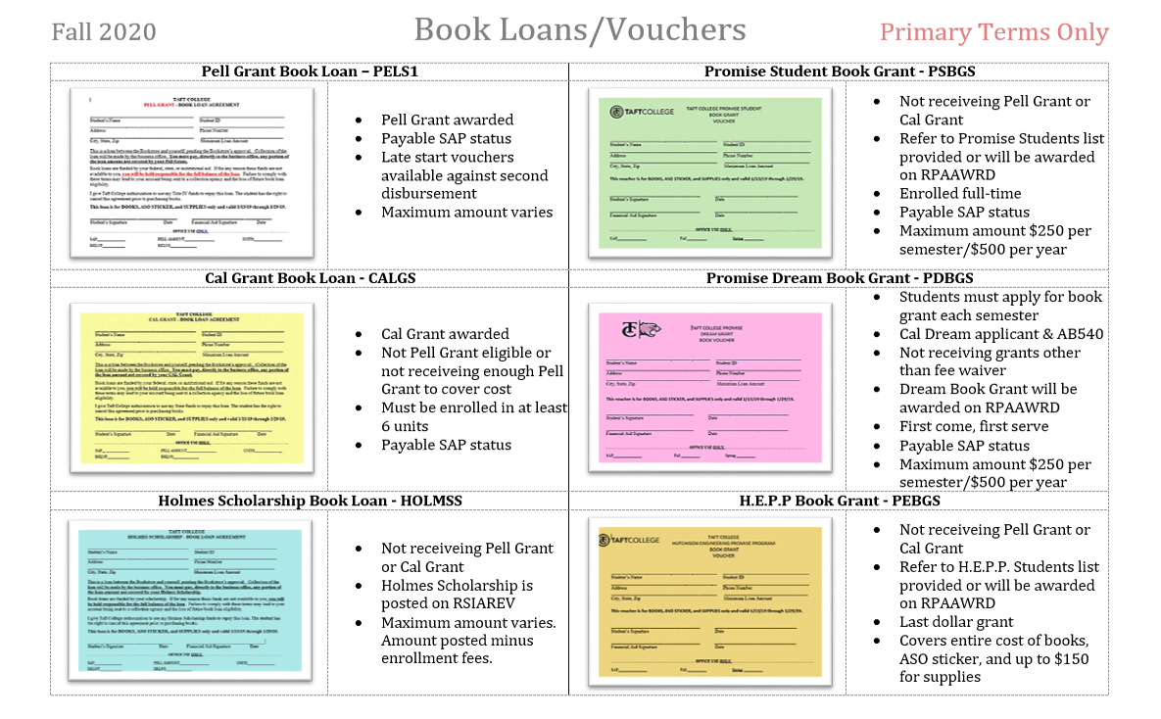
BOOK VOUCHERS & BOOK LOANS OFFERED

Slide 16
WHAT’S NEW IN FINANCIAL AID?
Disaster Relief Emergency SFA – Funding came from suspending the Dream Service Incentive Grant Program.
Eligibility requirements – Financial Need, Exempt from paying non-resident tuition (AB540 students), Completed a CADAA or CCPG application.
Taft College Allocation - $ 38,782.00
Number of students awarded and disbursed – 37
Amount of grants were $1200-FT, $900-TT, $600 HT, $300 Less HT
Entire allocation has been disbursed.

Slide 17
WHAT’S NEW IN FINANCIAL AID?
Finish Line Scholars Program – The Jay Pritzker Foundation has pledged $100 million, over a span of 20 years, to the Foundation for California Community Colleges to support this program.
Of the 116 California Community Colleges 34 colleges received the awards. Taft College was one!!
Our allocation is $128,000.
For the 2020-2021 academic year the entire allocation is to be used as emergency aid for students.
Moving forward we will be developing a Scholarship Program for a majority of the allocation with a small amount still earmarked for emergency aid.
Sheri Horn-Bunk and I will be reaching out to areas of the campus community to participate on a task force to develop a program which is equitable and inclusive.

Slide 18
WHAT’S NEW IN FINANCIAL AID?
SRC will be offering Meal Voucher and/or Grocery Gift Cards. Myisha Cutrona is coordinating this program.
Taft College Community Scholarship Program – January 19th, deadline March 19th @ 4:30pm. Completely electronic!
Work Study process has gone electronic. Currently we have 30 student workers across campus. Only in essential areas such as Maintenance, Bookstore and Tutoring.
Human Resources will be working to move the whole work study onboarding process to PayCor. Preliminary timeline is Fall 2021.

