Slide 1
STUDENT SERVICES UPDATES Spring 2022
Dr. Damon A. Bell
Interim Vice President, Student Services

Slide 2
STUDENT SERVICES updates
1st week of classes(extended hours)
Testing Hub
118/77
Covid, DSPS, Athletes
High School Counselors Luncheon (Jan 25)
Wildcat Day ( April 19)
Cougar Day ( April 26)
Veteran’s Center Move
Mental Health Services

Slide 3
Introducing the new
Dean of Student Services
Cecilia Alvarado
Start date: January 24, 2022
Orange Coast College (Director)
Riverside City College (Dean, Interim VPSS)
Riverside, Norco, Moreno Valley (EOPS Director)
She is from California and a community college alumna. Her parents are immigrants and speaks Spanish and English. She has been in the CCC for over 18 years. She has three daughters and a granddaughter.

Slide 4
Student Services Organizational Changes
VPSS Dean, Student Services
Student Life and SBNRC (Student Basic Need and Resource Center) EOPS/CARE/CalWORKs
Student Housing (Dorms) Counseling/Advising
Admissions and Records DSPS
Financial Aid Testing Hub
Veteran’s Center Outreach
Mental Health
Other duties:
Student Conduct Student Conduct
Title IX
Guided Pathways Guided Pathways

Slide 5
ADMISSIONS AND RECORDS
Rebecca Murillo
Director of Admissions and Records

Slide 6
A & R and Counseling Support Staff
Counseling Staff
Apolonia Cotto
Admissions Staff
Isaura “Izzy” Santiesteban
Mireya Zermeño
Records Staff
Technicians:
Lisa Brettschneider
Tosha Romandia
Evaluator:
Tiffany Payne

Slide 7
ADMISSIONS & RECORDS
Waitlists
Add Codes
Census Rosters (records@taftcollege.edu)
Adding/Dropping
EW (Online Petition)
Grade Changes (records@taftcollege.edu)
Incompletes / IPs (records@taftcollege.edu)
Final Grades
Arranged Hours
Catalog Changes/Corrections

Slide 8
FINANCIAL AID & SCHOLARSHIPS
Barbara Amerio
Director of Financial Aid & Scholarships

Slide 9
Financial Aid Team
Amber Garcia, Office Coordinator
Lori Murphy, Technician II / Work Study Coordinator
Alexcia “Lexi” White, Technician I
Baghdad Alkorin, Financial Aid Special Programs Coordinator

Slide 10
CARES ACT EMERGENCY FUNDING
HIGHER EDUCATION EMERGENCY RELIEF FUNDS
HEERF III
$3,743,224.00
Disbursed in Emergency Grants in Fall 2021
$2,171,563.13
To 2185 students
Remaining balance for Spring 2022
$1,571,660.87
FREE BOOKS FOR ALL CURRENTLY ENROLLED SPRING STUDENTS

Slide 11
Immediate return to title iv and FW’s Emergency Aid $431,396
It is extremely important for instructor's to clear their rosters. When rosters are not cleared properly students are disbursed financial aid they are not entitled to receive and then the District has to return the funds to the Department of Education. We then have to “try” to recoup the funds from the students.
For the fall semester I have had many instances where the instructor assigned an FW grade with a Last Day of Attendance within the first two weeks of the semester. The students were disbursed $3000+ each for the semester and the District is now required to return the funds and try to collect from the student.
Please review your rosters and drop students who have ceased attendance/participation to ensure our resources are going to the students who are actively pursuing their education.
Division Chairs – please remind all adjuncts in your division!

Slide 12
Immediate Scholarships Emergency Aid $431,396
Taft College Community Scholarship Program
Opens on January 18, 2022
Closes on March 18, 2022 at 4: 30 pm.
All applications, biographical letters and Faculty/Staff Evaluation forms must be turned in for a complete packet.
Kern Division Retired Teachers Association Scholarship
Opens on January 18, 2022
Closes on March 18, 2022 at 4:30 pm.
Separate application from the TC Community Scholarship applicaton

Slide 13
STUDENT LIFE AND BASIC NEEDS
Myisha Cutrona
Coordinator of Student Life and Basic Needs

Slide 14
Student Life and Basic Needs Team
ASO Executive Board
Club Officers
Club Advisors
Trained student-workers
Collaboration with Financial Aid for Cal Fresh
Collaboration with community programs: CAP K (Community Action Partnership of Kern County) and Taft Human Services Department)

Slide 15
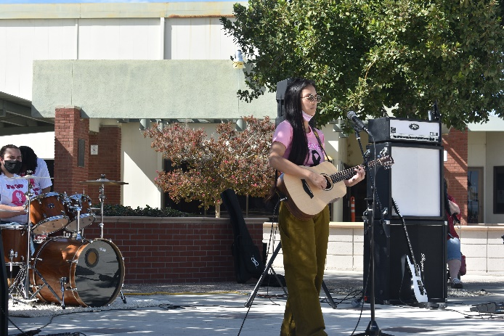
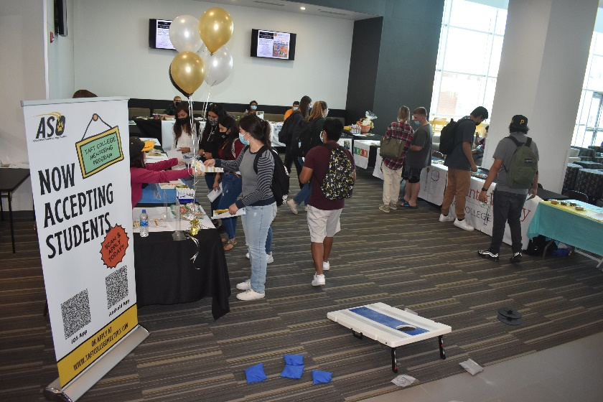
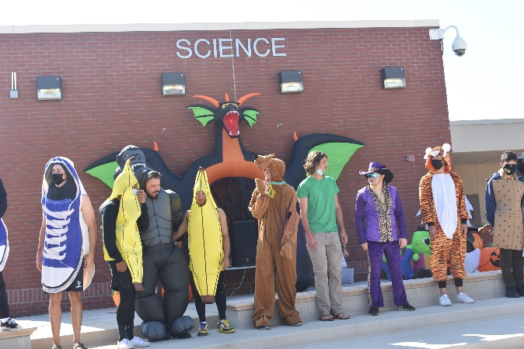
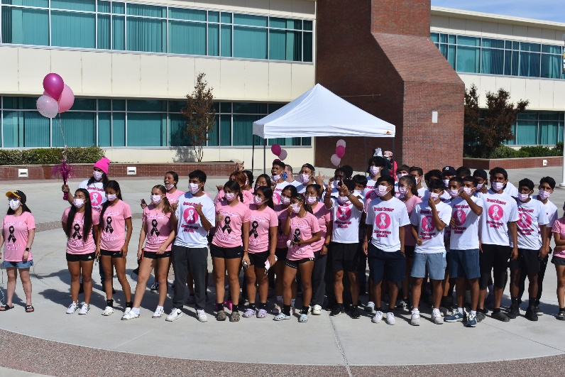
Student Life
Re-Cap
Fall 2021 – Return to
Campus
Events:
Welcome Week
Club Rush
Breast Cancer Awareness Week
October Halloween Rally

Slide 16
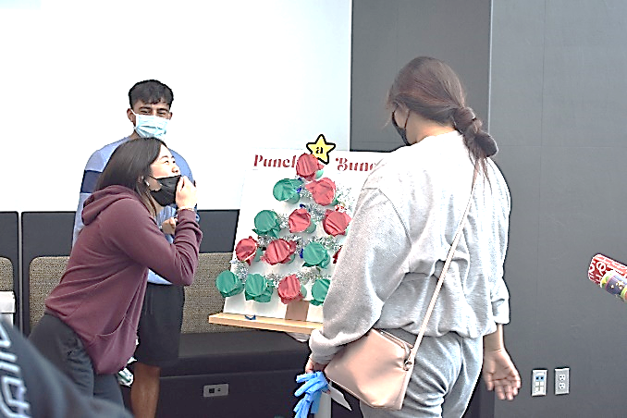
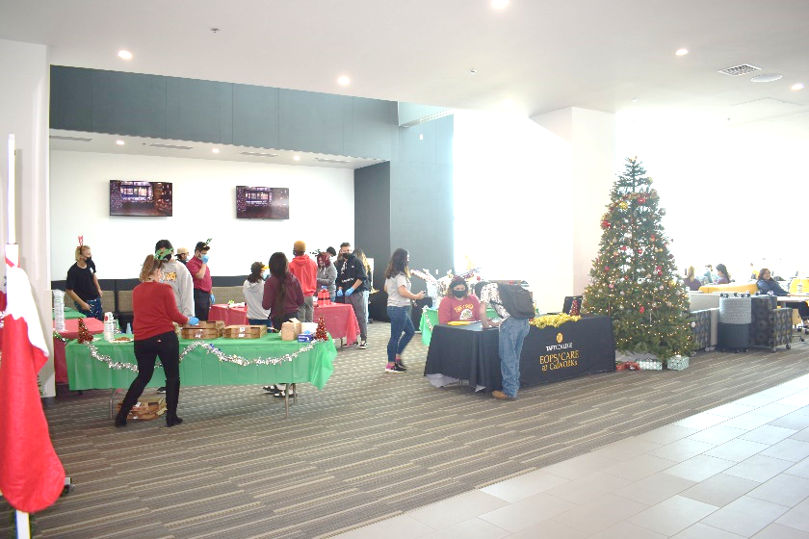
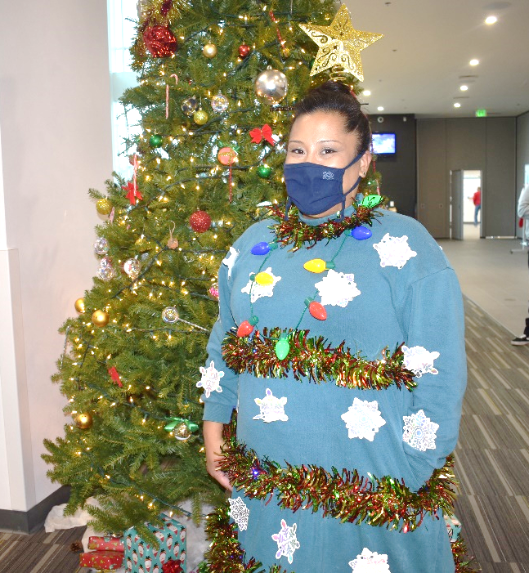
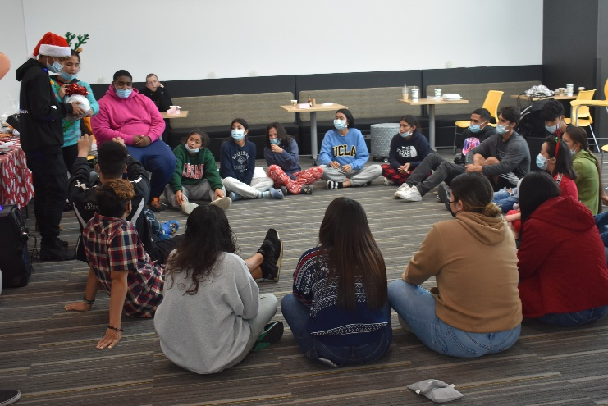
Student Life
Re-Cap
Fall 2021 – Return to
Campus
Events:
Native American Heritage Month
PTK Induction Ceremony
Student Center Holiday Extravaganza
EOPS Christmas Outreach-Reindeer Games

Slide 17
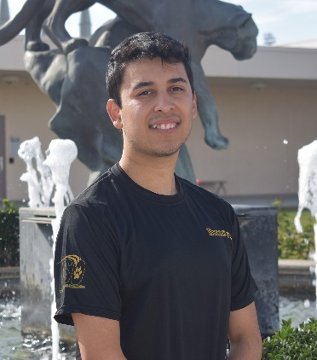
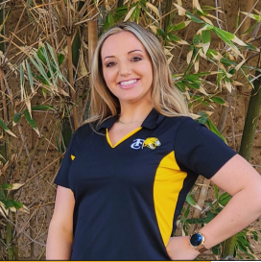
2021-22 Associated Student Organization
Executive Board & Trustee
Faith Angeles
Angelissa Garza
Marco Martinez
Miles Bassett-Graves
Zachary Carter
President
SSCCC Voting Delegate
Vice President &
Region VI Vice Chair
Newly Appointed Social Medial and Publicity Officer
&
Regional Affairs Director
Interclub Commissioner
Secretary/Treasurer
Priscilla Pyun
Desirae Salas
Waleed Harb
New 2022 Director,
Quentin Butler
Picture not available
Student Trustee
ASO Directors

Slide 18
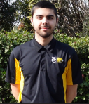
ASO Updates
All marketing videos created by the 2020-21 ASO Marketing Team are now live on YouTube. The athletics and admissions videos are provided in an English and Spanish version.
Below is a link to the entire YouTube playlist:
https://youtube.com/playlist?list=PLU4NsUhwaes0f69hBZf4bE6TtfPiOPVfp
Joshua Vazquez
Former President
Nick Castillo
Former Secretary/Treasurer
Spring 2022 Club Rush will be January 25 – 27th in the Student Center
The ASO Executive board and directors plan to attend the Student Senate of California Community Colleges (SSCCC) General Assembly in April

Slide 19
Student Basic Needs & Resource Center
The TC SBNRC is the one- stop-shop for students to receive support to help alleviate food insecurity as well as mitigate other identified basic needs. When students visit, they will be in a friendly environment where they can feel safe to address inequities and connect with peers.

Slide 20
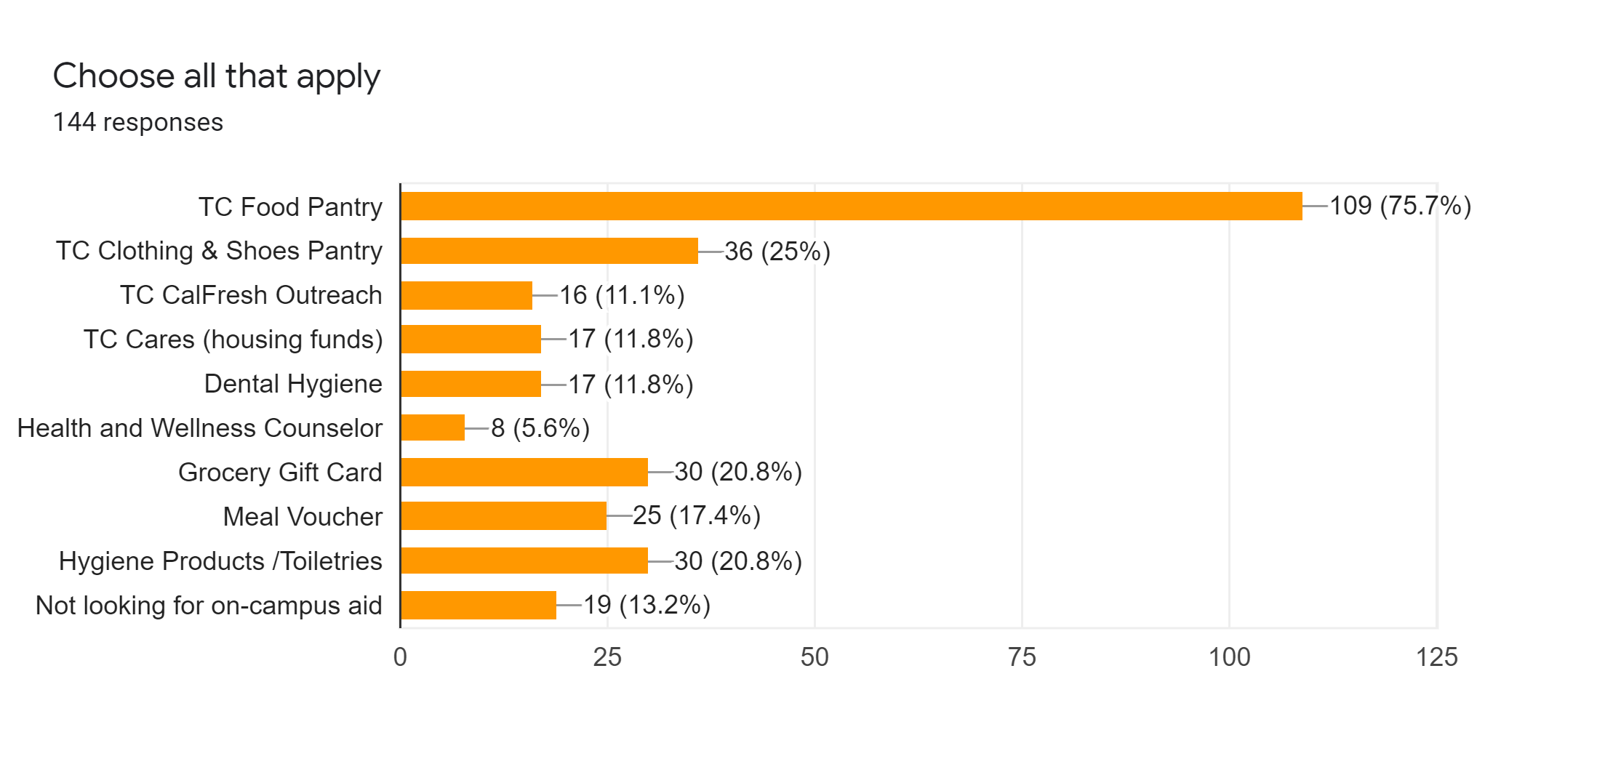
Fall 2021 On-campus Resources Used or Requested

Slide 21
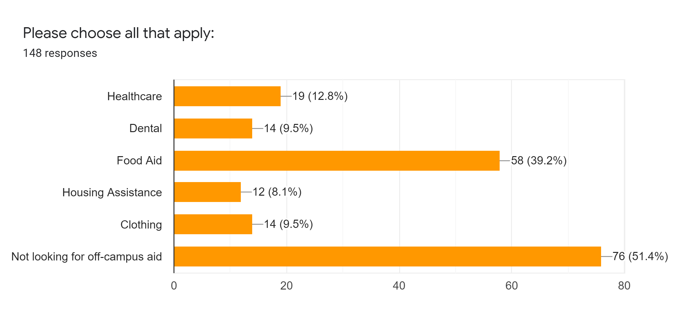
Off-Campus Resource inquiries

Slide 22
Student Basic Needs and Resource center Updates
Center will re-open Monday, January 25th
Online request must be submitted prior, no walk-ins
All inventory is currently in storage bins in preparation of the move to the new location.
SBNRC will move into the old IT building once renovations are complete
Expected completion date is sometime in February
The new location will house the food/clothing pantry, SBNRC student-worker area, Coordinator’s office, and the Veteran’s Center which will include a small lounge and workspace.
Hours of operation will remain the same: Monday – Thursday, 10 am – 2 pm.

Slide 23
Housing and Residence Life
Angelo Cutrona
Dorm Supervisor

Slide 24
Dorm occupancy
Total number of spaces in the dorms =118
Total available occupancy space for students = 108
1 room in the Cougar Dorm was dedicated as a quarantine room
2 rooms in the Ash Dorm were dedicated as quarantine rooms
1 room in the Cougar Dorm was for the Resident Assistant

Slide 25
Dorm occupancy continued
Fall 2021
89 students in the dorms
82% of total occupancy
50% male; 50% female
Spring 2022
Returning Students 61
68% retention
34 returning male students
27 returning female students
Students not returning
6 TIL students lived in the dorms during the fall and will move into TIL housing
Several students graduated or were eligible to transfer this spring
New 2022 dorm application submitted as of Jan. 6th = 12
Expected Dorm Occupancy = 73 students

Slide 26
Dorm renovations 2020-21
Cougar Dorms
Replaced flooring
Rooms painted
New mattresses and bed frames
Upgraded the cooling system
Each room has an air conditioner instead of a swamp cooler
Ash Dorms
Mattresses replaced
New couches in the Rec Room
New couches with USB ports
Replaced 30-year old couches
Same type of furniture as the student center

Slide 27
Covid Mandates & reported cases
Covid Mandates
Students were expected to come into dorms vaccinated
Residents were not allowed to have outside guests in the dorms
Student-Athletes were required to test through athletics
Students were supplied and required to clean and sterilize rooms
RA’s assisted with sterilizing common areas and door handles
Reported Cases
One reported case during the fall semester.

Slide 28
QUESTIONS

