Slide 1



Now Accepting Applications for the Adjunct position of:
Business Lecturer (Online)
OUR MISSION
Taft College is committed to creating a community of learners by enriching the lives of all students we serve through career technical education, transfer programs, foundational programs, and student support services. Taft College provides an equitable learning environment defined by applied knowledge leading to students’ achievement of their educational goals.
ABOUT TAFT
Located in the Central Valley of California, in the heart of the Monterey Shale oil fields, 30 miles west of Bakersfield, Taft is a growing community.
Taft is centrally located and provides direct access to the world’s fifth largest economy. With direct access to Interstate 5, Highway 99 and Highway 166 , Taft is less than a two hour trip to Los Angeles and the Central Coast. Additionally, you can travel to San Diego, Sacramento and Bay Area in less than four hours.
Taft College offers 46 Associate Degrees, 12 that are Associate Degrees for Transfer that allow students to complete a bachelor degree in the California State University system. The College also offers 23 Certificates of Achievement and 21 locally-approved certificates. In addition, specialized education is available in career technical education programs in a variety of disciplines including Energy Technology, Early Childhood Education and Family Studies, and Dental Hygiene.
OUR VALUES
Students and their success.
A learning community with teaching excellence.
An environment conducive to learning, fairness, dialogue, and continuous improvement.
A communicative, collaborative, collegial, and respectful culture.
A partnership of students, faculty, support services, and community.
Innovation, diversity, creativity, and critical thinking.
Academic, financial, personal, and professional integrity.
Employees and their professional development.
A transparent, accessible, participative governance structure.
Create Your Future With Us

Slide 2


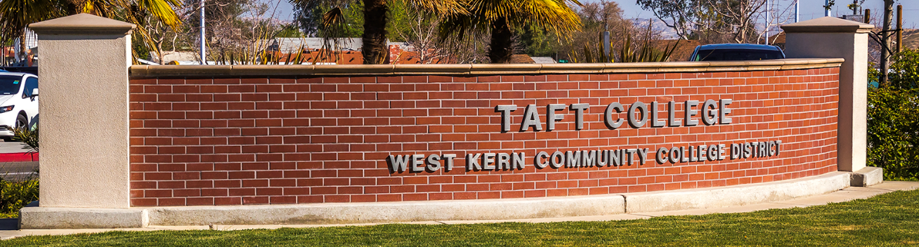
ABOUT US
Taft Junior College was established on August 30, 1922 as part of the Taft Union High School District, sharing a campus with the high school. The school title officially became Taft College on July 1, 1954, and in September of 1956 a separate campus opened in the current location at 29 Cougar Court adjacent to the high school. The West Kern Community College District was later formed, and is a single-college-district under the guidance of a five-member Board of Trustees. With strong leadership, Taft College offers a robust academic program for its students, and is one of the finest small colleges around!
POSITION DESCRIPTION
Taft College is seeking a pool of qualified candidates with demonstrated instructional skills to join an outstanding team of faculty and staff to provide high quality programs and services for our students. Teaching assignments may be temporary, part-time and/or on-call and may be immediate or as needed (as specified in Education Code 8748.25). We are seeking lecturers who have the ability to teach in the above area for inclusion in a pool for the 2019 spring semester. The 2019 spring semester begins on Tuesday, January 22, 2019 and concludes on Thursday, May 23, 2019.
Create Your Future With Us

Slide 3
QUALIFICATIONS
MINIMUM QUALIFICATIONS
The minimum qualifications for this adjunct lecturer pool can be met in one of four ways:
Master’s in business, business management, business administration, accountancy, finance, marketing or business education;
Bachelor’s in any of the above and master’s in economics, personnel management, public administration, or JD or LL.B degree;
Bachelor’s in economics with a business emphasis and Master’s in personnel management, public administration, or JD or LL.B degree.
An Equivalency Determination may be submitted along with all application materials to be considered for this position if you do not meet the stated minimum qualifications. The Equivalency Determination document may be found here or on the Taft College Human Resources website
Demonstrated sensitivity to and understanding of the diverse academic, socioeconomic, cultural, disability and ethnic backgrounds of community college students.
COMPENSATION
$60.11-$70.63 per hour.
EQUAL EMPLOYMENT OPPORTUNITY
The West Kern Community College District is committed to the principles of equal employment opportunity . The District is dedicated to a policy of nondiscrimination and, as such, is an equal opportunity employer. Veterans, women, minorities and people with disabilities are encouraged to apply.
Create Your Future With Us

Slide 4
APPLICATION PROCESS
Applications will be accepted until November 30, 2018.
Required Materials for Application:
Completed Academic Application- Downloaded from TC website or completed online at EdJOIN.
Letter of Introduction describing how you match the minimum and desired qualifications.
A current Resume
Complete transcripts of all college/university coursework (unofficial is acceptable).
Submit Application Materials to:
Email: tcjobs@taftcollege.edu
Complete online at EdJOIN
Mail or Walk-In: Taft College Human Resources, 29 Cougar Court, Taft, CA 93268
For More Information:
Please visit: http://www.taftcollege.edu/human-resources/job_opportunities/
Call: 661-763-7900
Email- tcjobs@taftcollege.edu
Create Your Future With Us

