Slide 1
Financial
$
$
$
Budget Management
Tips & Tricks to help keep your budget blooming!
$
$
$
$
$
$

Slide 2
Topics
$
$
$
$
$
Items to Watch
Types of Reports
Budget Maintenance
Scenarios!
Approval Check Points

Slide 3
Watch Items
What do you look for when reviewing your budget?
Payroll
Expenses
Encumbrances
Revenue
Will payroll budget cover costs for entire year?
Are there any personnel missing or any that shouldn’t be on the report?
Are expenses that posted charged to the right account?
Is there enough budget to cover costs?
Are all expected purchases showing as an encumbrance?
Are there any encumbrances that should have posted?
If you manage funds with expected revenues, is the revenue budget reflected correctly?
Do expense budgets match revenue budgets?
Did you receive the revenue expected?
$
$
$
$
$
$
$
A
B
C
D

Slide 4
Types of Reports
There are many ways to review your budget:
COGNOS Monthly Statement Reports
$
BANNER 9: FGIBDST (Organization Budget Status)
$
$
BANNER 9: FGRODTA (Organization Detail Activity Report)
BANNER 9: FGITRND (Detailed Transaction Activity)
Banner Self Service
Spreadsheets

Slide 5
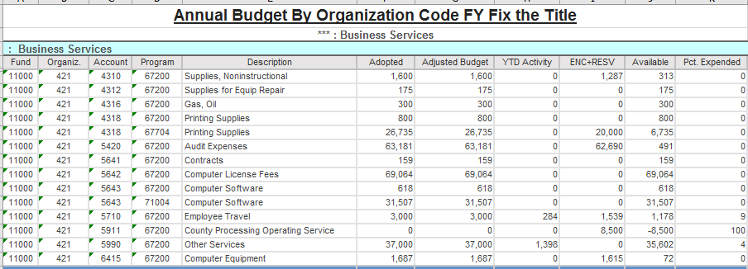
Cognos Monthly Statement

Slide 6
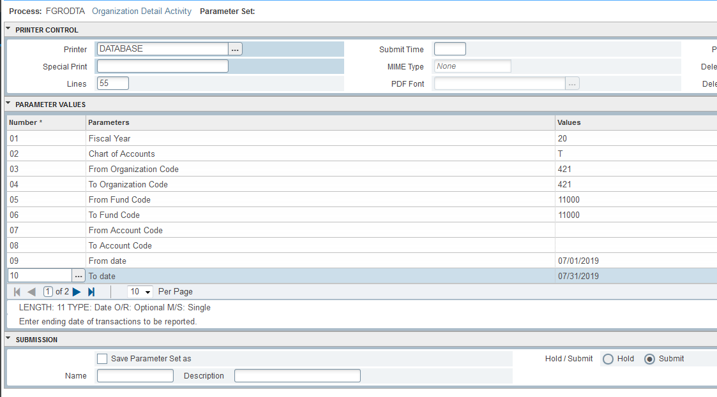
BANNER 9 - FGRODTA

Slide 7
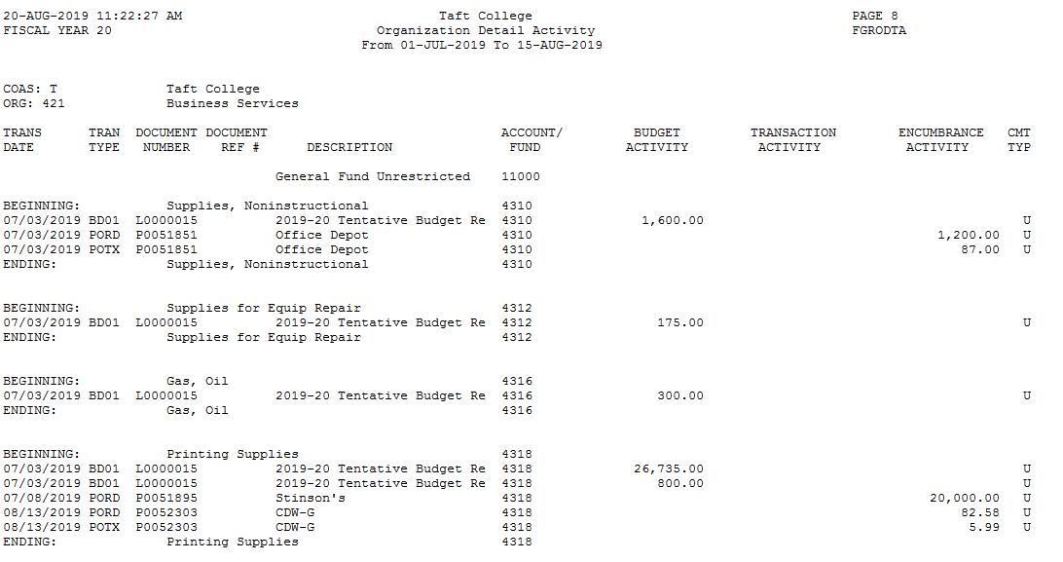
BANNER 9 - FGRODTA

Slide 8
BANNER 9 - FGIBDST

Slide 9
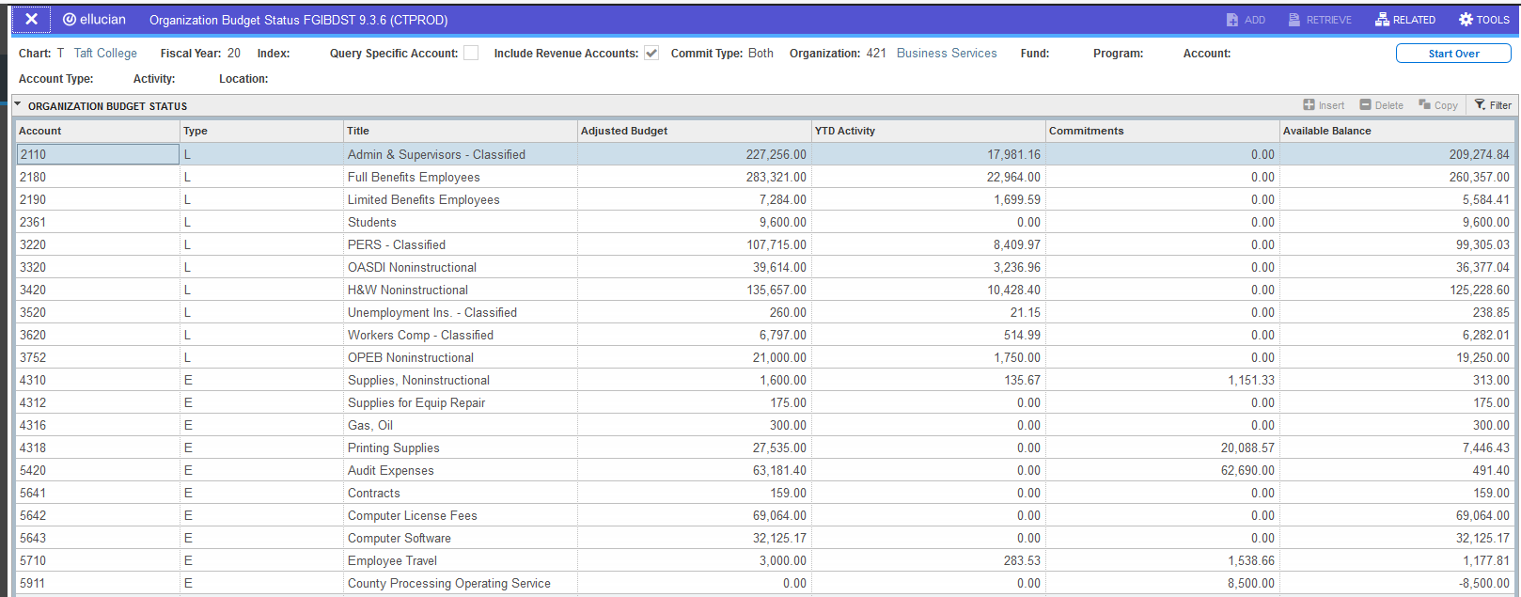
BANNER 9 - FGIBDST

Slide 10
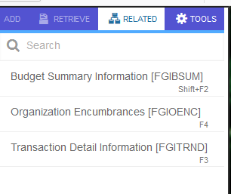
BANNER 9 - FGIBDST

Slide 11
BANNER 9 - FGITRND

Slide 12
BANNER 9 - FGITRND

Slide 13
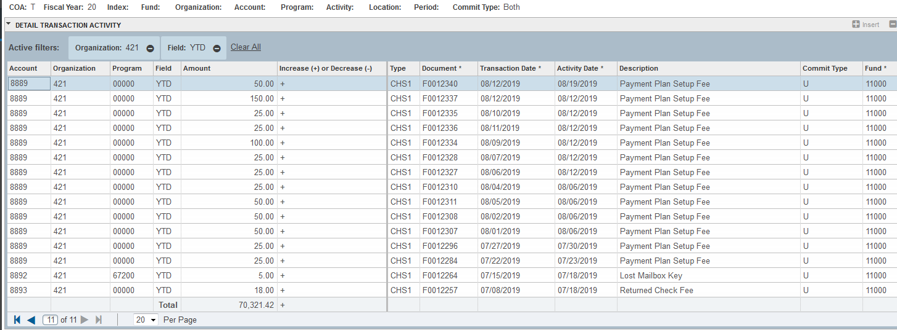
BANNER 9 - FGITRND

Slide 14
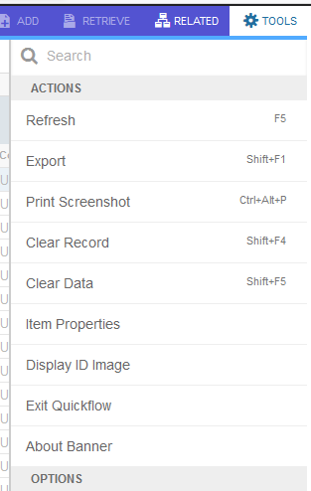
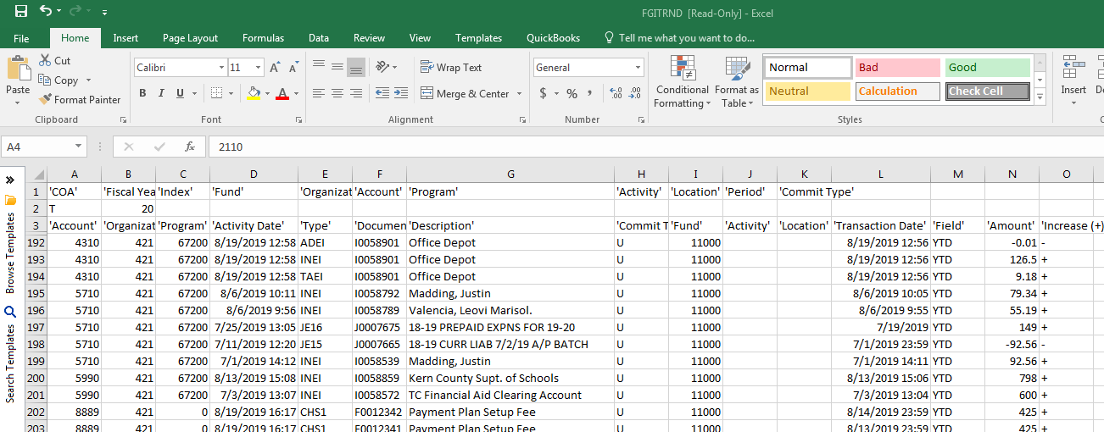
BANNER 9 - FGITRND

Slide 15
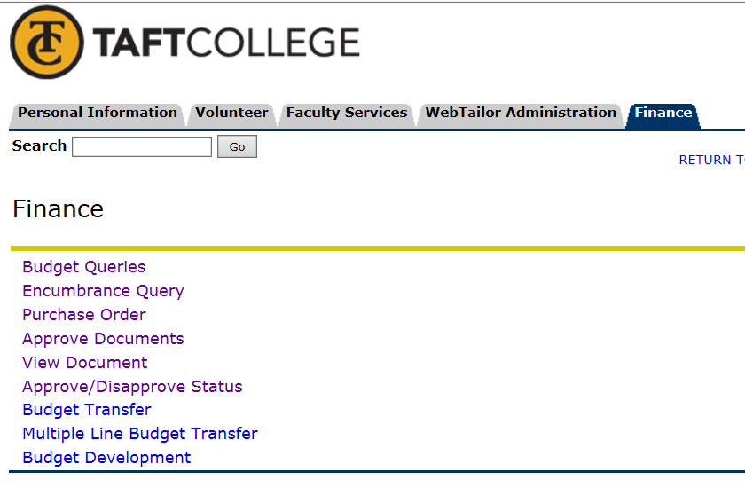
BANNER 9 – Self Service

Slide 16
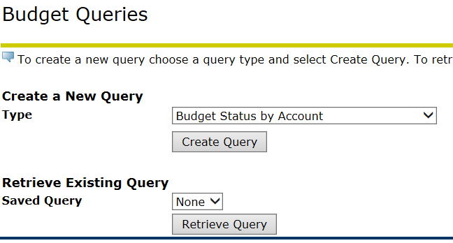
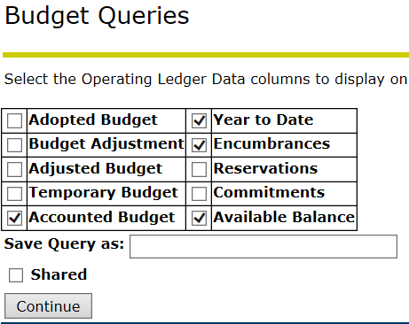
BANNER 9 – Self Service

Slide 17
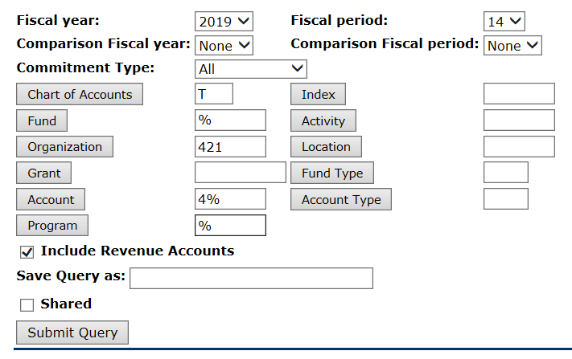
BANNER 9 – Self Service
Fiscal Period 14 will pull up July 1st – Current Date Data
%
Wild Card

Slide 18
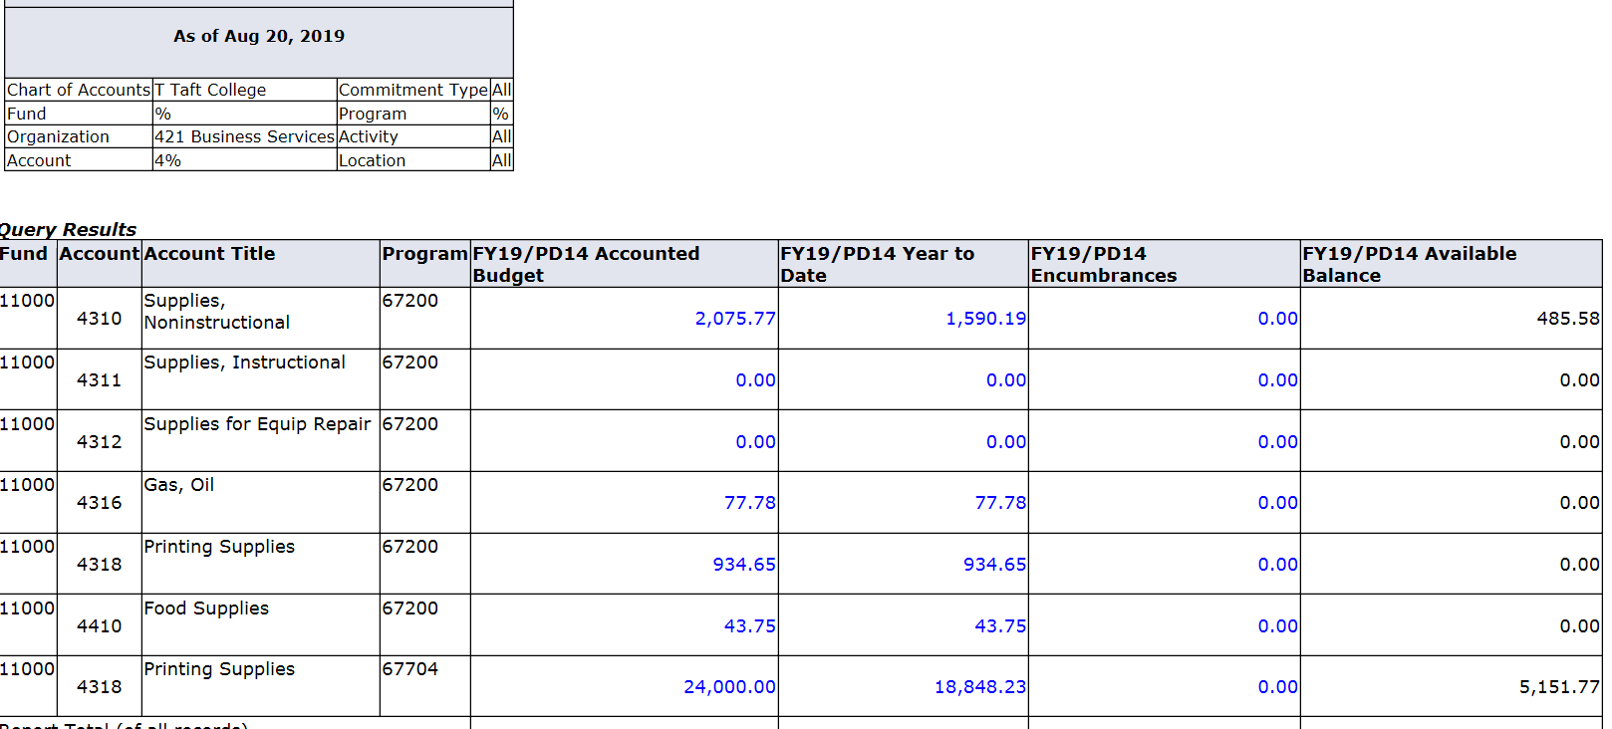
BANNER 9 – Self Service

Slide 19
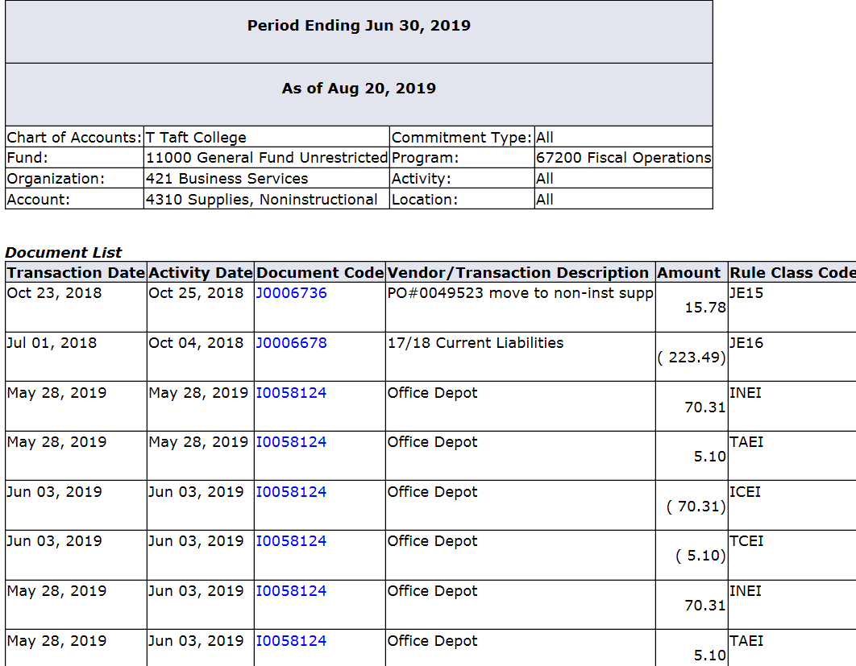
BANNER 9 – Self Service

Slide 20
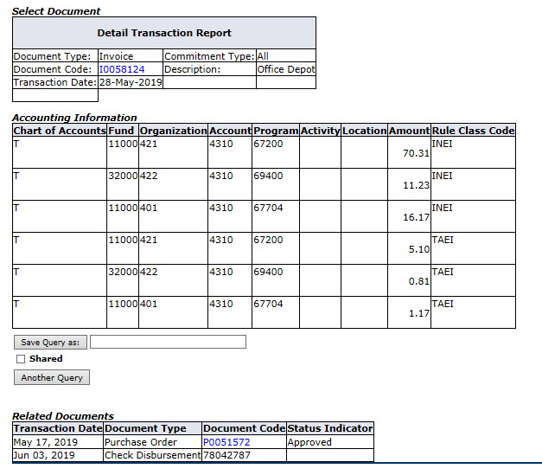
BANNER 9 – Self Service

Slide 21
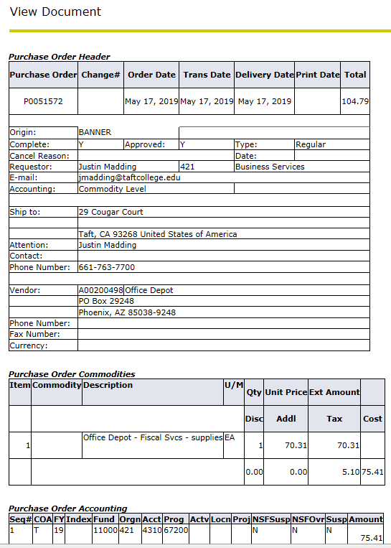
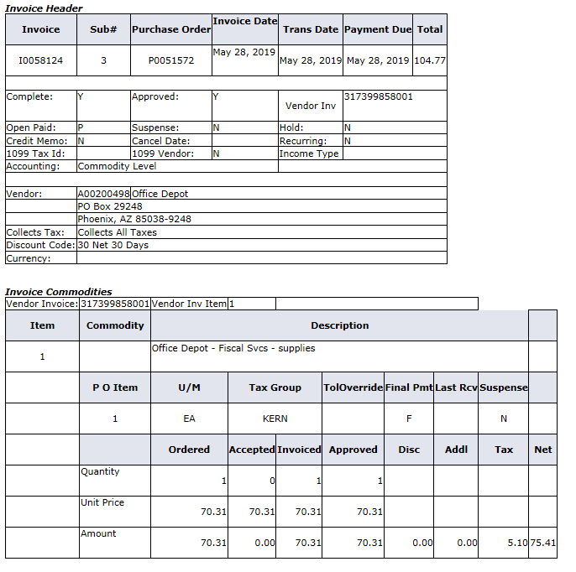
BANNER 9 – Self Service

Slide 22
Budget Maintenance
Every garden needs some TLC at times. Same goes for your budgets.
$
$
$
If expenses are posted to the wrong account, a journal entry will be needed
If the budget will not cover costs, a budget transfer will need to be
If you have payroll accounts, it is recommended to review transaction monthly & update HR, Payroll & Business Office is issues

Slide 23
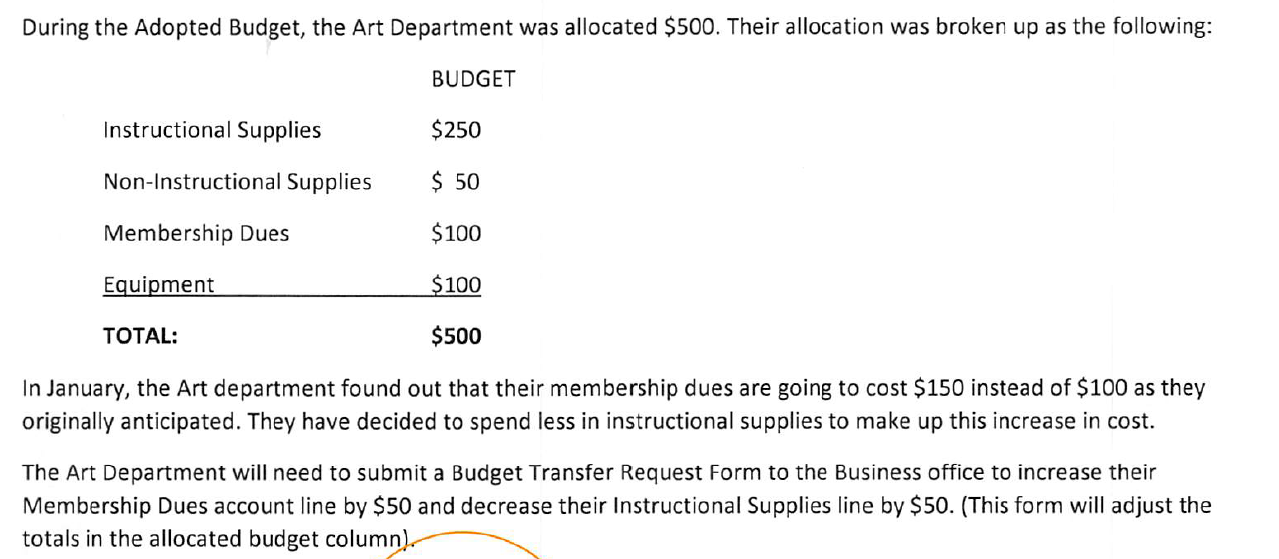
Budget Transfer Scenario

Slide 24
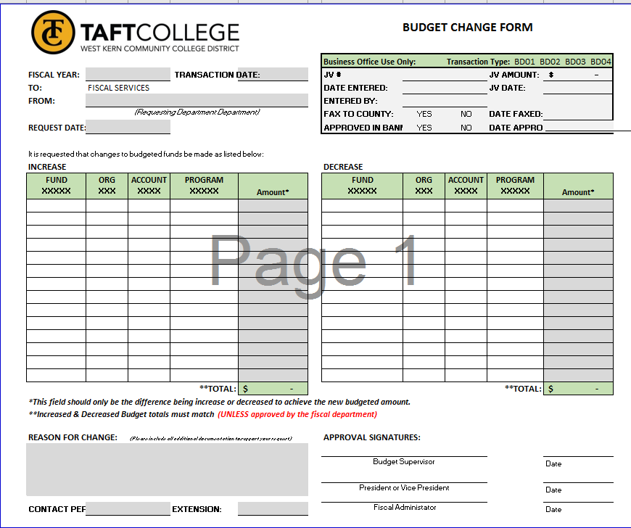
Budget Transfers

Slide 25
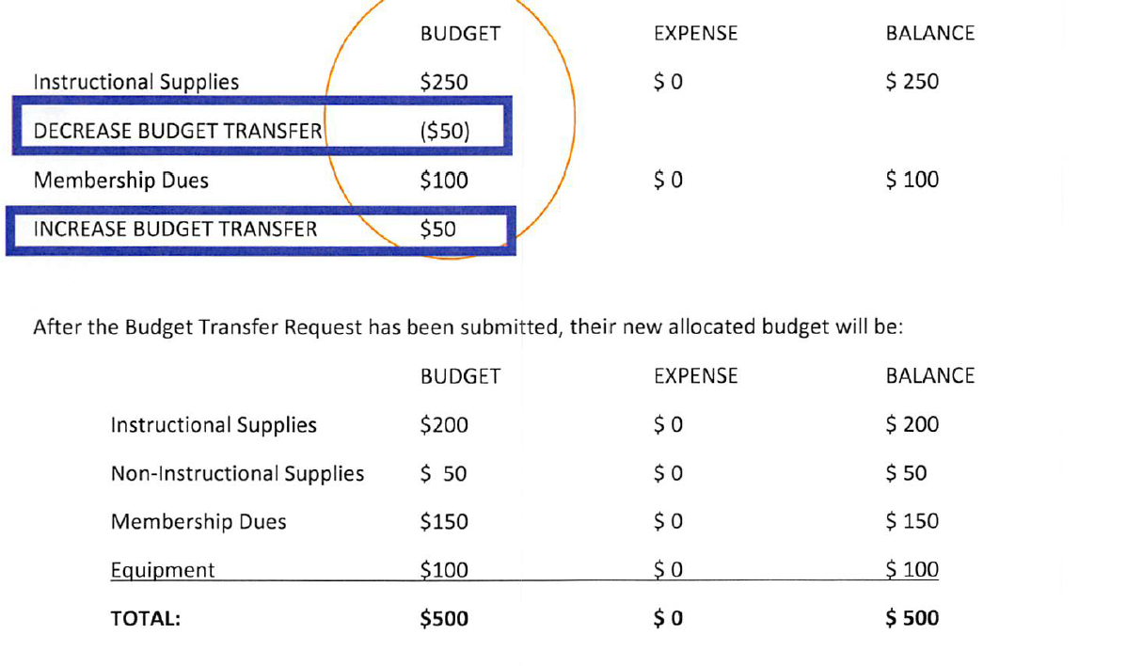
Budget Transfer Scenario

Slide 26
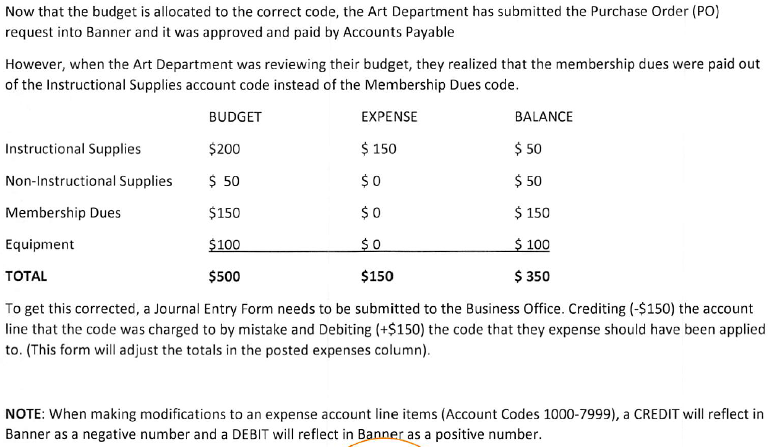
Journal Entry Scenario

Slide 27
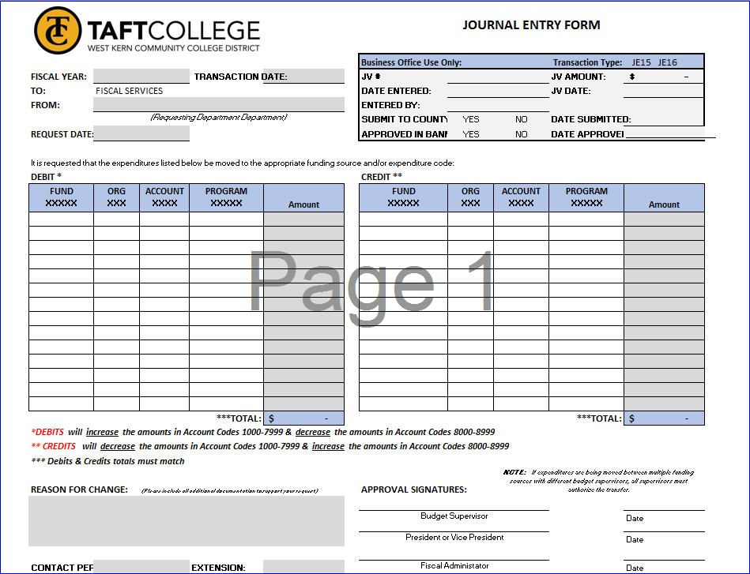
Journal Entry

Slide 28
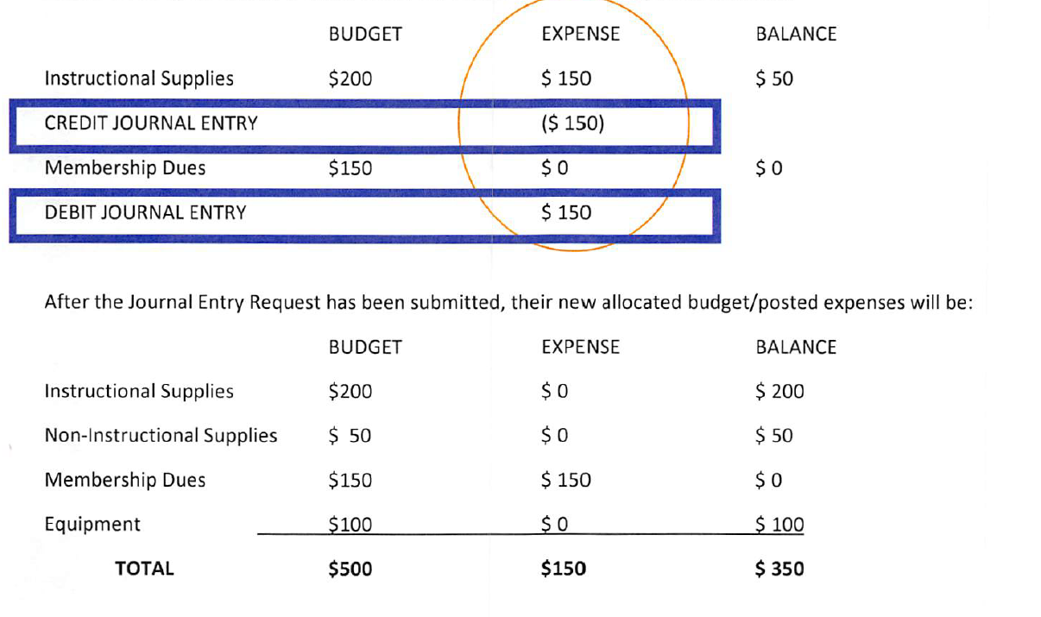
Journal Entry Scenario

Slide 29
Approval Queues
budget?
100%
Approvals must be reviewed daily.
enough
80%
Review budget account #:
Is it the correct number?
Is there enough budget?
60%
there
Is
40%
Review type of purchase:
Does it need to go to the board?
Is there a contract?
Does it require multiple quotes or bids?
Monitor purchase request through the encumbrance queue of your budget & ensure invoice information is being handled in a timely manner.
$

Slide 30
Summary
$
$
Budgets can seem scary at first but with some TLC your budget will continue to bloom!
$
$
$
$
$
$
Proactive
$
Review!
$
Be proactive in budget management.
The longer you wait to review your budget, the harder the process will be.
A
Verify at time of PO entry & PO Approval.
Run reports monthly
C
B
Review time cards & personnel postings monthly.
Resolve issues immediately.
D

