Slide 1
Budget Management Training
Under utilized banner tools & pivot tables

Slide 2
Today’s Agenda
Types of Reports
How to run reports
Excel Pivot Tables

Slide 3
Different Ways to View Your Budget
Software | Report Name | Banner Code | Type of Report
Banner 9 Admin Pages | Organization Detail Activity | FGRODTA | Report
Banner 9 Admin Pages | Organization Budget Status | FGIBDST | Query
Banner 9 Admin Pages | Detail Transaction Activity | FGITRND | Query / Raw Data
Self Service Banner (SSB) | Budget Queries | Budget Status by Account | Query
Cognos | Org Level All Expenditures |  | Report

Slide 4
Monthly Cognos Report

Slide 5
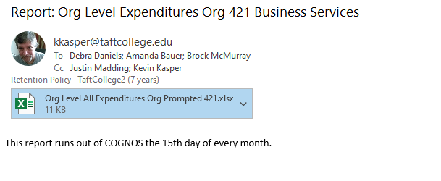
Monthly Cognos Report

Slide 6
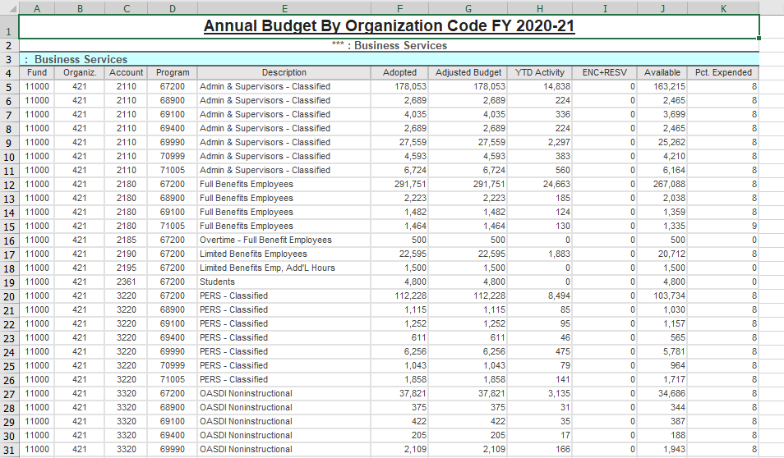
Monthly Cognos Report
Monthly Cognos Report

Slide 7
FGRODTA Organization Detail Activity

Slide 8
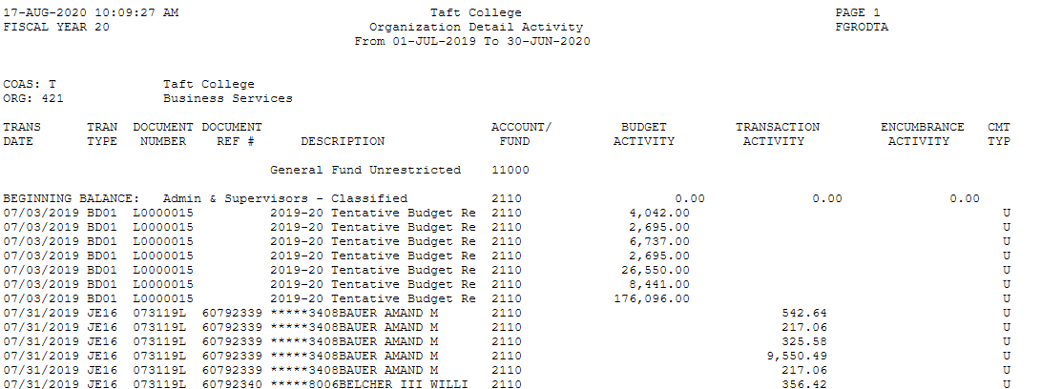
FGRODTA - Organization Detail Activity

Slide 9
FGRODTA - Organization Detail Activity *Parameters*

Slide 10
FGIBDST Organization Budget Status

Slide 11
FGIBDST - Organization Budget Status

Slide 12
FGIBDST - Organization Budget Status *Parameters*

Slide 13
Banner Self Service Budget Status by Account

Slide 14
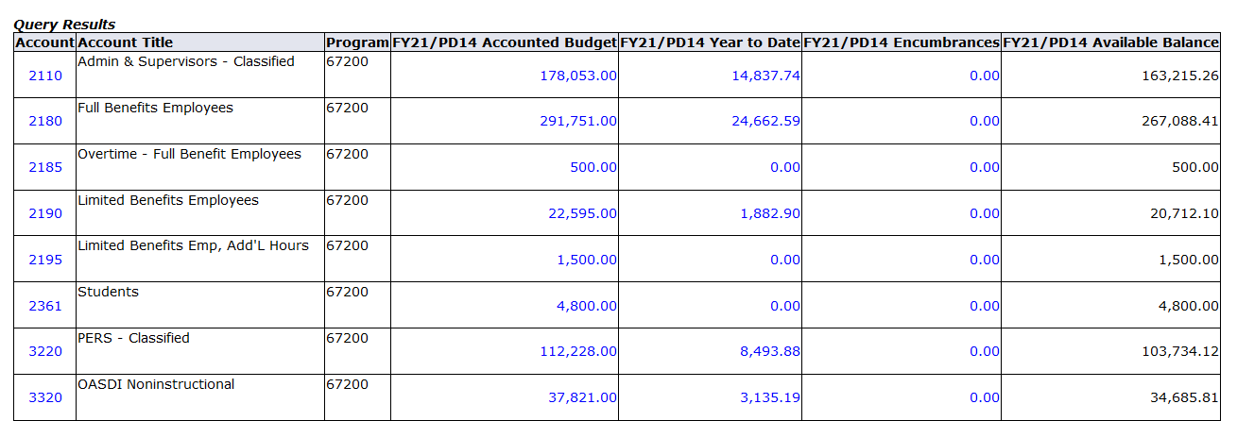
Banner Self Service – Budget Status by Account

Slide 15
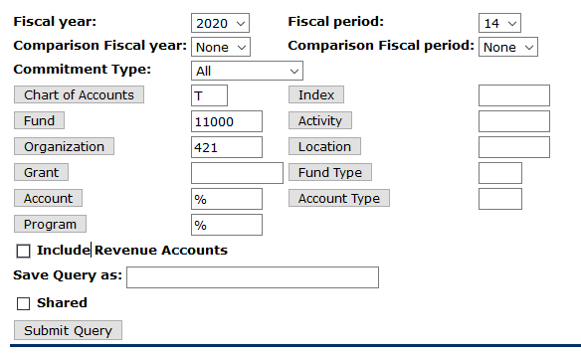
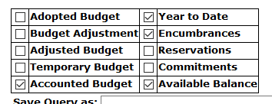
Banner Self Service – Budget Status by Account *Parameters*

Slide 16
FGITRND Detail Transaction Activity

Slide 17
FGITRND - Detail Transaction Activity

Slide 18
FGITRND - Detail Transaction Activity *Parameters*

Slide 19
EXCEL PIVOT TABLES
Learn the magic of pivoting!

Slide 20
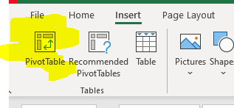
Click Pivot Table Shortcut to get started!

