Slide 1
Purchase Order Training
Self Service tools

Slide 2
Today’s Agenda
How to access Banner Self Service (SSB)
Creating a PO in Self Service
Tracking purchase orders pending approval
Revising a purchase order not yet approved
Tracking approved/active purchase orders in SSB

Slide 3
Access Banner Self Service
Access via TaftCollege.edu webpage
Anywhere you have internet access

Slide 4
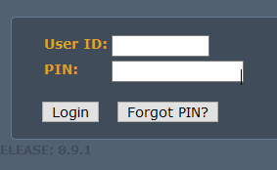
How to Log in
User ID: A#
PIN: Birthday (mmddyy)aftCo
Once reset, can only be a numeric passcode.llege.edu webpage
Anywhere you have internet access

Slide 5
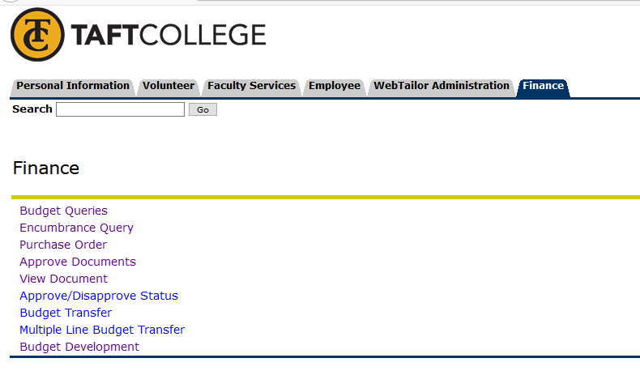
Navigating Self Service
Live Demo

