Slide 1
Taft College Advanced ISER January 25, 2020
Gohar Momjian
Vice President, ACCJC

Slide 2
Greetings! A continued conversation…
Introductions – who’s in the house
Purpose of conversation today:
ACCJC Refresher
What’s new
Questions
Working time

Slide 3
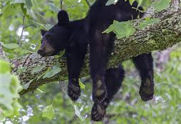
Why Accredit?
Power of Peer Review
It’s Your Story
A documentary
Accreditation: why bother?
Notes:
Quality Assurance
Recognition for transfer
Gatekeepers to Federal Financial Aid (Title IV)
Reflection, institutional improvement, standards basis of review

Slide 4
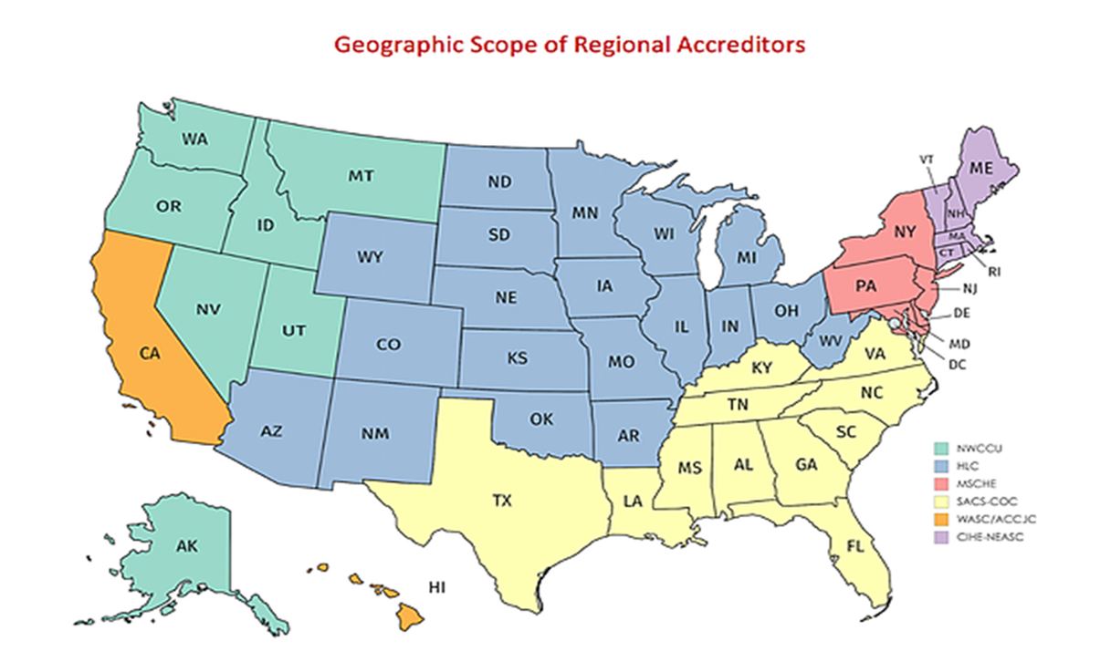
Accreditation 101
Regional Accreditor
6 Regions, 7 Accreditors
Notes:
Unique to U.S.
Uses academic inquiry to inform effective practices for improvement
-six geographic regions recognized USDE – regional accrediation.
-134 institutions in our region, 114 CA cc, more than 2.1 million students, private, non-profit/for profit, Islands

Slide 5
Notes:
Standards applied in several contexts and unique missions, also private

Slide 6
Our Purpose
Mission: The Accrediting Commission for Community and Junior Colleges supports its member institutions to advance educational quality and student learning and achievement. This collaboration fosters institutional excellence and continuous improvement through innovation, self-analysis, peer review, and application of standards.
ACCJC Core Values: Integrity; Quality Assurance; Institutional Improvement; Peer Review; Student Learning and Achievement; Collegiality
Strategic Plan & Goals
Notes:
Our own ongoing process of improvement, leading to meaningful change
Key Strategies
Strategy 1: Communicate and collaborate to advance the mission of ACCJC
Strategy 2: Foster institutional innovation
Strategy 3: Lead advocacy efforts on accreditation
Primary Objectives
Objective 1: Support institutional efforts to increase student achievement
Objective 2: Refine the comprehensive review process
Objective 3: Develop a new accreditation standards framework
Objective 4: Nurture ongoing collaborations and expand partnerships
Objective 5: Strengthen ACCJC infrastructure and capacity
Objective 6: Increase opportunities for two-way communication with member institutions

Slide 7
ACCJC: More Effective, More Responsive
ACCJC New Directions
Vice Presidents Portfolio Model
Improved Trainings and Resources
Lightening the burden on members
Annual report and annual fiscal report
Midterm report
Formative/summative approach
Standards Review (upcoming)
Notes:
More reliance on education, less on sanctions to effect change

Slide 8
Overview: Accreditation Process
Self-Reflection. . . the ISER
Peer Review. . . the Visit
Affirmation. . . the Commission’s Action
On-going Commitment to Improvement and Educational Excellence
Notes:
Institutional Self Evaluation (internal)
Institutional Self Evaluation Report (ISER)
Peer Review Team (a.k.a. the Visiting Team)
Commission Review and Action
Recommendations (for improvement or for compliance)
Commendations
Action levels

Slide 9
Where is Taft in process?
ISER Training – January 2019
Advanced ISER Training – January 2020
ACCJC and your CEO select a date for the visit – Fall 2020
ACCJC staff recruit your Peer Review Team (peers) – Spring 2021
You send the report and evidence to the Team on USB – August 2021
The Team attends training and begins review process – September 2021
The VISIT! - October 2021
The Team completes its “External Evaluation Report.” – Oct. 2021
Your CEO checks for errors of fact – November 2021
The Commission (peers) reviews everything and takes action. –January 2022
Notes:
2019-2020 Taft College hard at work, serving students, gathering evidence, reflecting, writing…

Slide 10
Accreditation Standards
Focus on effectiveness of the institution as a whole in meeting its mission
Adequacy of resources to support student learning
Processes of leadership, governance, and decision-making to adapt the institution to meet a changing future

Slide 11
The Standards
Standard I: Mission, Academic Quality and Institutional Effectiveness, and Integrity
Mission (4)
Assuring Academic Quality and Institutional Effectiveness (9)
Institutional Integrity (14)
Standard II: Student Learning Programs and Support Services
Instructional Programs (16)
Library and Learning Support Services (4)
Student Support Services (8)
Notes:
Gohar -- Focus on effectiveness of the institution in meeting its mission, the adequacy of resources, and the processes of leadership, governance, and decision-making to adapt the institution to meet a changing future. (Manual for Institutional Self Evaluation, p. 11)

Slide 12
The Standards
Standard III: Resources
Human Resources (15)
Physical Resources (4)
Technology Resources (5)
Financial Resources (16)
Standard IV: Leadership and Governance
Decision-Making Roles and Processes (7)
Chief Executive Officer (6)
Governing Board (13)
Multi-College Districts or Systems (7)
Notes:
Gohar – remind that there are 127, how dealing with issue of equally weighted even though not equal in complexity, alignment of standard comes into play again

Slide 13
Institutional Self Evaluation Report: ISER You’ve Got This!
Started w/standards and evidence
ISER addresses the standards
Evidence supports claim that you meet the standards
When gaps identified, improvement processes begun
College understands own processes
Notes:
Are we sufficiently responding to the standards?
Are we focused on the standards?
Does our evidence tell the story?
Too much or too little
Have we reflected, analyzed, and demonstrated our strengths in alignment to standards, exceeding of standards, and areas of improvement?
Do we have actions in place to address areas of improvement?
Does our community understand the institutional processes described in the ISER?
Are we on target with our deadlines, time for discussion, governance review, board review?

Slide 14
Quality Focus Essay – Proposed Projects
Improvement component
Connect to student learning and achievement
What doing to move the needle?
Long-term projects with clear demarcation line
Peer Review team provides constructive feedback
Report on QFE projects in Mid-term report (4 years out from start)
Notes:
gohar

Slide 15
Expectations of Peer Reviewers
Excerpted from Team Training ppt Fall 2019
Seek to understand
Seeking to understand starts with the ISER
Practice appreciative inquiry on site
Alignment with standards rather than hunting for deficiencies
Validation and affirmation
Goal: educational quality and institutional improvement
Your outcome: the team report. . . reflection of your team and ACCJC

Slide 16
Professional Judgement of the Team
Excerpted from Team Training ppt Fall 2019
The team must make a determination whether the standard is met or not met
Different “levels” of evaluation and feedback
Compliance and improvement: recommendations
Team suggestions
Exceeding the standards: commendations
Team recognition

Slide 17
Reviewing the College and ACCJC Core Values
Excerpted from Team Training ppt Fall 2019
Peer: collegial, co-equal, collaborative, cordial
Appreciative inquiry:
trust their expertise
lead with assumptions of success
apply your expertise in search of best practices
identify alignment with Standards
identify areas for improvement or compliance
Triangulate consistency of information
Trust. Respect. Appreciate.

Slide 18
Thoughts and Remaining Questions??

