Slide 1

Welcome Back!

Slide 2
Thank You to all for In-Service Week
Introduction of new employees

Slide 3

Instructional Updates
Vice President of Instruction

Slide 4
What’s new? Transitions
New Academic Senate president:
Sharyn Eveland
New SLO coordinator:
Jo’ell Chaidez
Newly tenured:
Chris Flachmann
Abbas Jarrahian
Tina Mendoza
Debora Rodenhauser

Slide 5
What’s new? Students!
 | 2014-15 | 2015-16 | 2016-17 | 2017-18 | 2018-19 | 2019-20
Summer ('30) | 250 | 312 | 322 | 290 | 336 | 347
Fall | 1071 | 1052 | 1118 | 1197 | 1222 | 1237
Spring ('20) | 972 | 992 | 1029 | 1093 | 1078
 | 2292 | 2355 | 2469 | 2580 | 2636 | 1584 | 0
2014-15 | 2015-16 | 2016-17 | 2017-18 | 2018-19 | 2019-20
2081 | 2501 | 2566 | 2541 | 2821 | 2901
8569 | 8171 | 8668 | 9385 | 9394 | 10553
7571 | 7651 | 8018 | 8387 | 8383
18221 | 18323 | 19252 | 20313 | 20598 | 13454 | 0

Slide 6
What’s new? Curriculum!
Courses approved:
ENGL 1501 Enhanced Composition and Reading
HIST 2212 World Civilization since 1500
HIST 2000 Critical Thinking and the Historian’s Craft
MGMT 1565 Professionalism and Etiquette
MGMT 1570 Diversity at Work
ENER 2900 Energy Technology Capstone
EDUC 1520 Introduction to Elementary Education

Slide 7
What’s new? Curriculum!
More courses approved:
MATH 1510 College Algebra for Liberal Arts
BIOL 2258 Human Anatomy and Physiology
BIOL 2259 Human Anatomy and Physiology II
STSU 1525 Transfer Planning
STSU 1550 Funding a Transfer Plan
STSU 1530 Transitioning from High School to College
DS 1507 Introduction to supporting People with Disabilities

Slide 8
What’s new? Curriculum!
Courses approved for online delivery:
MGMT 1570 Diversity at Work
MGMT 2900 Management Capstone
MGMT 1565 Professionalism
ENER 2900 Energy Tech Capstone
MATH 1510 College Math, Lib Arts
ENGL 1650 Intro Literature
EDUC 1520 Introduction to Elementary Education
SPAN 2500 Latin Amer. Culture
STSU 1525 Transfer Planning
STSU 1530 Transitioning from High School to College
STSU 1550 Funding Transfer Plan
RECR 1510 Intro to Recreation and Leisure Service

Slide 9
What’s new? Curriculum!
New certificates:
CSU GE-Breadth – Certificate of Achievement
Intersegmental GE Transfer Curriculum (IGETC) - Certificate of Achievement
Program revisions:
Liberal Arts Area of Emphasis: Math and Science
Occupational Safety and Health (OSH) – Associate in Science

Slide 10
What’s new? Curriculum!
Course revisions, 5-year cycle:
38 in Math/Science
22 in Applied Tech
8 in Liberal Arts
8 in Social Science
5 in Learning Support
5 in English
Programs inactivated:
Information Management and Technology: Associate in Science
Information Management and Technology: Certificate of Achievement
Information Technology and Management: Certificate (Local)

Slide 11
What’s new? Curriculum
Distance learning updates:
3 classes are now fully aligned to the statewide CVC-OEI rubric: ENGL 1500, BUSN 1500, ECON 2120
18 courses are in the works to align
97 faculty members Canvas trained
14 fully online ADTs
Expanding online student resources: tutoring, student readiness modules, proctoring, and counseling
Courses inactivated:
7 in Applied Tech, IES
3 in Applied Tech, Business
4 in Applied Tech, Welding
2 in Math/Science, Engineering

Slide 12
What’s new? Learning Support!
Tutoring/Learning Center grows:
Embedded Tutoring - Successful pilot with PSYC 2200. (Learn more at Faculty Reports!)
Expansion into the PDC - The former Professional Development Center is now the Calculus Lab! Tutoring for trigonometry, all calculus, and differential equations is here.
The existing Math Lab - tutoring for stats and PSYC stats, Math 230-1060, 1500, 1520, 1505.
Library moves ahead:
New charging stations for devices
New printing process
650+ books added to the library collection
Watch for new library catalog service (statewide) in the next year

Slide 13
What’s new? SUMMER Camp!
STEM-CiTE summer camp for kids:
83 kids attended, elementary to high school (191 kids total since 2014)
Big enrollment increase since last year – 2 extra sessions added for elementary age
Activities: 3-D printing, solar power car building and racing, tie-dye, slime, and much more
Faculty participation – we appreciate your help and ideas!
(Note new name: STEM-CiTE, STEM + Careers in Technical Education, pronounced “Stem City”)

Slide 14
What’s new? FACULTY 0rientations!
Full time faculty orientations:
New full-time faculty this year: Participate in 1 or 2 meetings per month over the year, includes discussions, panels, and more
New faculty in the past 4 years: Invited to participate
Not new? You’re also welcome!
Adjunct faculty orientations:
New adjunct faculty this year: Participate in discussions, panels, and more; in hybrid format
Not new? You’re also welcome!

Slide 15
What’s new? Grants!
New and continuing grants for instructor development and student success:
CVC-OEI CTE (state) for instructors creating online curriculum
Perkins/VTEA (federal) to support vocational programs
CTE Transitions (state) to support career training
Strong Workforce (state) to support workforce preparation
Guided Pathways (state) to improve student success

Slide 16

Ready for Fall? Let’s Go Cougars!

Slide 17
STUDENT SERVICES UPDATE
Severo Balason, Jr.
Vice President of Student Services

Slide 18
STUDENT SERVICES
Guided Pathways Update
Guided Pathways Dashboard
CAPP - GPAP
Emergency Preparedness

Slide 19

STUDENT SERVICES
Guided Pathways Update

Slide 20
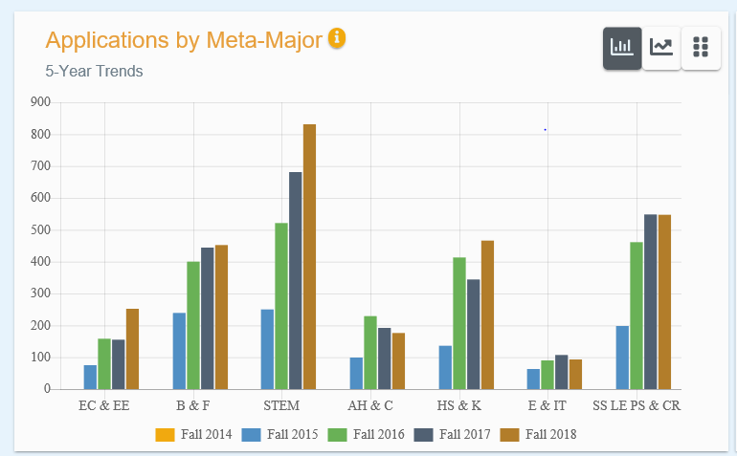
STUDENT SERVICES
Clarify the Path
https://dvknejbjwl2jp.cloudfront.net/clarify

Slide 21
STUDENT SERVICES
Clarify the Path
https://dvknejbjwl2jp.cloudfront.net/clarify
Applications by Age
Applications by Ethnicity
Applications by Gender
Applications by High School
Applications by City of Origin

Slide 22
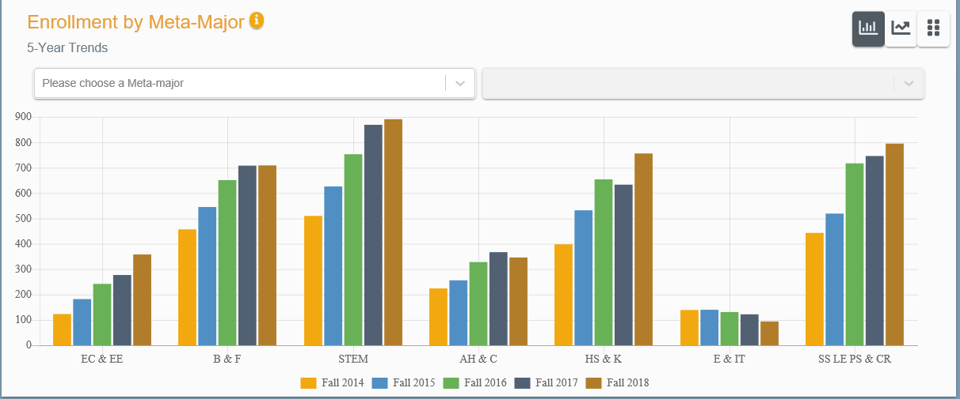
STUDENT SERVICES
Enter the Path
https://dvknejbjwl2jp.cloudfront.net/enter

Slide 23
STUDENT SERVICES
Enter the Path
https://dvknejbjwl2jp.cloudfront.net/enter
Enrollment by Age
Enrollment by Ethnicity
Enrollment by Gender

Slide 24
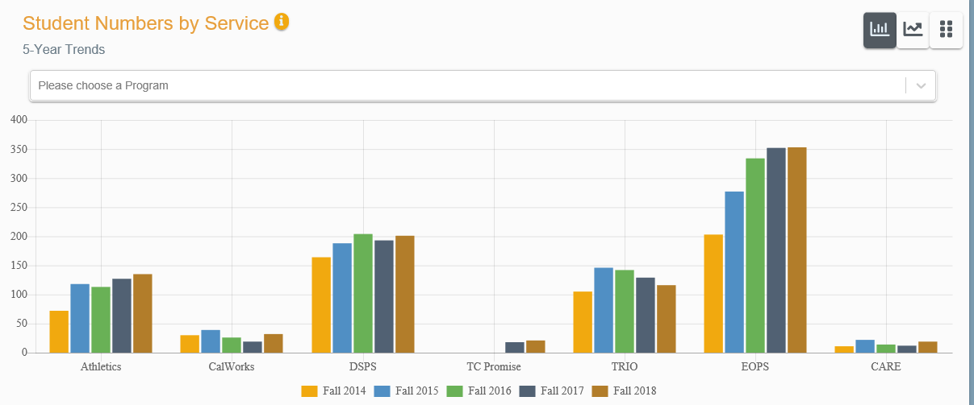
STUDENT SERVICES
Stay on the Path
https://dvknejbjwl2jp.cloudfront.net/stay

Slide 25
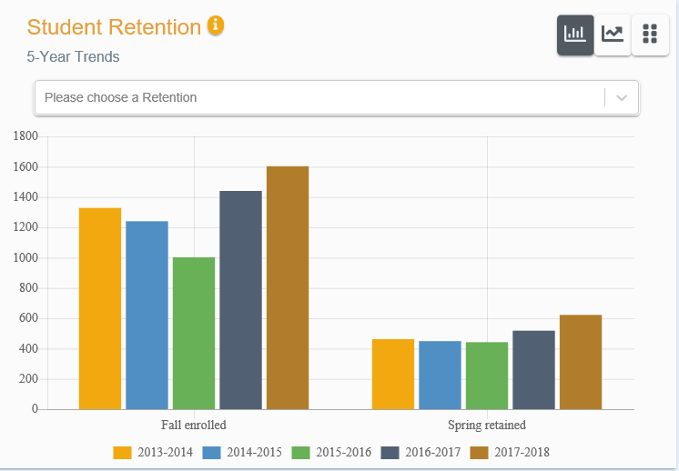
STUDENT SERVICES
Ensure Learning
https://dvknejbjwl2jp.cloudfront.net/ensure

Slide 26
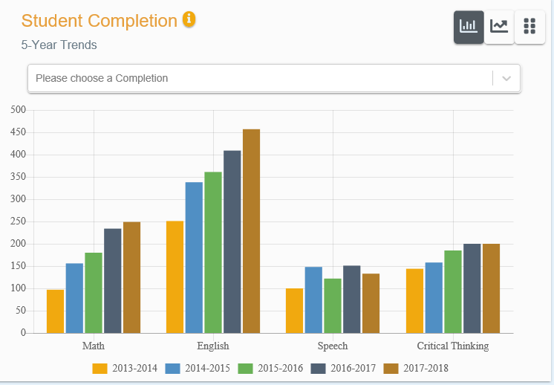
STUDENT SERVICES
Ensure Learning
https://dvknejbjwl2jp.cloudfront.net/ensure

Slide 27
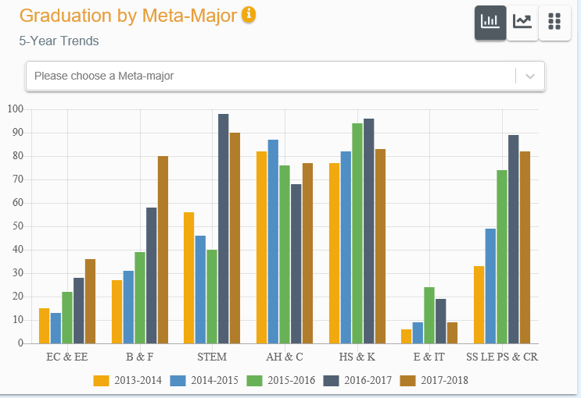
STUDENT SERVICES
Ensure Learning
https://dvknejbjwl2jp.cloudfront.net/ensure

Slide 28
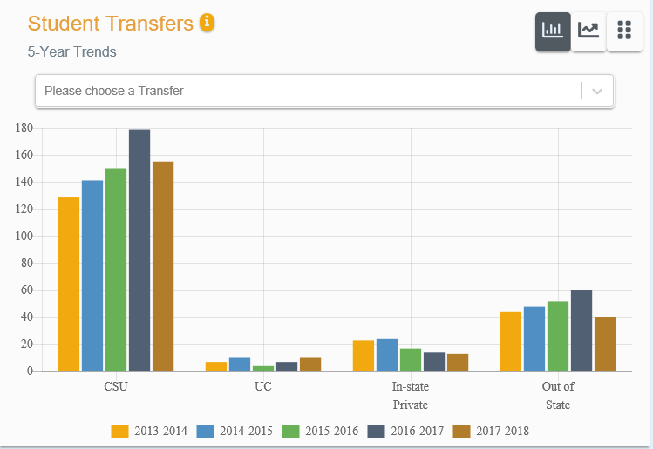
STUDENT SERVICES
Ensure Learning
https://dvknejbjwl2jp.cloudfront.net/ensure

Slide 29
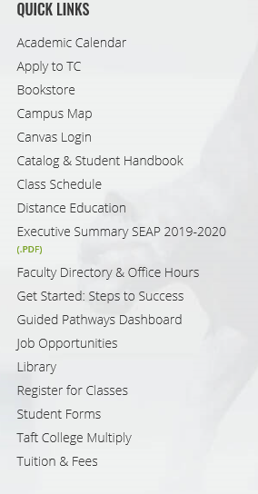
STUDENT SERVICES
GP Dashboard

Slide 30
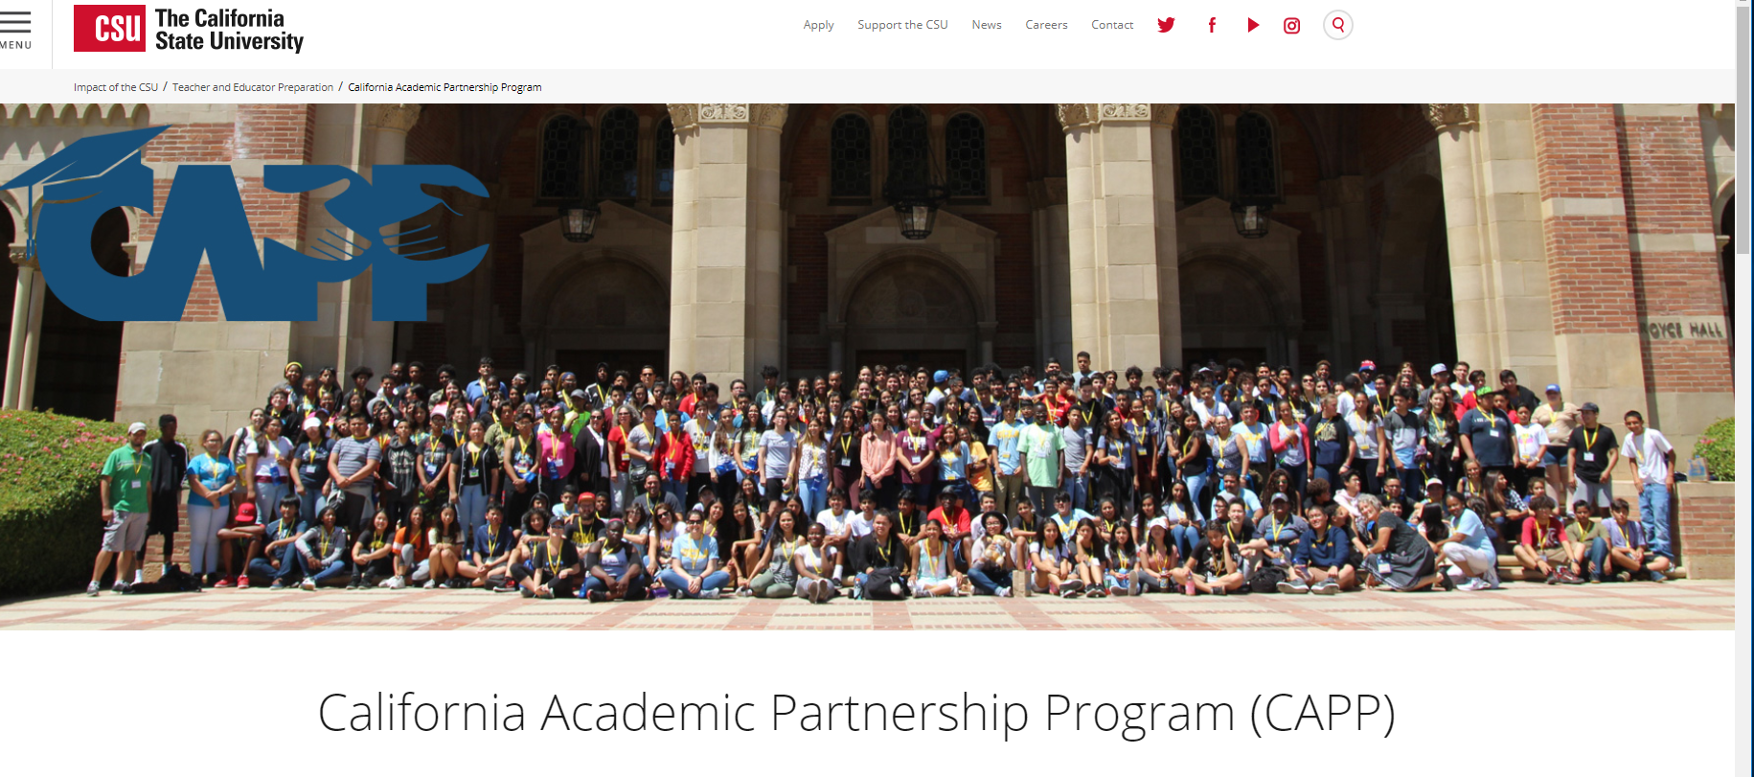
STUDENT SERVICES
CAPP - GPAP

Slide 31
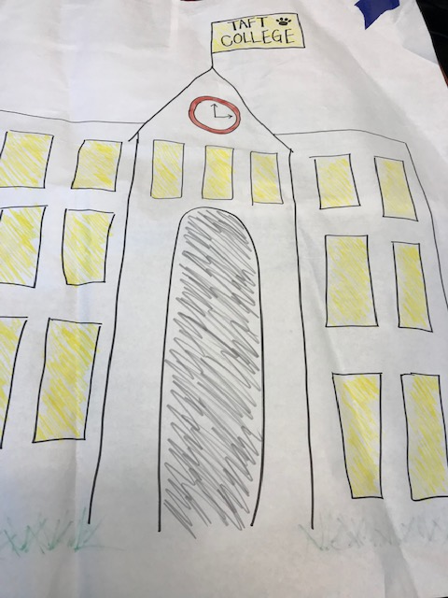
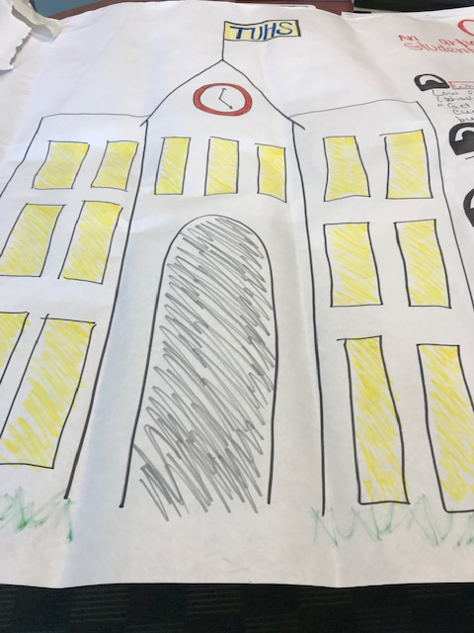
STUDENT SERVICES
CAPP - GPAP
Long Beach City, 2-day Convening

Slide 32
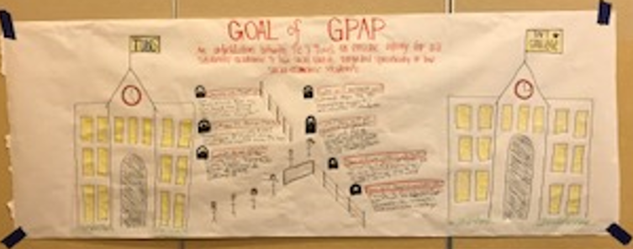
STUDENT SERVICES
California Academic Partnership Program

Slide 33
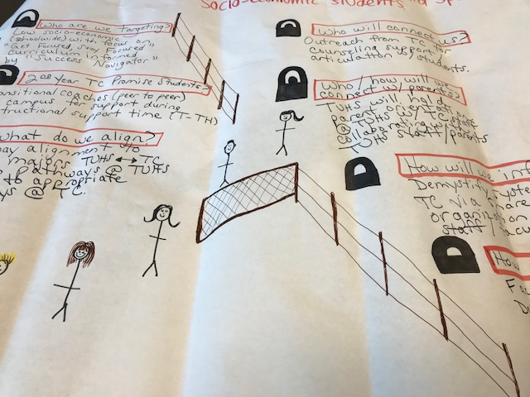
STUDENT SERVICES
CAPP - GPAP
Goal of GPAP
An articulation between TC & TUHS to ensure equity for all students’ academic and life skill needs targeted specifically to low socio-economic students.

Slide 34
STUDENT SERVICES
CAPP - GPAP
Who are we targeting?
Socio-economic (school-wide) with focus on “Get Focused, Stay Focused” curriculum informed by Success Navigator (170).
2nd Year TC Promise Students as transitional coaches on campus (peer to peer)
What do we align?
Pathway alignment to meta majors, TUHS has 11 pathways to align appropriate pathways at TC.
Who will connect us?
Outreach from TC for counseling support, articulation with students.

Slide 35
STUDENT SERVICES
CAPP - GPAP
Who/How will we connect with parents?
Parent orientation at TUHS with TC and TUHS collaboration.
How will we inform all staff?
TUHS and TC via shared personnel organizational charts
How will teams collaborate?
Faculty to faculty meetings, department to department meetings,
counselor to counselor meetings, and cross-curricular meetings

Slide 36
STUDENT SERVICES
CAPP - GPAP
Timeline 2019-2020
Summer 2019
Counselor Summit (TUHS & TC) 6/21/2019
Alignment of pathways –Dean of Student Success
Get Data-TUHS students @TC (Jacobi)
Fall 2019
Ongoing Get Focused, Stay Focused – Mary Alice Finn
TC Booth at BTSN – Parent outreach – 8/19/2019

Slide 37
STUDENT SERVICES
CAPP - GPAP
Timeline 2019-2020
September 2019 – English collaboration – English Department
Planning for TUHS outreach by grade level
-Review success navigator with students and get feedback
Sharing Organizational Charts
Spring 2020
Promise students start at TUHS as Transitional Coaches
Cougar Day – Student Services
Sophomore Success Navigator administration
Summer 2020
TC Tutors in Summer School - Vicki

Slide 38
STUDENT SERVICES
Campus Safety & Security
Updates on Emergency Preparedness
Active Shooter Presentation (Updated – 8/23/19)
Active Shooter Simulation (January 2020 – TBA)
AED units on different locations on campus
26 CPR/AED Certified TC Staff & Administrators

Slide 39
STUDENT SERVICES
Campus Safety & Security
Locations of AED Units
Administration Building 1st Floor
Administration Building 2nd Floor
Tech Arts
Ash Dorms
Cougar Dorms
ETEC Building

Slide 40
STUDENT SERVICES
Campus Safety & Security
Locations of AED Units
Maintenance & Operations
Welding Shop
Gym (2 units)
Dental Hygiene
CIL (2 units)
Children’s Center

Slide 41
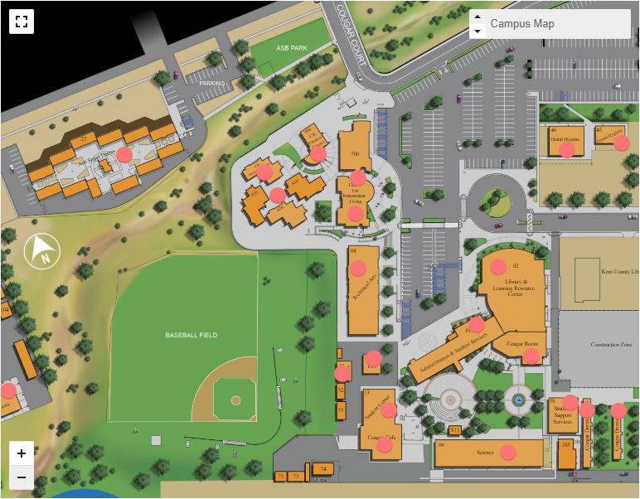
STUDENT SERVICES
Campus Safety & Security
Interactive Map
Campus Safety Website
  Annual Reports
  Daily Crime Log
  Lost & Found
  CSA Resources
  Emergency Alert Portal
  California Shake
  Campus Fire Drill

Slide 42
Vice president of human resources Heather del rosario

Slide 43
2019/20 Updates
Open Enrollment
Employee Self Service
Newton
Vision Resource Center

Slide 44

Open enrollment

Slide 45

Open Enrollment 2019-20
Runs August 1st – 27th
Passive Enrollment
No medical plan changes for the plan year
New dental plan option for Kern County residents
Elections made during OE will be effective October 1
Open Enrollment meetings are scheduled for August 23 at 9am and 10am. Please see the in-service schedule for location
Plan information and election forms are available on the HR website www.taftcollege.edu/human-resources and in the HR office

Slide 46
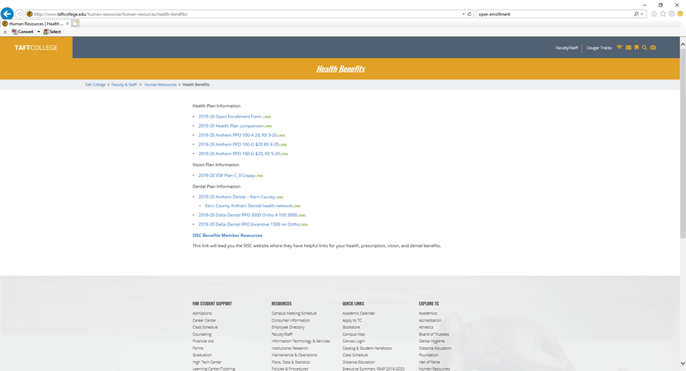
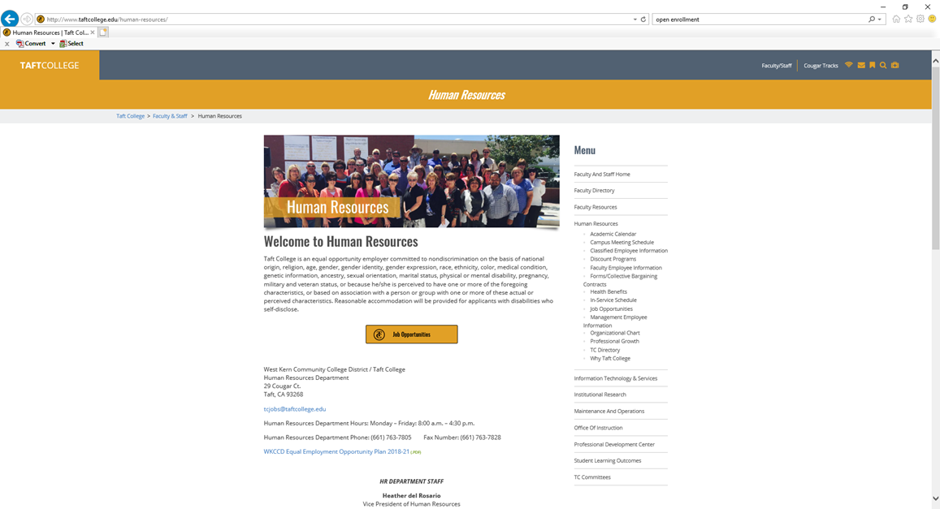

Slide 47
    Did you know you can….
View and update your personal information, including contact information, emergency contact and required medication.
View your pay history and print up to 5 years of check stubs.
Add or change your direct deposit.
Go Green! Elect to not receive hard copies of check stubs.
Print copies of W-2 and ACA tax forms.
Coming Soon – View your leave balances and transaction history.
Ready to register? Visit our website to download Employee Self Service Registration Instructions.

Slide 48
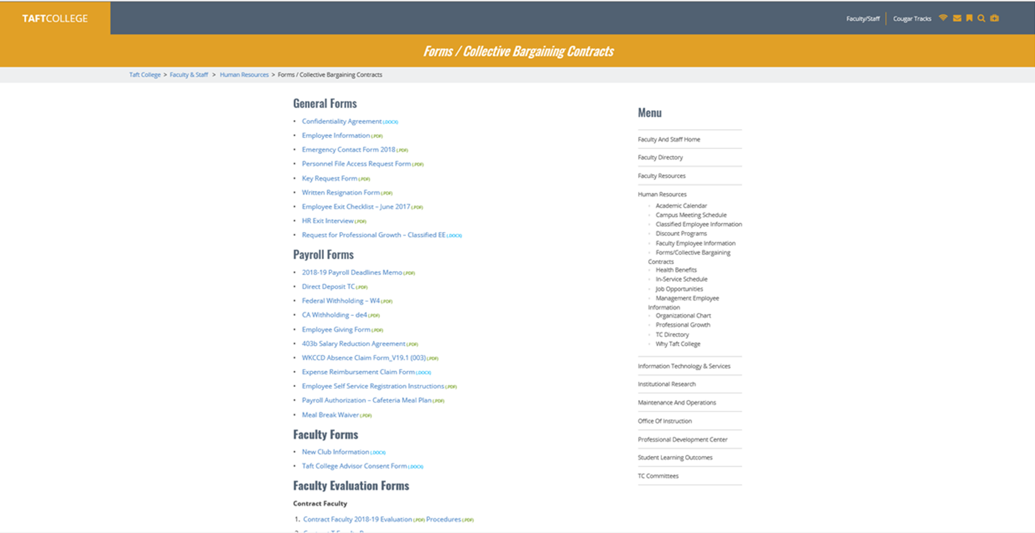


Slide 49
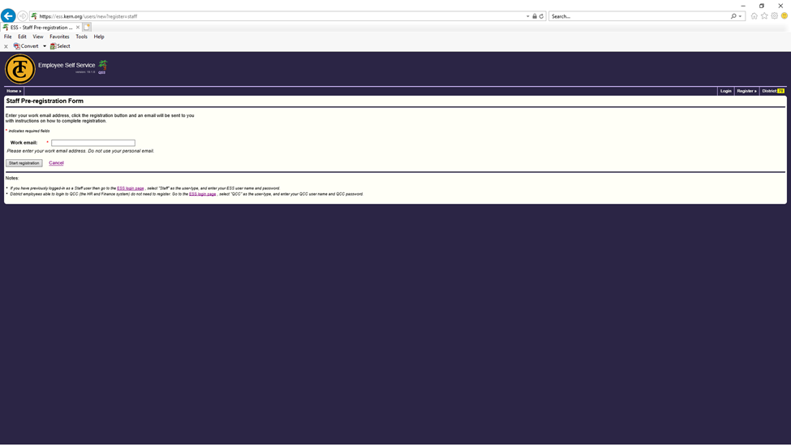

Slide 50
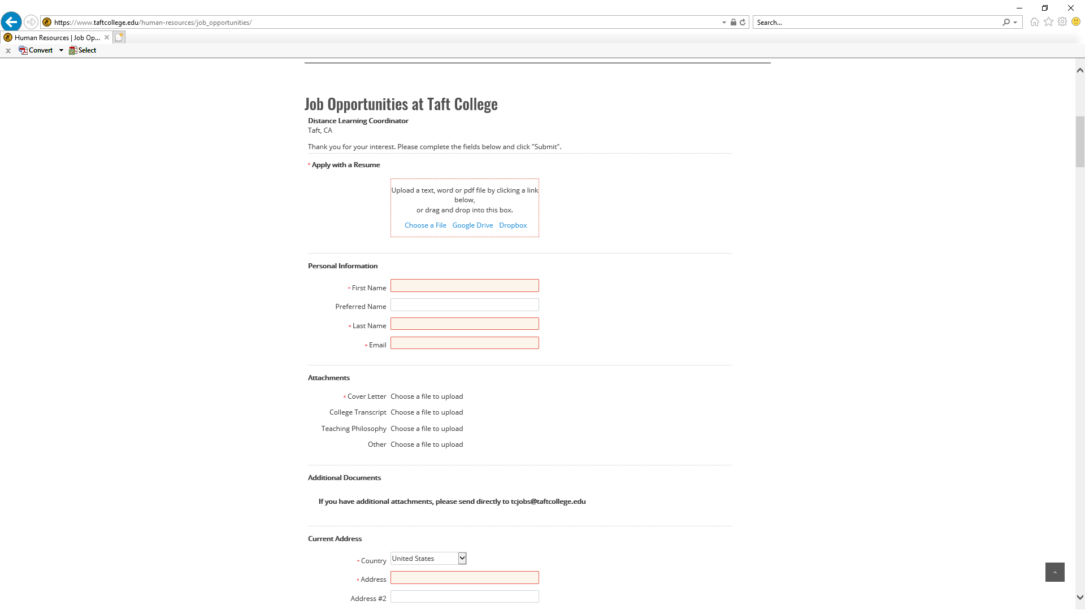
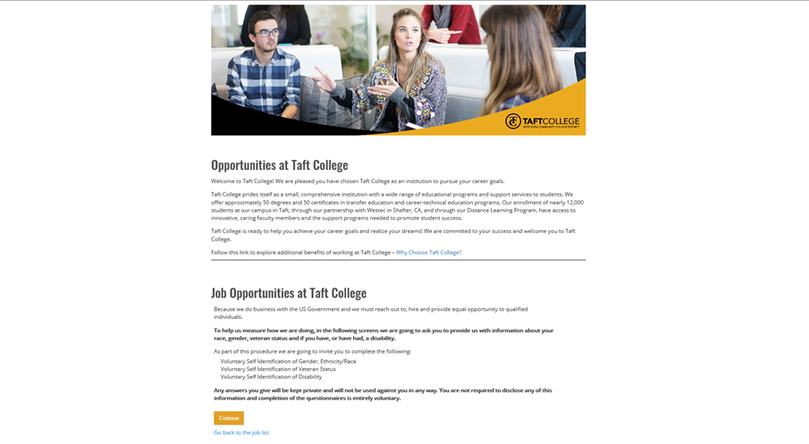
Applicant Tracking-Newton

Slide 51
Employee assistance program
Work Life Balance
Child & Elder Care Resources
Financial Guidance
Legal Services
Identity Theft
Smoking Cessation
Professional Development
Counseling Services
24/7 Confidential Help – Online and Phone Support
Employee Assistance Program
800-999-7222 anthemEAP.com
Enter SISC to log in.

Slide 52


Questions or Concerns?

Slide 53
Administrative Services Update
Brock McMurray, Ex.VP of Administrative Services

Slide 54


Slide 55
Student Centered Funding Formula (SCFF) –
How does it Work?
Old formula: 100% FTES.
New formula (current version):
  70% based allocation
  20% Supplemental Allocation
  10% Student Success Allocation

Slide 56
Base Allocation
70% of SCFF

Slide 57
Base allocation (70%)
METRICS
  Credit: Three-year rolling average of funded FTES (16-17 to 18-19).
  Special Admit Credit: FTES from high school students who are concurrently, dually, or otherwise enrolled at Taft College (16-17).
  Incarcerated Credit: FTES from incarcerated students (16-17).
  Basic Allocation: Funding based on district type, FTES, and rural college allocations.

Slide 58
Base allocation (70%)
TC 18-19 Funding
Metrics | Amount (FTES) | Rate | Revenue
Credit | 2698.42 | $ 4,934.00 | $ 13,313,995
Special Admit Credit | 23.91 | $ 7,223.83 | $ 172,722
Incarcerated Credit | 88.84 | $ 7,223.83 | $ 641,765
Basic Allocation | N/A | $ 5,163,851.00 | $ 5,163,851
Total Base Allocation | 2,811.17 |  | $ 19,292,333

Slide 59
supplemental Allocation
20% OF SCFF

Slide 60
Supplemental allocation (20%)
METRICS
  Pell Grant Recipients: Headcount of all students in the prior year who were recipients of financial aid under the Federal Pell Grant program (16-17).
  AB540 Students: Headcount of all AB540 students in the prior year who were granted an exemption from nonresident tuition (16-17). AB540 students are, in essence, nonresidents who graduated high school in California and are now enrolled at Taft College.
  California Promise Grant Recipients (Formerly BOG fee waiver): Headcount of all students in the prior year who were received a fee waiver under the California Promise Grant (16-17).

Slide 61
Supplemental allocation (20%)
TC 18-19 Funding
Metrics | Headcount | Rate | Revenue
Pell Grant | 1,496 | $ 919 | $ 1,374,824
AB540 | 143 | $ 919 | $ 131,417
California Promise Grant | 3,177 | $ 919 | $ 2,919,663
Total Supplemental Allocation |  |  | $ 4,425,904

Slide 62
Student Success Allocation
10% OF SCFF

Slide 63
Student success allocation (10%)
METRICS
  ADT: Count of all Chancellor's Office approved associate degrees for transfer granted based on prior year data (16-17).
  AA/AS: Count of all Chancellor's Office approved associate degrees granted (excluding associate degrees for transfer granted) based on prior year data (16-17).
  Credit Certificates: Count of all Chancellor's Office approved credit certificates requiring 16 or more units granted based on prior year data (16-17).
  Transfer Level Math & English: Count of all first-time students who successfully completes both transfer-level mathematics and English courses within the same district within the first academic year (summer, fall, and spring) of enrollment based on prior year data (16-17).

Slide 64
Student success allocation (10%)
  Transfer: Count of all students who successfully transferred to a four-year university based on prior year data (16-17).
  9 or more CTE units: Count of all students who successfully completed nine or more career technical education (CTE) units within the same district based on prior year data. CTE courses are SAM A, B, C courses or all courses with a CTE TOP Code (16-17).
  Regional Living Wage: Count of all students who obtained a regional living wage within one year of community college completion based on prior year data. (Based on the numbers reported in 16-17. Measures the number of non-transfer students who were enrolled in 15-16, exited, and had earnings above the living wage in Kern County in 16-17.)
  Additional Metrics: Any students who are a Pell Grant or Promise Grant recipients who also achieve any of the aforementioned success metrics are funded at various additional rates above normal success funding rates.

Slide 65
Student success (10%)
TC 18-19 Funding
All Students
Metrics | Headcount | Rate | Revenue
ADT | 108 | $ 1,760 | $ 190, 080
AA/AS | 362 | $ 1,320 | $ 477,840
Credit Certificates | 31 | $ 880 | $ 27,280
Math & English | 53 | $ 880 | $ 46,640
Transfer | 221 | $ 660 | $ 145,860
9 or more CTE | 313 | $ 440 | $ 137,720
Living Wage | 3,734 | $ 440 | $ 1,642,960
Total |  |  | $ 2,668,380

Slide 66
Student success (10%)
TC 18-19 Funding
Pell Grant Students
Metrics | Headcount | Rate | Revenue
ADT | 68 | $ 666 | $ 45,288
AA/AS | 204 | $ 499.50 | $ 101,898
Credit Certificates | 19 | $ 333 | $ 6,327
Math & English | 24 | $ 333 | $ 7,992
Transfer | 81 | $ 249.75 | $ 20,131
9 or more CTE | 185 | $ 166.50 | $ 30,803
Living Wage | 202 | $ 166.50 | $ 33,633
Total |  |  | $ 246,072

Slide 67
Student success (10%)
TC 18-19 Funding college promise Students
Metrics | Headcount | Rate | Revenue
ADT | 91 | $ 444 | $ 40,404
AA/AS | 294 | $ 333 | $ 97,902
Credit Certificates | 24 | $ 222 | $ 5,328
Math & English | 32 | $ 222 | $ 7,104
Transfer | 125 | $ 166.50 | $ 20,887
9 or more CTE | 267 | $ 111 | $ 29,637
Living Wage | 374 | $ 111 | $ 41,514
Total |  |  | $ 242,776

Slide 68
Student success (10%)
TC 18-19 Funding
Categories | Revenues
All Students | $2,668,380
Pell Grant Students | $246,072
College Promise Students | $242,776
Total Success Allocation | $3,157,228

Slide 69
2018-19
Total computational revenue
Categories | Revenues | Percentage
Base Allocation | $19,292,333 | 71.8%
Supplemental Allocation | $4,425,904 | 16.5%
Student Success Allocation | $3,157,228 | 11.7%
Total Computational Revenue | $26,875,465 | 100%
Constrained TCR | $26,494,614
Adjusted TCR Reflecting Available Revenue | $26,330,663

Slide 70
Student Centered Funding Formula (SCFF)
Changes going into 2019-20
Major Policy Changes
  2019-20 Recalculated Rates
  Student Success Allocation Counts
  Student Success Allocation Calculation
  Transfer Definition

Slide 71
Assuming same data metrics
from 18-19 to 19-20
3 year average impact

Slide 72
2019-20
Estimated SCFF Revenue
Categories | Revenues | Percentage
Base Allocation | $19,970,149 | 73.0%
Supplemental Allocation | $4,414,087 | 16.1%
Student Success Allocation | $2,968,415 | 10.9%
Estimated SCFF Revenue | $27,352,651 | 100%
2019-20 Advanced Apportionment | $26,494,614

Slide 73
What now?
What does this mean for 2019-2020?
What is the future impact on Taft College?
What steps do we take moving forward?

Slide 74


Slide 75
Executive director of institutional research & planning xiaohong li

Slide 76





Key Functions of the Office of IR & Planning
1. Accreditation
2. Strategic Planning
3. Program Review
4. Institutional Research
5. Support Student Learning Outcome

Slide 77
Accreditation Process – IR office
Accreditation
An indication that the academic programs of the institution conform to federal or state established standards
Self-Evaluation
Submission to ACCJC
Accreditation Team
Site Visit
Report to ACCJC
ACCJC Board Review & Votes on Action
Reaffirmed
Assurances of institutional integrity/effectiveness & educational quality
Notes:
Accreditation is of significant importance to all colleges and universities because it is an indication that the academic programs of the institution conform to federal or state established standards. It can assure the quality and effectiveness of Taft College's educational programs and services
1. the source provided to regional and national accreditation bodies to document how institutions fulfill the standards for accreditation.
2. compiles data for institutional self-study and accreditation by external agencies
Providing leadership in gathering data and preparing updates on the status of internal Actionable Improvement Plans and ACCJC Recommendations
3. Providing leadership in the preparation of Reports to ACCJC
4. Assisting the President in preparation for external evaluation team visits
What is accreditation?
Voluntary, non-governmental, self-regulation, peer review participation
Systems of self-evaluation on standards of good practice:
Mission, goals, objectives
Appropriateness, sufficiency, utilization of resources
Usefulness, integrity, effectiveness
Achievement of intended student learning outcomes
Assurances of institutional integrity/effectiveness & educational quality

Slide 78
Strategic planning
Foundation
Mission & Vision Statement
Course Success Rate
71.8% to 75.4%
Completing Transfer Level Math & English in 1st Year
6% to 16%
Strategic
Action Plan
2018-19 To 2020-21
Persistence Rate
79.9% to 87.4%
Supporting
Values; Institutional Goals
Goals and Objectives
Implementation Plan
Strategic Planning Process
Board
President
Institutional Research & Planning
Governance Council
Academic Senate
Data Support
Data Support
Strategic Planning Committee
Evaluation of Planning Process
Finding Data
Collecting Data
Data Calculation
Presenting Data
Notes:
o Assisting College Council with Strategic Plan Updates and Mission Statement Review
o Assisting any participatory governance committee upon request
In March 2018, based upon the recommendations of the Governance Council and Academic Senate, the SAP was approved by the President and the Board of Trustees.

Slide 79
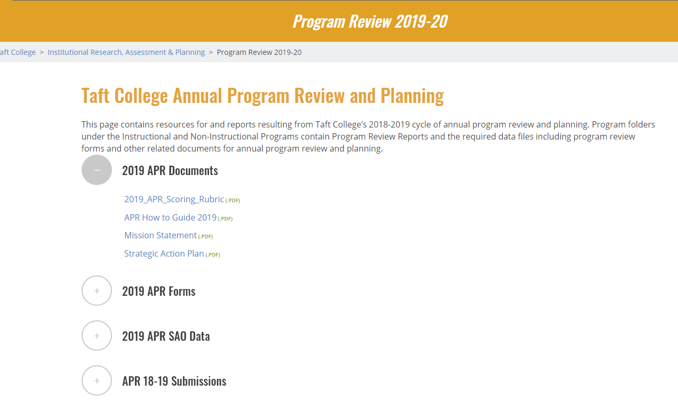
Annual Program review – academic and administrative unit
  Examination of current operations
  Identification of opportunities for enhancement
  Implementation of adjustments
  Establishment of plans for continuous improvement
  New Program Review Website
  http://www.taftcollege.edu/iarp/program-review-2019-20/

Slide 80
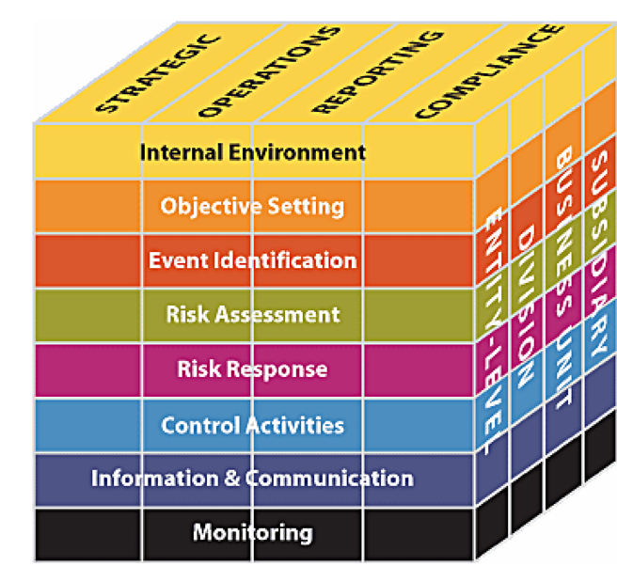

Institutional research
The primary purpose of institutional research is to promote institutional effectiveness. This is done by collecting, analyzing, and reporting data and information, which are used to encourage evidence-based reflection, planning, and action.
These include, but are not limited to:
  Conduct Research to Support Student Success
  Online Data Resources
    Scorecard, etc.
  IRP Data Publications
    Quick Stats
  Cognos
  Program Assessment Studies
  Surveys
  Ad Hoc Requests
  Mandatory Reporting

Slide 81
Support
- Student learning outcome (SLO)
Assisting SLO coordinator’s
Managing the data entered in the eLumen Assessment software
Assist faculty with SLO assessment and data entry
Provide SLO reports for program review

Slide 82
2019/20 updates
Strategic Action Plan
Successfully Complete APR 2019/20
Improve Office of IRP Capacity and Output by Significantly Improved the Data Available on the Department Website
  Redesign IRP Website
  Online Interactive Fact Book
Thanks IT for Allowing us to Use their Ticketing Management software - ITHELP
Organized Job Folder Structure and Established Report Templates for Data Consistency
Building and Creating Cognos Reports by Programs’ need
Continuing to Assist SLO

Slide 83
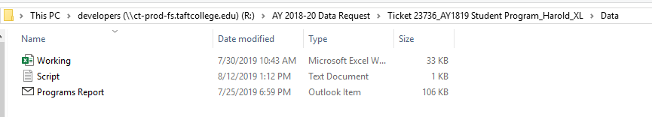
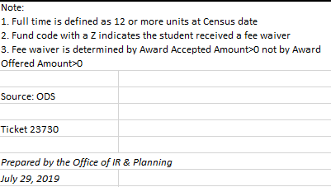
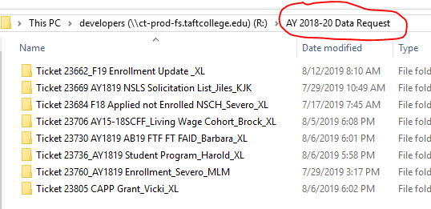
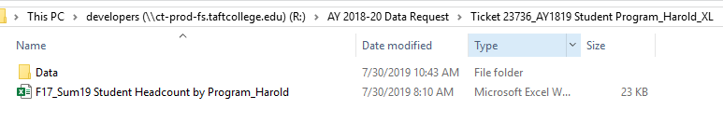
2019/20 updates
How to submit a data request
  Submit Ticket to ITHELP with Subject line – Data Request
Organize Job Folder to Centralize

Slide 84
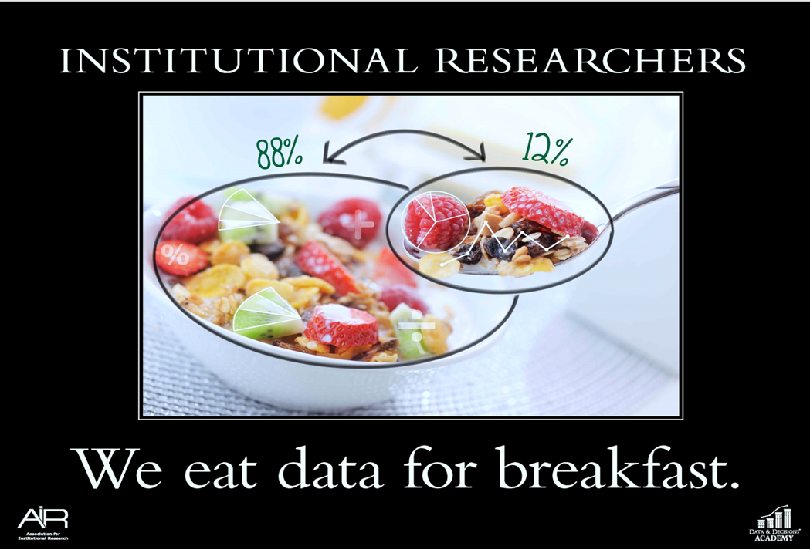
Thank you!
We are looking forward to working with you by providing the data and analytic service to
  Support your program improvement
  Increase student success

Slide 85
Executive director of information services andy prestage

Slide 86
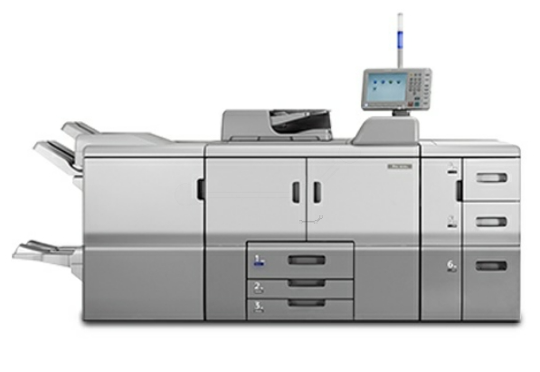
New Copiers
Mailroom
120,000 / month
High Speed
Stapling
Hole Punch

Slide 87
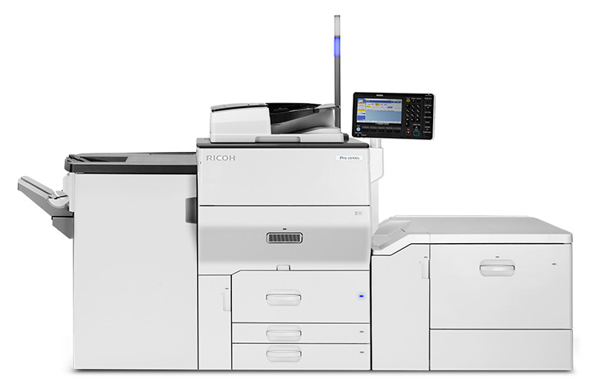
New Copiers
Bookstore
Professional
Print Services
Web Portal
Early October
Outsourcing

Slide 88

ID Badge for New Copiers?
Print? Yes
Copies? Yes
Mailroom? Yes
G-02? Yes

Slide 89

Student Workers
Student Worker
Copier
Card

Slide 90
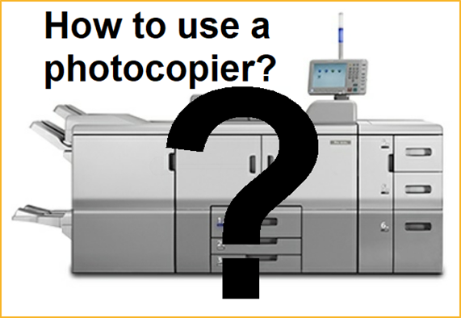
Copier Training
How to:
Copier Use
Follow-me Print
Mobile Print
Scan > Me/Network
Enroll ID Badge
See Inservice Schedule!

Slide 91

Door Security
Gym:
ID Badge Access

Slide 92
Which Should You Dial?
Emergency vs. Outside Line
  911, 9911 8
  Emergency  Outside Line
  Need Immediate
  Assistance

Slide 93
Classroom Updates
Windows 10
Office 365

Slide 94
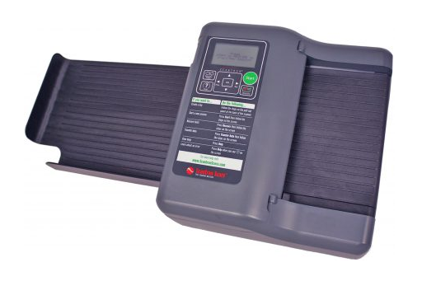
Instructional Support
New Scantron
in Mailroom

Slide 95
Foundation Update
Sheri Horn-Bunk
Executive Director of the Foundation

Slide 96

YOUR

Slide 97
A
20 Applications received
$39,874.31 requested
16 Applications awarded
$25,000 awarded
Innovation Grants
Grant Selection Committee Members
Adam Alvidrez
Carole Cohen
Penny Fulton
Larry Peahl
Don Zumbro

Slide 98
Aaron Markovits –$1,945 for Tablet for TIL
Aaron Markovits –$1,150 for Phones for TIL
Andy Prestage –$440 for IT Team Boost
Bruce Ferguson –$1,500 for Hydrocollator
Chase Brown/Kanoe Bandy –$400 for Game Attendance Initiative
James May –$2,000 for Covington Engineering Sphere Machine
Jill Brown –$1,672 for TRIO Student Support Services
Joanne Dumbrigue –$1,500 for Welcoming New TC Students
Justin Uribe –$490 for Veteran Club T-Shirts
Meghan Hall-Silveira –$2,000 for Beds for Babies
Richard Treece –$2,000 for Professional & Uniforma Appearance
Sarah Criss –$1,250 for Display Board
Steve Lytle –$2,000 for Microscopes for G8
Tiffany Rowden –$1,100 for TC Operations Hydration
Vince Maiocco/Gabriela Braxey –$2,000 each for Rapsodo Hitting Unit
Taft College 2018-2019 Awarded Grants

Slide 99

Join us TODAY at the Employee giving Ice cream overload
In the CONN Expo Room from 1 p.m. - 3 p.m.
2 Drawings – 1 for existing employees giving and 1 for new sign-ups. You don’t have to be present to win.
2018 Employee Giving total was $15,445.
2019 End of Year goal is $25,000.
Give to any program at Taft College-Tax deductible and pre tax deduction from payroll

Slide 100
Thank you to all the employees giving
Alfonso Alfaro
Jennifer Altenhofel
Nicole Avina
Severo Balason
Kanoe Bandy
Darcy Bogle
Kamala Carlson
Diana Champion
Sarah Criss
Dr. Deb Daniels
John Dodson
Jessica Grimes
Meghan Hall-Silveira
Sheri Horn-Bunk
Mike Jiles
Kathleen Johnson
Diane Jones
Kelly Kulzer-Reyes
Aaron Markovits
Mahea Maui
Brock McMurray
Tina Mendoza
Michelle Oja
Debora Rodenhauser
Becky Roth
Vicki Waugh
Susan Wells
Jessica White
Brandy Young

Slide 101
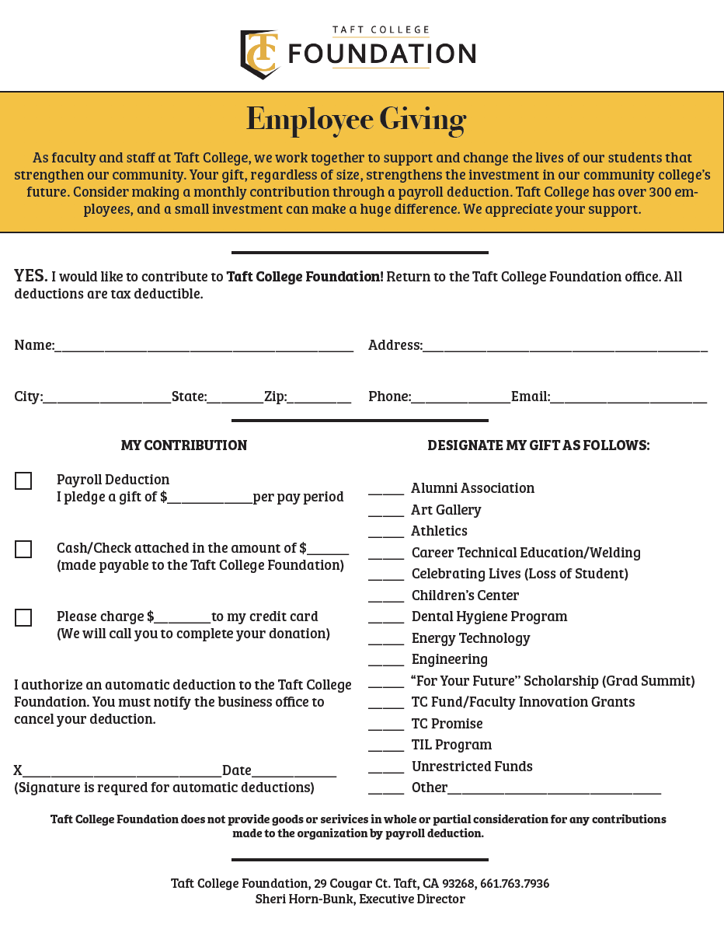
Employee Giving Forms
You may fill out a form, located on your tables.
Or come the Ice Cream Overload and fill one out.
We are asking to give $10 or more a month for Payroll Deduction.
If a program isn’t designated on the form, select Other and indicate what program to support.
Donations are a tax write off.
Thank you letters will be mailed at the beginning of every year.

Slide 102

TIL Casablanca Casino Night
September 7, 2019
West Side Recreation & Park District Gymnasium
Tickets are $75
Sponsorship from $1,500-10,000.
Catering Moroccan Cuisine by the Cougar Café
Live auctioneer, Senator Shannon Grove

Slide 103


Slide 104

10th Annual cougar cookout
October 24, 2019
5:30 p.m. – 8:30 p.m. in the Taft College Quad.
In Honor of our Community Veterans, each Veteran will receive 2 complimentary tickets.
Tickets are on sale for $30 for General Admission & $20 for TC Faculty, Staff, Student, & Alumni.
Sponsorship’s available $1,000 - $3,000.
Tickets can be purchased online.

Slide 105
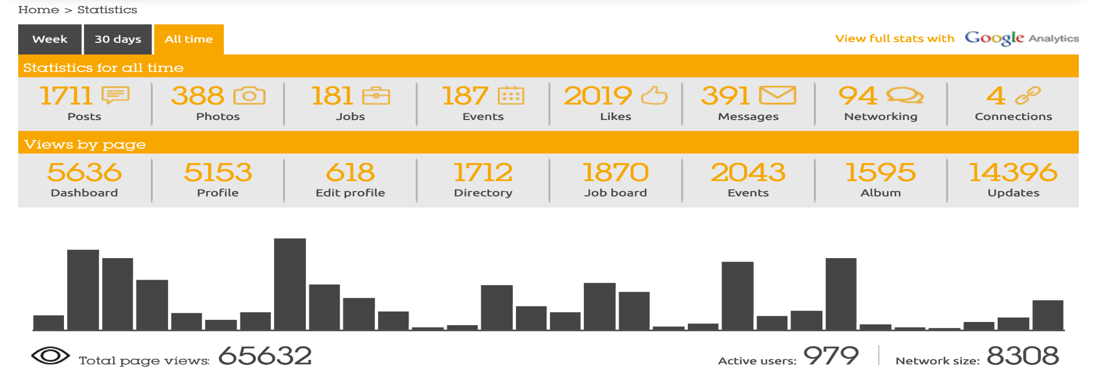
A
979 Active users
287 users joined this year
Taft College Multiply

Slide 106
foundation
TC Multiply Newsletter
Cougar Alumni Spotlight
Participate by sending names of alumni to the Foundation office
We will select and interview 1 alumni a month to be featured in the Alumni Spotlight in the TC Multiply Newsletter

Slide 107
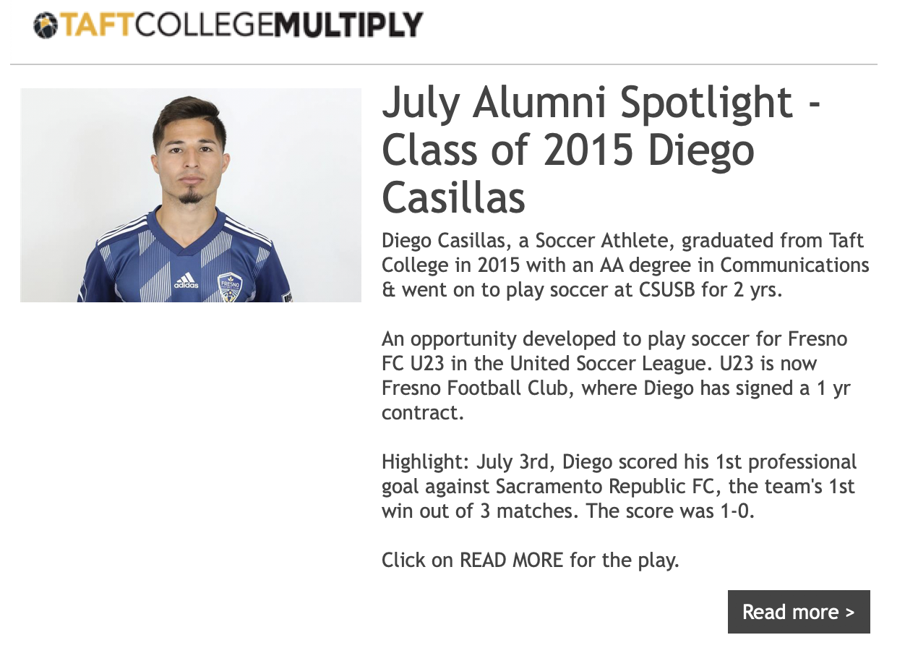
foundation

Slide 108
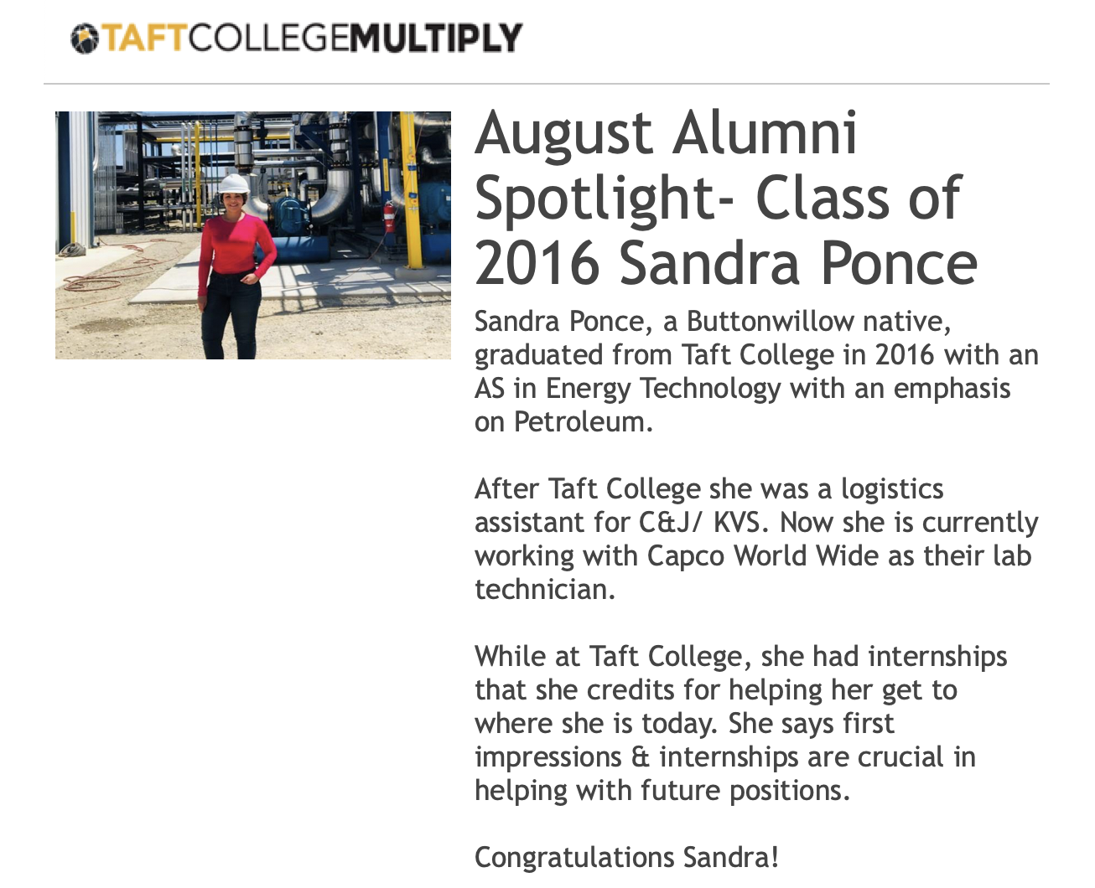
foundation

Slide 109
Join us TODAY at the Employee giving Ice cream overload
In the CONN Expo Room from 1 p.m. - 3 p.m.
2 Drawings – 1 for existing employees giving and 1 for new sign-ups. You don’t have to be present to win.
2018 Employee Giving total was $15,445.
2019 End of Year goal is $25,000.
Give to any program at Taft College-Tax deductible and pre tax deduction from payroll

Slide 110

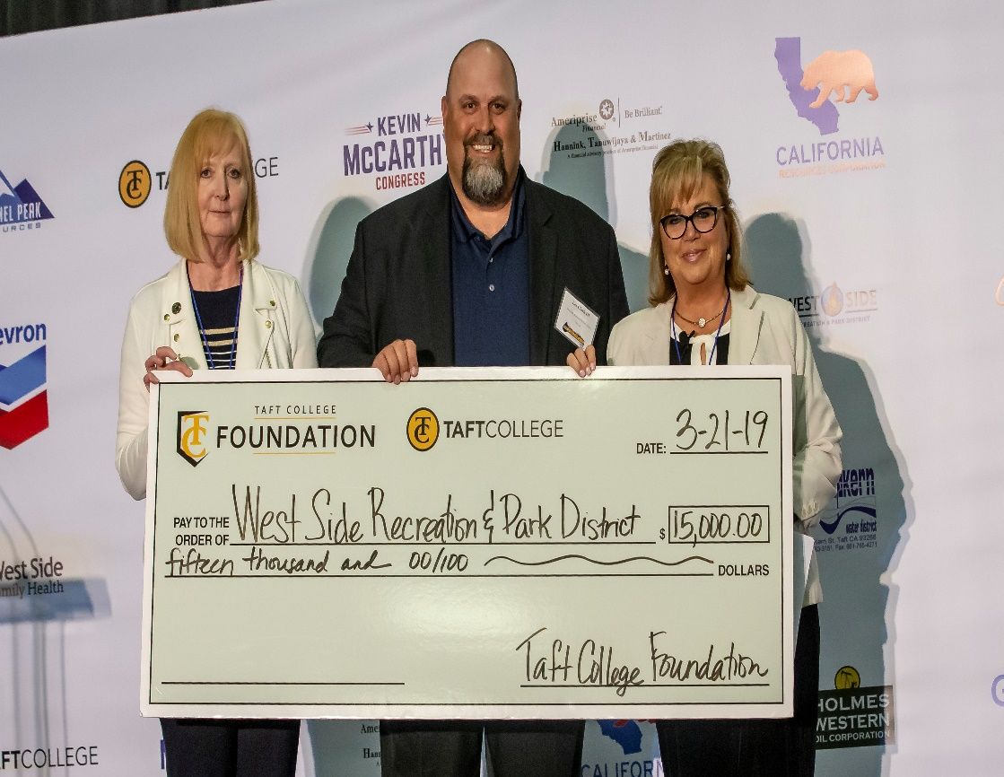
Thank you for all you do to make Taft College GREAT!
We are here to serve you!
Sheri, Mahea and Javier

Slide 111
Thank you for your presentations!

Slide 112
Compensation study
Started in 2016 and updated and validated in 2018
  Performed by outside company
  Compared to peer institutions across the state and also local markets
  Validated and updated data
  Implemented over the past year
Positions affected
  Classified positions-50
  Confidential positions-5
  Administrator positions-11

Slide 113
Program review
$~$375,000
S4 Remodel (PR Priority1)
English faculty in tutoring lab (PR Priority 2)
Psychology research study (PR Priority 5)
IPads for math (PR Priority 6)
Mental Health and Wellness Counseling hours (PR Priority 8)
Life Science PD (PR Priority10)
Update of Athletics facilities (PR Priority 20)
Athletic uniforms and furniture (PR Priorities 28 & 30)
Child Development Center remodel for safety (PR Priority 29)

Slide 114
Professional development
PALM in its 3rd year
Pilot Coaching Program
Established PD Fund for faculty

Slide 115


Slide 116


Slide 117


Slide 118
Last year’s Challenges
Child Development Center
Maintenance and Operations
Student Center Building
Opportunities for Communication

Slide 119
Opportunities to communicate
Ask an Administrator
Open Forums for Administrator Hiring Process
One on One Meetings
Hired Executive Director of Marketing and Community Relations

Slide 120


Slide 121

Thank you for your commitment to serving our students!

